Slide 1
FY24 Academic Affairs Budget Presentation
University Budget Committee
May 17, 2023

Slide 2
EWU MISSION & VISION
Eastern Washington University expands opportunities for personal transformation through excellence in learning.
EWU achieves its mission (core themes in bold) by:
  Enhancing access to higher education in the Inland Northwest and beyond by recruiting and supporting traditional college-bound students, non-traditional students, and those from underserved populations
  Delivering high-quality academic programs that undergo regular, rigorous review informed by data and assessment of student learning
  Delivering a high-quality co-curriculum designed to develop the intellectual, cultural, personal, and practical aspects of students’ lives
  Promoting student success by supporting student engagement and timely degree completion
Vision Statement
  Eastern Washington University is a driving force for the culture, economy, workforce and vitality of Washington state. Our graduates think critically and make meaningful contributions to both their career fields and their communities. EWU is the public university whose students, faculty, staff and alumni make profound and significant contributions to the economic and social vitality of the region. EWU remains the best value for higher education in the state.

Slide 3
A.A. CORE BUDGET DRIVERS
Adequacy – appropriate resources to advance academics and serve students properly
Equity – alignment of mission/vision with priorities, strategies and investments
Performance – metrics for performance and accountability
Evaluation – planning, development, implementation and assessment of resources

Slide 4
FINANCIAL SOURCES & USES
Index 1: State-General Operating Funds (F011)
Primary Academic & Administrative Funding
Personnel/Direct Expense/Professional Development
Appropriations/Tuition based Funds
Funds expire at fiscal year end
Index 2: Self-Support/Special Revenue Funds (F015)
Self-sustaining UG/GR programs
Summer Session
Continuing Education
Fees: courses/application/testing
Indirect Cost Recovery
Funds persist at fiscal year end
Index 3: Service & Auxiliary Funds
Minimal funding within Academic Affairs
Curricular & Co-curricular requests - ASEWU
Funds expire fiscal year end
Index 5: Sponsored Programs/Contract Funds
Special Revenue
Extramural Projects
Funds align with project performance periods
Index 9: Foundation/Gift Funds
Donor Gifts
Endowments
Funds persist fiscal year end

Slide 5
ACADEMIC AFFAIRS
FY24 Total Planned Budget
50 - Revenue | 60 - Labor Cost | 70 - Expenditures | 83 - Transfer-In | 88 - Transfer Out
$50,740,894 | $81,721,662 | $31,500,236 | $7,990,067 | $13,493,067
*FY2023 Revenue/Expenses to date as of April 2023

Slide 6
INDEX 1 – ALLOCATION DISTRIBUTION
Academic Affairs - Index 1 Budget Allocation Distribution
Fiscal Year | 60 – Personnel/Labor | % of Budget | 70 - Operating Expenses | % of Budget | Total
FY2022 | $58,577,009 | 86% | $9,834,974 | 14% | $68,411,983
FY2023 | $57,772,027 | 88% | $7,766,992 | 12% | $65,539,019
FY2024* | $60,095,556 | 90% | $6,544,132 | 10% | $66,639,688
*Includes Nursing appropriation of $1,035,164 & Summer Bridge $99,000

Slide 7
INDEX 1 – STATE BUDGET ALLOCATIONS
Org # | Academic Affairs Org Description | FY2022 Index 1 Budget | FY2023 Index 1 Budget | % Change | FY2024 Index 1 Budget | % Change
210 | Academic Affairs Administration | $ 6,299,376 | $ 4,607,301 | -27% | $ 3,135,134 | -32%
240 | College of Professional Programs | $ 15,899,874 | $ 13,623,846 | -14% | $ 13,847,067 | 2%
250 | College of Arts, Humanities & Social Sciences | $ 16,500,569 | $ 15,970,545 | -3% | $ 16,085,638 | 1%
260 | College of Science, Technology, Engineering & Mathematics | $ 15,112,601 | $ 15,792,767 | 5% | $ 16,474,396 | 4%
290 | Office of Grant & Research Development | $ 260,650 | $ 260,650 | 0% | $ 260,651 | 0%
310 | Institutional Effectiveness | $ 904,471 | $ 826,332 | -9% | $ 801,797 | -3%
350 | College of Health Science & Public Health | $ 6,838,420 | $ 7,445,451 | 9% | $ 9,043,896 | 21%
360 | Student Success, Planning & Policy | $ 2,796,078 | $ 2,887,930 | 3% | $ 2,828,050 | -2%
370 | Graduate Studies | $ 1,551,954 | $ 1,531,142 | -1% | $ 1,456,438 | -5%
520 | Enrollment Services | $ 2,247,990 | $ 2,593,055 | 15% | $ 2,706,622 | 4%
Total |  | $ 68,411,983 | $ 65,539,019 | -4.2% | $ 66,639,689 | 1.7%

Slide 8
INDEX 2 – BUDGETED
SELF-SUPPORT FUNDS
Account Category | FY2024 Budget
50 - Revenue | $50,457,594
610 - Administrative | $2,418,803
620 - Faculty | $4,989,326
623 - Faculty (PT) | $5,730,897
630 - Classified | $2,183,392
650 - Benefits | $4,760,072
660 - Wages - Hourly | $1,470,695
670 - Benefits - Hourly | $72,914
700 - Direct Expense | $23,231,379
720 - Capital Equipment | $109,157
750 - Scholarships & Grants | $40,000
830 - Transfer In | $7,990,067
880 - Transfer Out | $13,493,067

Slide 9
INDEX 5 – SPONSORED PROGRAMS
Grant and Contract Proposals Submitted
FY22 |  |  |  |  |  | FY23 YTD (thru 4/5/23)
CAHSS | CHSPH | CPP | CSTEM | Provost | Total | CAHSS | CHSPH | CPP | CSTEM | Provost | Total
4 | 10 | 57 | 17 | 4 | 92 | 5 | 11 | 48 | 33 | 4 | 101
Grant and Contract Awards including Terms
 | FY22 |  |  |  |  |  | FY23 YTD (thru 4/5/23)
Term | CAHSS | CHSPH | CPP | CSTEM | Provost | Total | CAHSS | CHSPH | CPP | CSTEM | Provost | Total
0-12 months | 0 | 6 | 39 | 5 | 4 | 54 | 3 | 8 | 32 | 4 | 4 | 51
13-24 months | 2 | 1 | 24 | 2 | 1 | 30 | 0 | 0 | 11 | 5 | 0 | 16
25-36 months | 0 | 0 | 4 | 3 | 1 | 8 | 0 | 0 | 1 | 1 | 0 | 2
37-48 months | 0 | 0 | 1 | 1 | 0 | 2 | 0 | 0 | 2 | 0 | 0 | 2
49+ months | 0 | 0 | 1 | 1 | 0 | 2 | 0 | 1 | 0 | 2 | 0 | 3
Total | 2 | 7 | 69 | 12 | 6 |  | 3 | 9 | 46 | 12 | 4
Grant and Contract Expenditures
FY22 |  |  |  |  |  | FY23 YTD (thru 4/5/23)
CAHSS | CHSPH | CPP | CSTEM | Provost | Total | CAHSS | CHSPH | CPP | CSTEM | Provost | Total
$ 221,594 | $ 2,651,064 | $ 6,583,675 | $ 1,173,171 | $ 1,176,548 | $ 11,806,051 | $ 115,729 | $ 2,191,683 | $ 5,383,596 | $ 930,105 | $ 899,473 | $ 9,520,586
Indirect Costs Returned
FY22 |  |  |  |  | FY23 YTD (thru 4/5/23)
CAHSS | CHSPH | CPP | CSTEM | Provost | CAHSS | CHSPH | CPP | CSTEM | Provost
$ 67,149.80 | $ 67,998.85 | $ 170,464.42 | $ 44,985.64 | $ 82,000.68 | $ 11,727.47 | $ 46,657.30 | $ 105,687.94 | $ 29,747.07 | $ 89,770.19

Slide 10
INDEX 9: FOUNDATION FUNDS
10 Faculty Grants Awarded in FY22 totaling $55,000
277 AA Endowments w/ market value of $27.2M as of 6/30/22
5,434 Gifts totaling $4,696,454 in FY22 that directly support/advance Academic Programs
  Includes $1,425,334 of academic endowment gifts
Notes:
Academic Leadership Area of Focus in FY2024

Slide 11
2023-2025 OPERATING
BUDGET APPROPRIATIONS
Bachelor in Nursing
  Further support to establish a UNDG Nursing Degree
  Base funding: $2.29M/year
Academic Bargaining (SB5238)
  Academic employee bargaining – Graduate Students
  Base funding: $18k/year
Postsecondary Student Needs (HB1559)
  Student Benefits Navigator to aid with basic needs
  Base funding: $59k
College in the High School
  Partnerships with High Schools/Teachers
  Enrollment (performance) based funding: ~$2.5M each year
MESA Program
  Establishes mathematics, engineering, and science achievement program
  Base/One-time funding $262k & $238k
Urban & Regional Planning
  Collaborative public planning studios to assist with city and county projects
  Base funding: ~$100k each year
Racial Covenants
  Research and collaboration funding on covenants
  One-time funding $235k & $241k
Northwest Autism Center
  Pass through funding for the NW Autism Center
  One-time funding $150k/year

Slide 12
2023-2025 CAPITAL
BUDGET APPROPRIATIONS
Lucy Covington – Pre-Design
  Major Project Renovation - Design to study the programmatic needs for the Lucy Covington Center. Facility design is to improve graduation attainment for Native American students as well as create a center to educate the Spokane region through interdisciplinary partnerships with tribes and urban native communities.
  BE funding: $300,000
Science Renovation – Phase I
  Major Project Renovation – Continuation of the BE balance of the ISC Building Phase I previously allocated at $45M.
  BE funding: $26,452,000
Science Building Construction – Phase 2
  Major Project Renovation – builds on current Phase I @ $45M for completion of 148,149 sq. ft. in the ISC for Chemistry, Biology, Physics, and Geosciences.
  BE funding: $58,000,000
Martin/Williamson Hall Renovation - Pre-Design
  Major Project Renovation – Designs renewed spaces for the School of Education and School of Psychology. Also improves Counseling and Psychological Services (CAPS) spaces associated with student services.
  BE pre-design funding: $350,000
Notes:
Science Building Construction Phase 2 - Science Building is the only facility, on campus, that will contain research laboratories, capable of accommodating the four science programs research needs. Funding will improve building include health and safety issues, accessibility violations, HVAC lifecycle failures, technology deficiencies and lack of student spaces. This fortyseven‐year‐old building has high cost of maintenance and repairs, as well as very high energy costs.
Martin Hall was built in 1966 and renovated in 1980. Williamson facility was built in 1977.

Slide 13
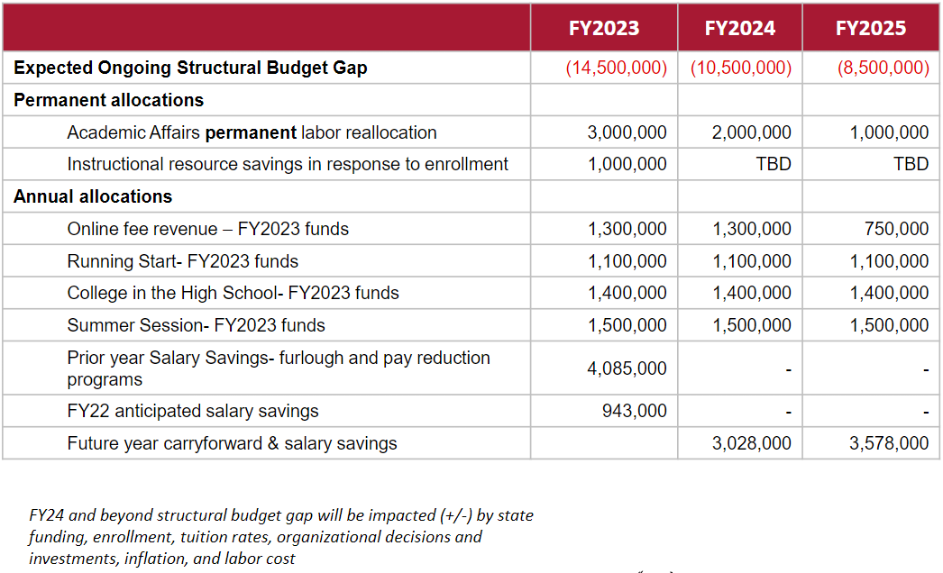
University Budget Gap Plan
Notes:
FY24 Index 1 Budget Reduction Targets = $2.5M -- CPP - $350k, CAHSS - $800k, CSTEM - $600k, CHSPH - $500k, AA - $250k
FY23 Cash Contributions: $3.38M - Index 1 Operating Carryforward, $4.91M - Index 1 Position Savings, $5.30M - Index 2 self-sustaining programs and fees

Slide 14
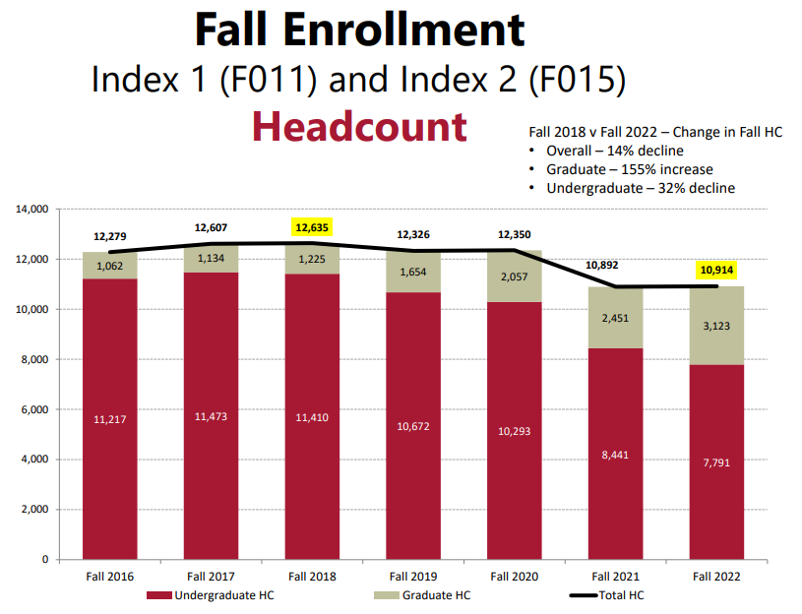
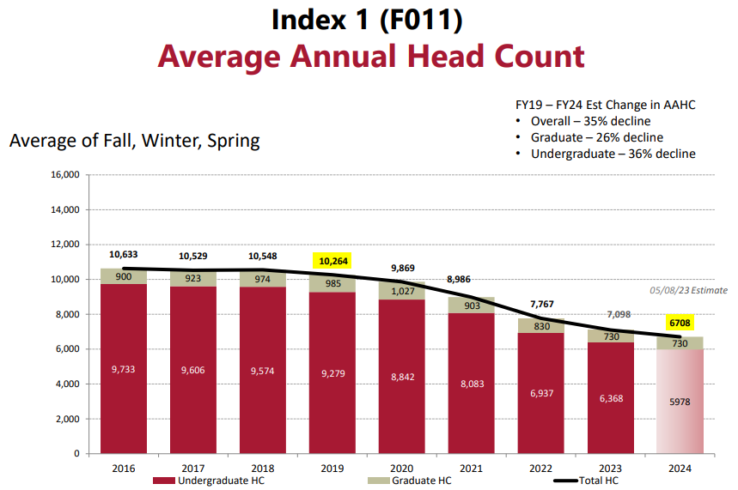
HEADCOUNT ENROLLMENT

Slide 15
STATE UNDERGRADUATE ENROLLMENT
Optimizing our Enrollment & Budget
  Average Annual Headcount
    Academic Year 2022-23: 7,098
    Est. Academic Year 2023-24: 6,708
Undergraduate Changes from Fall 2023
  Retention 1%
  First Time in College -1.5%
  Transfer Students -2.2%
  Headcount -5.5% Fall over Fall

Slide 16
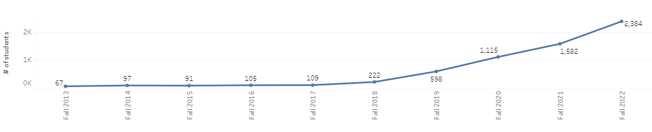
Graduate Education: AP
Accelerated (AP) Graduate Programs:
Enrollment Summary:
  Fall ‘21 over Fall ‘22 enrollment of growth of 802 students or 108% growth
  New enrollment: 871 vs 801
  8.7% growth
Market Adjustment
  Tuition Increase: $25/credit
Program/Curriculum Quality Review
  Assessment of course content/refresh
AP Contract Process
  Continuous assessment/ performance review
  Collaborative discussions on-going
  Faculty Feedback Meeting
  No new programs within 18 months of contract ending without an extension
  Expires September 2025
  Optional Extension: 2 additional, 2-year renewals available
Self-sustaining Graduate Student Enrollment Trend
Notes:
AP Contract: Ann Van Wig/Frank Lynch – organizing faculty discussion/feedback on AP
State Graduate Program Initiatives: Direct Admissions Program, Quality Initiatives: Graduate Assistantships/Strategic Waivers, Strategic Recruitment/Enrollment Plan: marketing/communications
New Graduate Programs in 2024
Digital Design
MFA Screen Writing
Public Administration

Slide 17
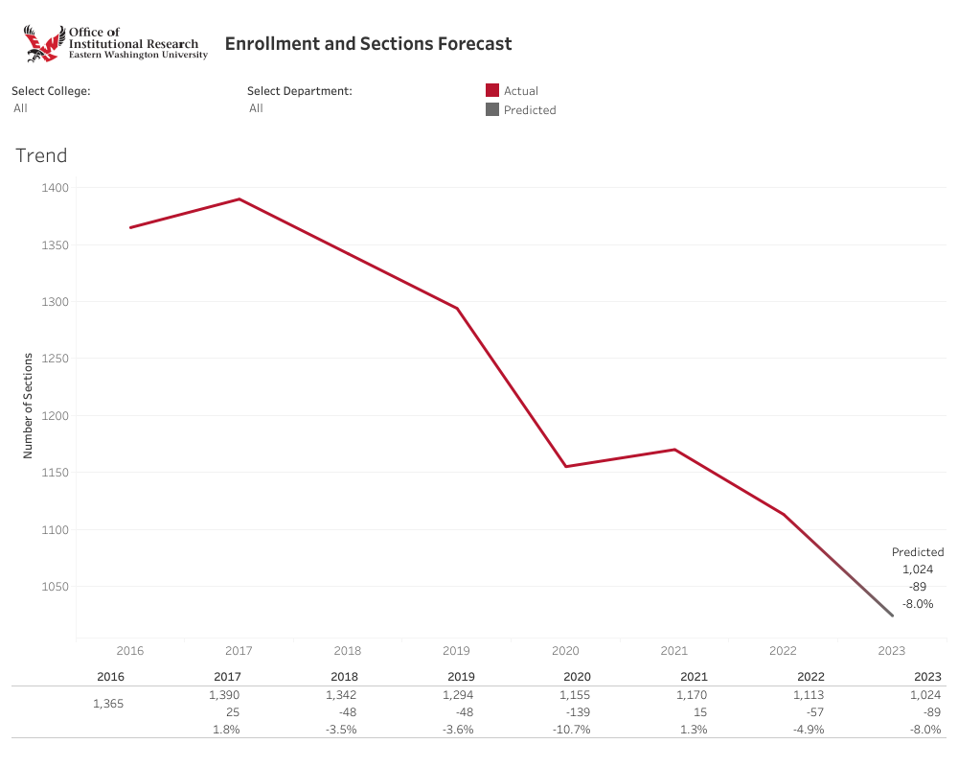
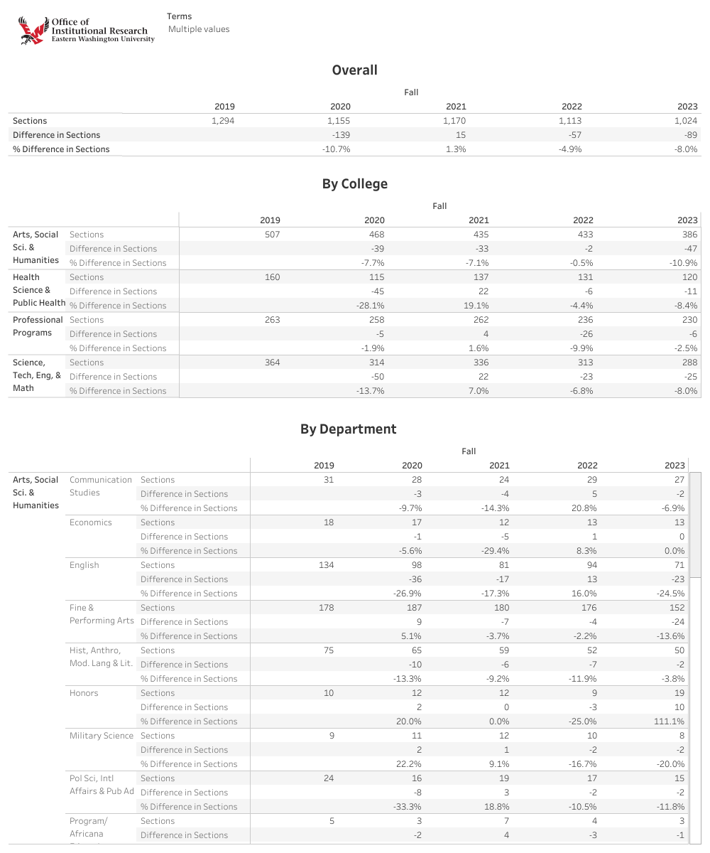
Adjustment Measures:
Course Section Management
Notes:
UBC request: Discuss impact of cutting PTOL and change to class sizes. Will this drive real savings?
*Academic budget savings will come from a variety of sources: personnel separations, enrollment trends, course section review, efficiencies, etc.

Slide 18
Looking Forward – Charting Our Path
Strategic Resource Allocation
University Strategic Plan
Enrollment Strategies
Faculty Investment & Support
Student Success Initiatives
Notes:
SRA process underway in Phase 3: Preparation – next steps: Phase IV - Data Gathering/Assessment & Report Presentation
University Strategic Plan with AASCU’s John Welty. University-wide kick-off in Fall 2023.

Slide 19
Looking Forward – Charting Our Path
Systems & Service Efficiencies: ePAF/FLAC
Balancing our Financial Funds
AA Faculty & Staff Budget Planning
Growth & Containment Opportunities
Mix & Fund Utilization (index 1 & index 2)
Notes:
Led by IT/Christine Van Winkle: ePAF launch and rollout this summer – June 2023. Followed by immediate launch of Faculty Load & Compensation module within Banner
Balancing state resources with courses/faculty --- self-sustaining courses and with revenue earned resources. Net revenue use on priorities/initiatives
FY25 Budget Planning in AA will be a collaborative learning and development process in partnership with College staff and faculty – more to come in September
Growth: opportunities cont. and prof. education, new degrees and tracks Containment: compensation savings, course offerings/sections and workloads alignment
AA has engaged with our B&F partners to evaluate the best and most effective practices in balancing needs and financial resources

Slide 20
Questions?

