Slide 1
University Advancement
FY24 Proposed Budget
Barb Richey, VP of University Advancement
Executive Director of the EWU Foundation
May 12, 2023

Slide 2
Advancement Mission
University Advancement, leads an integrated and collaborative effort to develop, communicate and enhance Eastern Washington University’s image and academic reputation; build and nurture relationships with its constituents; and secure philanthropic investment in the university’s strategic goals, its programs and students.
Ultimately, advancing the mission of Eastern Washington University all while focused on donor intent in an ethical manner.

Slide 3
Advancement Overview
FY2024 Staffing
Office of Alumni Relations (3 FTE)
Office of Marketing, Web, Social Media, and Communications (13.75 FTE)
Office of Philanthropy (13 FTE)
Office of Advancement Services (7.63 FTE)

Slide 4
Advancement Overview
FY2024 Index 1 Budget
Compensation $4,090,005
Direct expenses/operating $423,405
Total budget University support $4,513,410

Slide 5
Original Budgets FY18 – FY24
FY24 budget increase due to rise in benefit costs – no additional FTE

Slide 6
Advancement Budget as Percentage of Eastern Washington University

Slide 7
EWU Foundation

Slide 8
Foundation Overview
The Eastern Washington University Foundation is a 501(c)(3), not for profit organization, responsible for all fundraising activity on behalf of Eastern Washington University. The Foundation seeks to engage EWU alumni and friends in philanthropic support of the university’s mission:
  Eastern Washington University expands opportunities for personal transformation through excellence in learning.

Slide 9
Foundation Overview (cont’d)
The EWU Foundation was formed in 1977
EWU & EWU Foundation MOU
Oversight provided by Board of Directors
  Executive Committee
  Finance & Audit Committee
    Gift Acceptance
  Governance & Nominating Committee
  Investment Committee
  Eagle Grants Committee

Slide 10
Foundation Overview (cont’d)
Foundation produces its own financials
  Financial Statements audited annually by EideBailly
  Form 990 – Return of Organization Exempt From Income Tax filed annually for both the EWU Foundation and Alumni Association
Endowment Performance Summaries

Slide 11
Volunteers
EWU Foundation Board
EWU Alumni Board
College Advisory Boards

Slide 12
Comprehensive Campaign
A campaign is an organized fundraising effort with an announced financial goal and timeline. It focuses on obtaining support for the university’s highest, most strategic priorities by identifying and soliciting prospects in a planned, systematic manner.
Campaigns also typically engage organized volunteer leadership to represent the campaign and help make the university a top philanthropic priority during the life of the campaign and beyond. We call the campaign “comprehensive” because it will benefit almost every facet of EWU. In measuring success, we also count gifts, pledges, estate gifts and in-kind contributions from nearly all sources during the campaign.
Annual, major gifts, planned gifts, capital gifts
2017 to 2023 and beyond
  $53.7M to $100M Goal

Slide 13
Our Priorities
  In year four of the silent phase of the comprehensive campaign
    Donors are giving to Student Emergency Fund, Scholarships and certain initiatives with the campaign:
      Prairie Restoration
      Eagle On
      School of Nursing
      Stadium/Field
      Catalyst
      Naming Opportunities
      Lucy Covington
      Undergraduate Research
      Other areas receiving impact – DEIJ areas (ex: JLR MCC), Student Affairs and Alumni Programs

Slide 14
Scholarships
Gifts to Scholarships as of December 2022
Total: $19,033,100
76% to goal
This total includes significant scholarship lead gifts for
the School of Nursing

Slide 15
Other Student Success
Gifts to Other Student Success as of December 2022
Total: $8,647,821
173% to goal
This total includes significant scholarship lead gifts for Nysether Community Room, Planned Gifts

Slide 16
Catalyst
Gifts to Catalyst as of December 2022
Total: $5,610,000
56% to goal
Examples: Capital, Steiner Scholarship,
Micro-Grants, Corporate Naming

Slide 17
Other
Gifts to Other as of December 2022
Total: $6,646,146
225% to goal
This total includes significant gifts to Micro Grants/Krumble Foundation, Donor Intent Ex: Student Emergency Fund and Student Research
Eagle On, Total: $333,665, 7% to goal
Prairie Restoration Project: Total: $ 39,120, 1% to goal
Lucy Covington Initiative, Total: $ 21,500, 1% to goal

Slide 18
Student Health and Wellness and Athletic Facilities*
Gifts to Athletic Facilities as of December 2022
Total: $5,844,797
23% to goal
Gifts to Student Athlete Health & Wellness
as of December 2022
Total: $3,385,222
*Defer to Athletics presentation

Slide 19
Foundation Mission: Support to Students
Takeaway: A large donation was made in 2021 by Krumble. The FY22 decrease in scholarships awarded directly correlates to the drop in the market value of endowed funds. FY23 funds raised only thru March 28th still 3 months left in FY23. Winter scholarships have not been recorded yet. But the combined total fall and winter scholarships awarded is approximately $1.1 million. Still have spring and summer to go. Anticipate it to slightly exceed the FY22 amount.
Notes:
We awarded to 807 recipients last year. We have over 350 scholarship awards.

Slide 20
Foundation Mission: Support the University
Takeaway: FY19 included $5m transfer for Catalyst. The decrease in program support in FY22 is due to a timing issue on when funds were transferred to the University. Transfer not completed until after audit was underway on the foundation books, so the transfer was booked in FY23. This will result in a dramatic increase in Program Support to EWU for FY23 compared to FY22.

Slide 21
Advancement Combined Budget
Index 1 Original Budget | 4,513,410
Index 2 Original Budget | 223,111
Local Fund Budget | 969,600

Slide 22
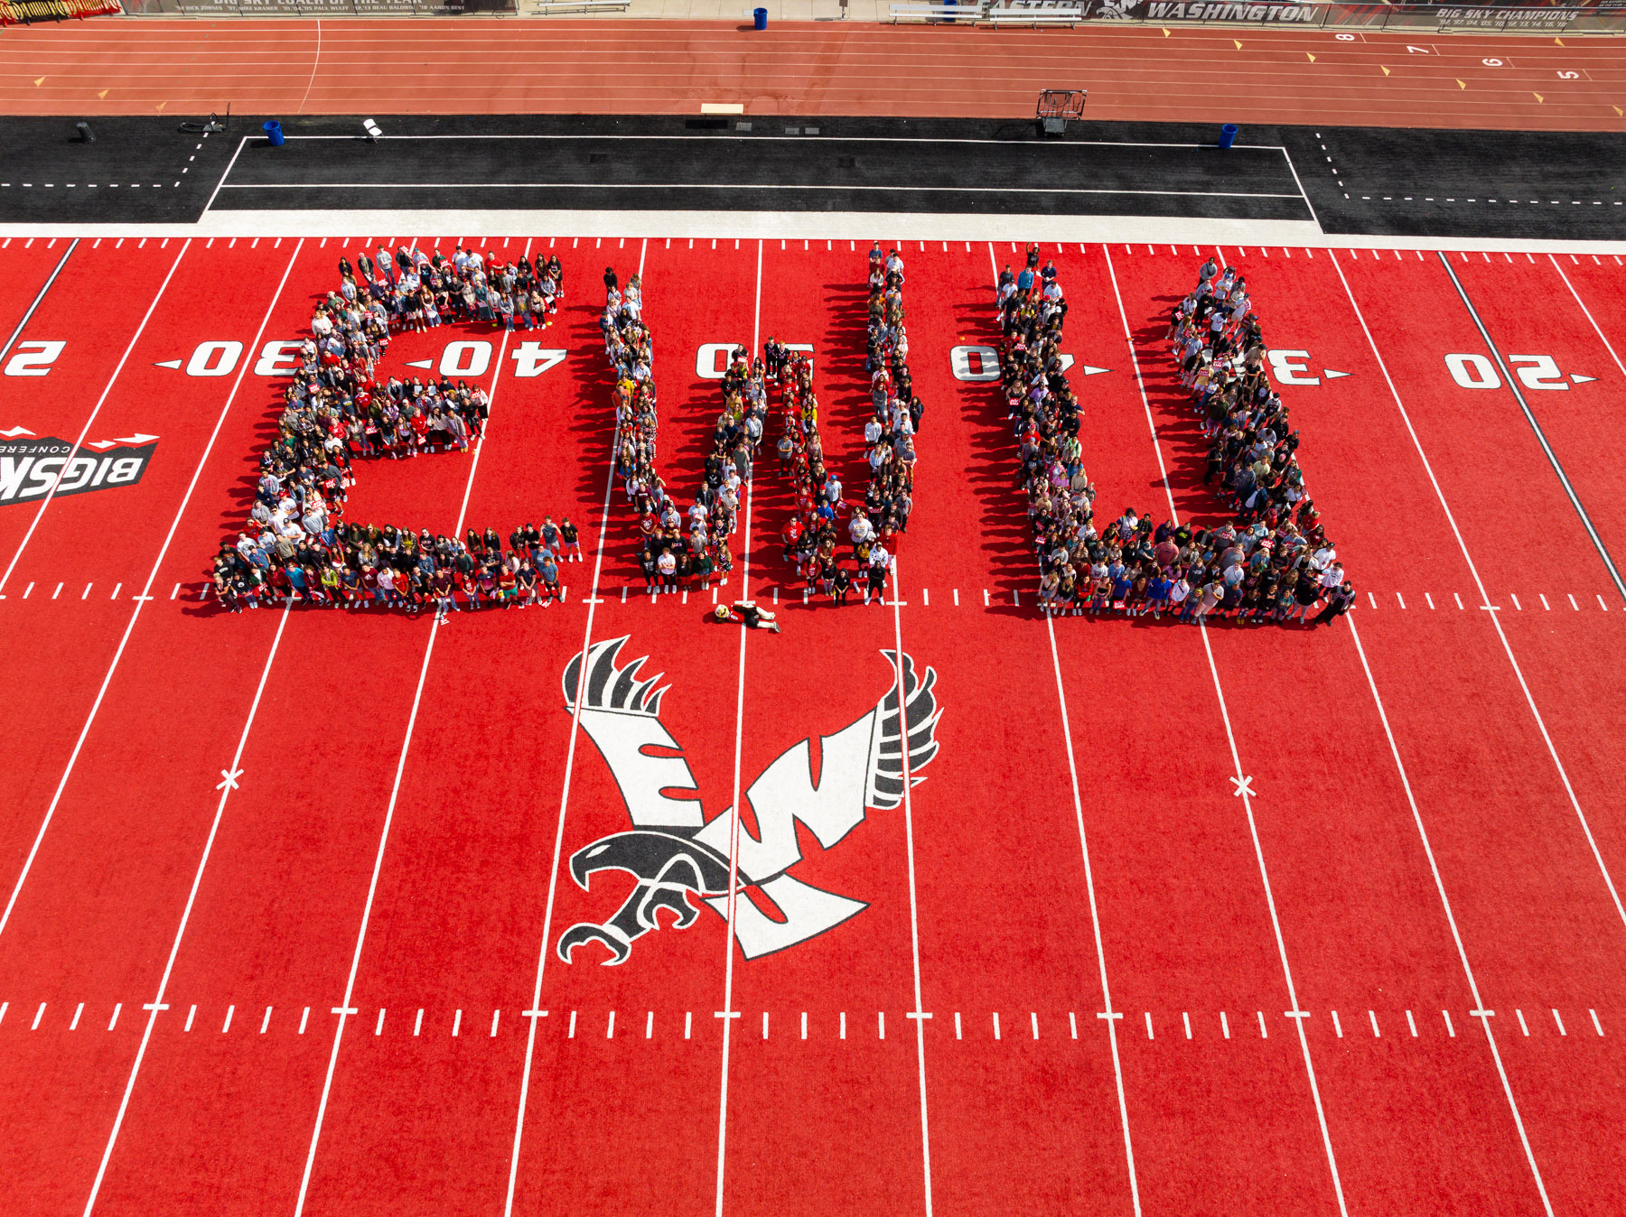
Questions?

