Slide 1


Slide 2
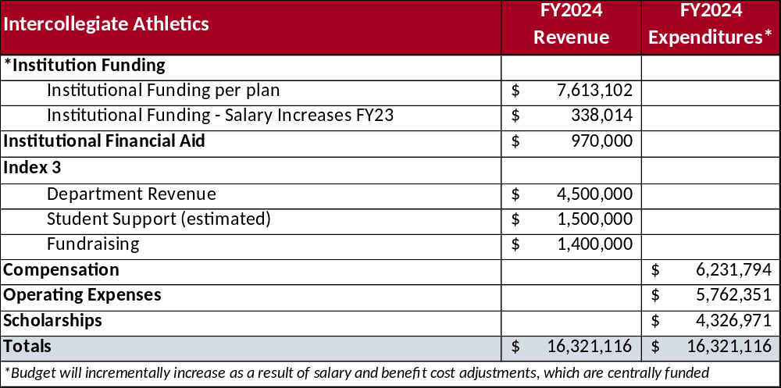
FY24 Overview
Athletics – FY24 Overview
1

Slide 3
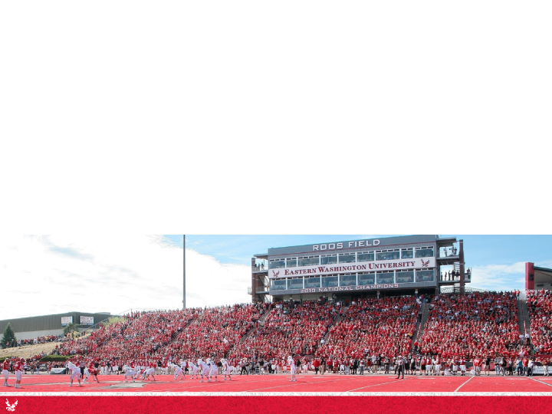
Self Support Sources of Revenue
Ticket Sales
Game Guarantees
Pepsi Agreement
NCAA Distributions
Licensing
Media Rights
Fundraising
Student Fee
Athletics – Self Support Sources of Revenue
2

Slide 4
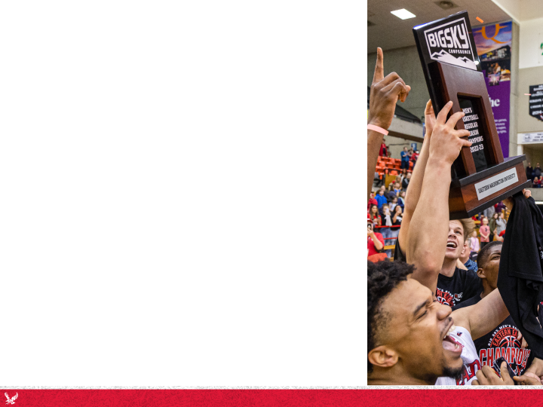
Strengths
Team(s) success & competitiveness
Student-athlete graduation & retention rates
Visibility at local & national levels
Fan loyalty & a culture that does more with less
Ticket sales vs. conference peers
Circular budget
Athletics – Strengths
3

Slide 5
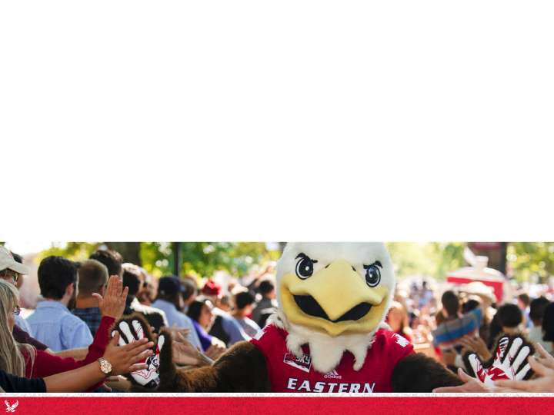
Challenges
Challenge | Effect
Inflation & geographic impacts | Higher costs in travel, food, min. wage
New NCAA/Big Sky mandates | Shifting of Resources
Outdated facilities | Decrease in student and fan experience
Athletics – Challenges
4

Slide 6

Budget Reductions
FY18 Proforma = $17.72M for FY23
FY23 Budget = $16.32M (-7.90%)
Impacts of Budget Reductions
  Reduced staffing impacted revenue generation & services
  Loss of revenue in ticket sales, events, and giving
  Loss of funding impacted salaries and ability to retain/recruit
  Staff overloaded with duties to support student-welfare
Athletics – Budget Reductions
5

Slide 7
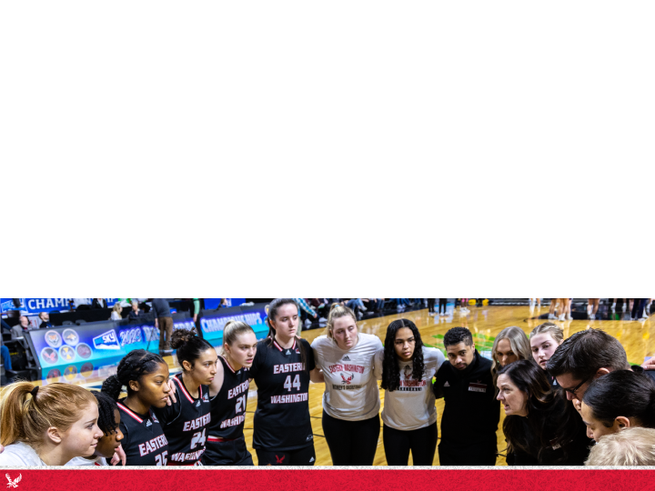
Budget Controls
Annual Planning & Expense Review by Dept./Sport
Internal Budget Tracking Reports
Implementation of Cost-Savings Measures
Pre-approval requirements for all travel requests
Athletics – Budget Controls
6

Slide 8
New Ventures (Part I)
Eagle Athletic Fund
  NEW website & donor guide to educate donors and change the giving culture
  Added giving levels to promote higher-levels and lower-tier entry points to target recent graduates
  Re-focused giving options: Donate to the EAF, buy season tickets, or contribute to a team or capital project fund
  Established goal of $1M in giving with a long-term goal of 2,000+ EAF members and $2M per year
Philanthropic Giving, Alumni Networking & Special Events
  Rebuilding of external staff: two major gift officers; EAF Director; Marketing Director; Digital Media Specialist
  Invested in a networking platform to reach former student-athletes
  Re-establishing events and the Hall of Fame to engage donors
  Partnering with special interest groups – 6th Man Club & EFN
Athletics – New Ventures (Part I)
7

Slide 9
New Ventures (Part II)
Ticketing & New Revenue Generation
  Adjusting ticket & tailgate prices (based on peer data)
  Refocusing ticket sales strategies (entry-level season & group tickets)
  Adding Women’s Sports Pass and ticketing volleyball & soccer
  Adjusting FB seating layouts in support of ticket sales (e.g., student section)
  Reseating Reese Court
  Researching ways to increase ticket sales staff to meet $1M annual revenue goal
  Adding beer sales for football, volleyball, soccer, and basketball
  Researching licensing plan as it impacts merchandise and royalty revenues
Campus Partnerships & Fan Experience
  Building better campus relationships between athletics & academic programs
  Focusing on relationships between student-athletes & general student body
  Creating meaningful game-day experiences via pre-game and in-game promos
  Enhancing digital media in support of sales and marketing goals
Athletics – New Ventures (Part II)
8

Slide 10
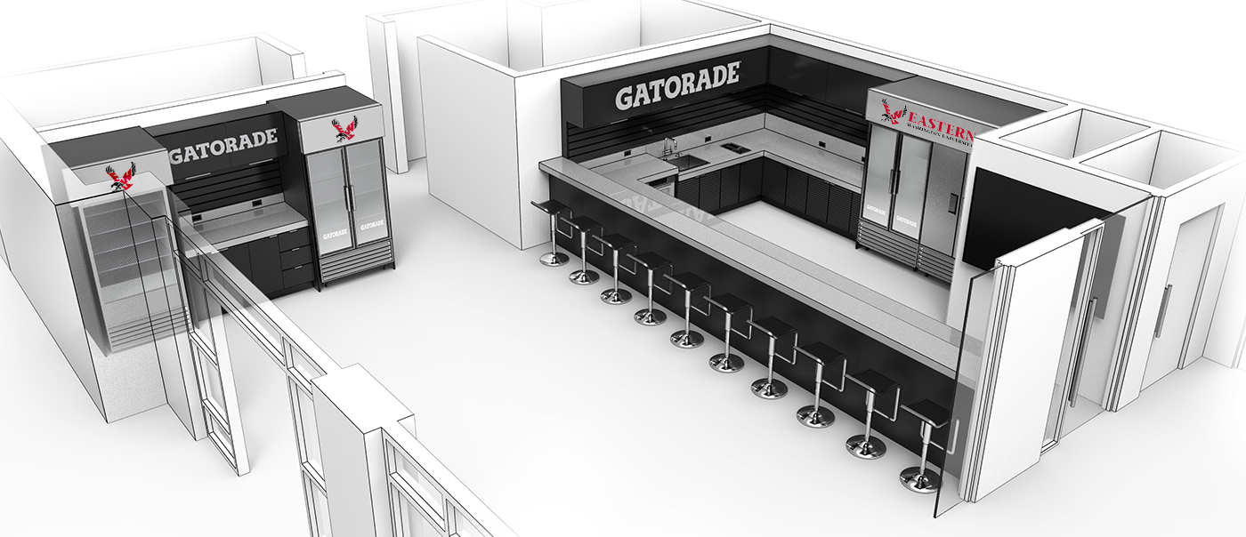

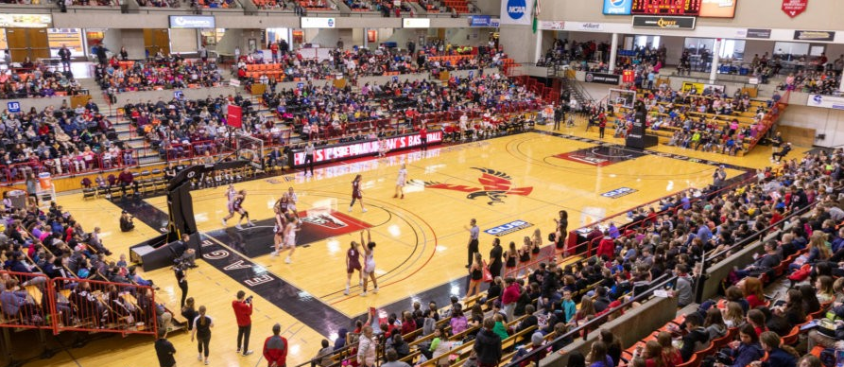
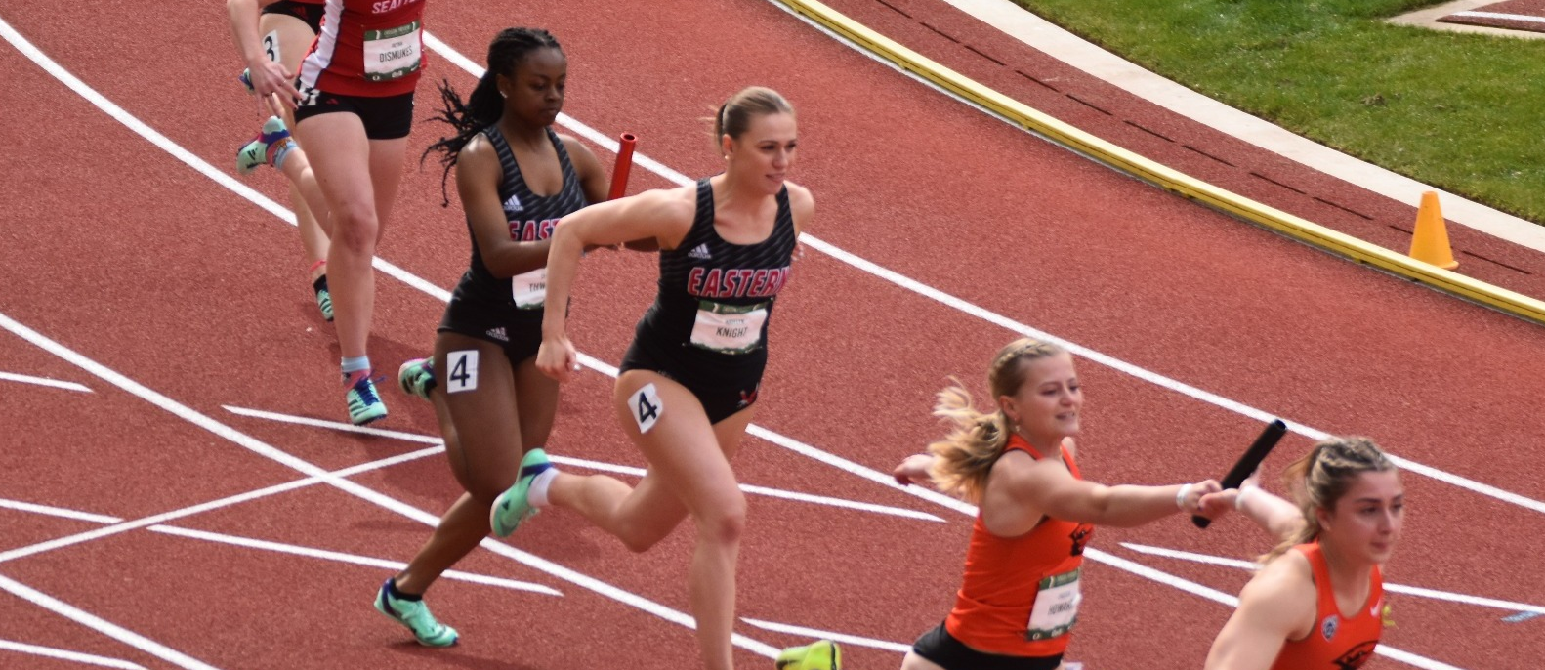
Capital Projects
Note: No budgetary funding has been received for these projects
Nutrition Station (New Build in Phase)
  Big Sky mandate
  $150k raised for build ($90k in sponsorship, $60k donors)
  $3-5k per month expenses to be supported via fundraising
New Basketball Floor (Reese Court)
  Current floor beyond its lifespan
  Seeking sponsorship for funding
New Track (Relocation)
  $5M Pledge with $1M realized in foundation account for Phase 2 of stadium renovation
Athletics – Capital Projects
9

