Slide 1
OFFICE OF THE PRESIDENT
FY24 Budget Proposal

Slide 2
Office of the President
Primary Operational Areas:
Manage President’s Activities
Support BOT and VPs
Legislative Priorities
Tribal Relations
Public Comments and Connections
Catalyst Building Operations

Slide 3
Office of the President
 | FY24 Budget Plan
 | Local Operating - Index 1 | President Special Projects - Index 2
Office of the President | 1,600,979 | 50,000

Slide 4
Office of the President
Office of the President - $1,187,562
  Staffing (The President and 3 positions)
  Management of Multiple Initiatives
  Maintains Multiple Relationships
Board of Trustees - $70,000
  The eight person BOT serves as an advocate for the university and as a steward of the public trust. The Board participates in charting the future course of Washington post-secondary education and works in collaboration with the President on guiding the university forwards.
    Provides travel-related costs for meeting and events

Slide 5
Government Relations
Government Relations - $246,635 (1 position)
  Coordinates legislative communication
  Manages relationships with local, state and federal government officials
  Collaborates and coordinates with other public higher education institutions
  Collaborates and coordinates with faculty and students on important issues
  Future Goals – continue to build support for EWU and higher education generally in the legislature and expand efforts at the federal level

Slide 6
Tribal Relations
Tribal Relations - $15,300 (1 Position)
  Provide leadership, guidance and support for Native American initiatives
  Collaborates and coordinate the EWU Tribal Nations Advisory Council (TNAC)
  Provide direction and partnership for Native American organizations and programs by strengthening relationships

Slide 7
Catalyst Operations
Catalyst Ops - $61,000 (1 position)
  Some classroom materials
  Building needs
  Support for public events
  Response to maintenance needs, security, student/staff/faculty support
  Liaison work with Emerald Initiative

Slide 8
Office of the President
Additional Resources
  President’s Special Projects - $50,000

Slide 9
OFFICE OF THE PRESIDENT
Index 1 Original Budget

Slide 10
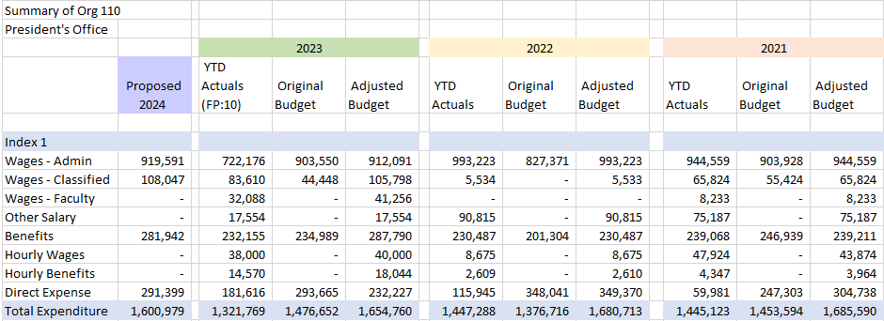
President’s Office
Index 1

Slide 11
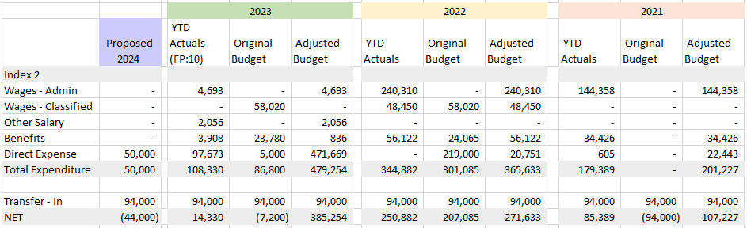
President’s Office
Index 2

