Slide 1
Electrical
OSHA 10-hour Outreach Training
General Industry

Slide 2
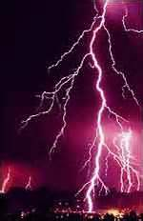
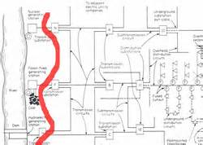
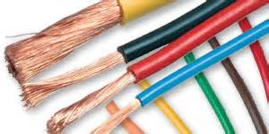
Electrical
Source of photos: OSHA

Slide 3
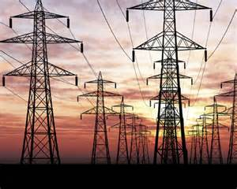
Introduction
Lesson objectives:
  Identify major electrical hazards
  Describe types of electrical hazards
  Describe electrical protection methods
  Recognize employer requirements to protect workers from electrical hazards
Source: OSHA
Notes:
Enabling Objectives:
Identify major electrical hazards.
Describe types of electrical hazards.
Describe electrical protection methods.
Recognize employer requirements to protect workers from electrical hazards.

Slide 4

Introduction
Definitions:
Electricity – movement
of the free electrons between
atoms;
  Related terms:
    Current – the movement of
    electrical charge
    Resistance – opposition to current flow
    Voltage – a measurement of electrical force
Source: NIOSH

Slide 5
Introduction
    Conductors – substances, such as metals, that have little resistance to electricity
    Insulators – substances, such as dry wood, rubber, glass and Bakelite, that have high resistance to electricity
    Grounding – a conductive connection to the earth which acts as a protective measure

Slide 6
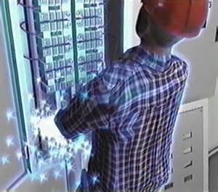
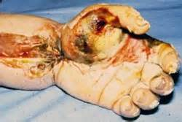
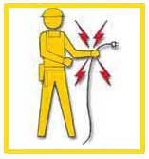
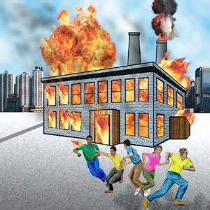
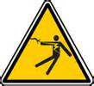
Electrical Hazards
Serious injuries and death can be caused by electrical hazards such as arc flash, shocks, burns, falls, and fires. Source of graphics: OSHA
Notes:
Source: https://www.osha.gov/Publications/osha3075.pdf
“Most electrical accidents result from one of the following three factors:
• unsafe equipment or installation,
• unsafe environment, or
• unsafe work practices.”

Slide 7
Electrical Hazards
Examples of electrical hazards that could cause workers to be electrocuted.
Repair Welder Electrocuted
Lockout/Tagout Failure
Notes:
Discuss examples given in class.
Watch OSHA videos and discuss videos.
Video #1: Repair Welder Electrocuted – 1 fatality (runtime: 00:02:23)
Video #2: Electrical Panel Repair Results in Electrocution – 1 fatality (runtime: 00:01:56)

Slide 8
Electrical Hazards
BE SAFE:
Burns
Electrocution
Shock
Arc flash/arc blast
Fire
Explosions
Notes:
BE SAFE by recognizing, avoiding and protecting against all of these electrical hazards.

Slide 9
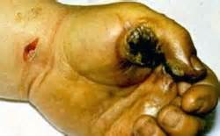
Electrical Hazards
Burns:
Most common shock-related injury
Three types of electrical burns:
  Electrical
  Arc flash
  Thermal contact
Source: OSHA
Notes:
Electrical burns are the most common shock-related injury.
The three types of burns from electricity are:
- Electrical burns result from heat generated by the flow of electric current through the body.
- Arc/Flash burns are high temperature burns caused by an electric arc or explosion.
-Thermal contact burns occur when skin comes in contact with overheated electric equipment.

Slide 10
Electrical Hazards
Electrocution:
Is fatal
Meaning: to kill with electrical shock
Results when a human is exposed to a lethal amount of electrical energy
Notes:
Electrocution is fatal; it means to kill with electrical shock.
Electrocution results when a human is exposed to a lethal amount of electrical energy.

Slide 11
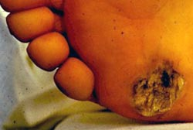
Electrical Hazards
Shock:
Body becomes part
of electrical circuit
Reflex response to
passage of electric
current through the body
Source: OSHA
Notes:
Shock results when the body becomes part of the electrical circuit; current enters the body at one point and leaves at another.
Electrical shock is defined as a reflex response to the passage of electric current through the body.

Slide 12
Electrical Hazards
Arc Flash/Arc Blast
Arc flash
  Sudden release of electrical energy through air when a high-voltage gap exists and there is a breakdown between conductors
  Gives off thermal radiation (heat) and bright, intense light that can cause burns
  Temperatures as high as 35,000°F
Notes:
An arc flash is the sudden release of electrical energy through the air when a high-voltage gap exists and there is a breakdown between conductors.
An arc flash gives off thermal radiation (heat) and bright, intense light that can cause burns.
Temperatures have been recorded as high as 35,000°F.

Slide 13
Electrical Hazards
Arc blast – high-voltage arcs can also produce considerable pressure waves by rapidly heating the air and creating a blast
Notes:
High-voltage arcs can also produce considerable pressure waves by rapidly heating the air and creating a blast
An arc flash can be spontaneous or result from inadvertently bridging electrical contacts with a conducting object. Other causes may include dropped tools or the buildup of conductive dust or
corrosion.
For more information on arc flash/blast, including best practices in electrical safety, refer to NFPA
70E: Standard for Electrical Safety in the Workplace available online at: http://www.nfpa.org/codes-and-standards/all-codes-and-standards/list-of-codes-and-standards?mode=code&code=70E

Slide 14
Electrical Hazards
Fire:
Most result from problems with "fixed wiring”
Problems with cords, plugs, receptacles, and switches also cause electrical fires
Notes:
Fire
Most electrical distribution fires result from problems with "fixed wiring" such as faulty electrical outlets and old wiring.
Problems with cords (such as extension and appliance cords), plugs, receptacles, and switches also cause electrical fires.

Slide 15
Electrical Hazards
Explosions:
Occur when electricity ignites explosive mixture of material in the air
Note:
  Electricity is source of these hazards
  All hazards are of equal importance
  Lesson focuses on eliminating electrical hazards
Notes:
Explosions
An explosion can occur when electricity ignites an explosive mixture of material in the air.
Note that although electricity is the source of these hazards, and all of these hazards are of equal importance, this lesson focuses on eliminating electrical hazards.

Slide 16
Electrical Hazards
Examples of fatal accidents:
Case #1: Worker electrocuted when the ladder came in contact with overhead power lines
Case #2: Worker electrocuted when mast came in contact with high voltage overhead lines
Notes:
Case #1: Two workers were moving an aluminum ladder. One of them was electrocuted when the ladder came in contact with overhead power lines.
Case #2: Worker was raising a mast on a water well drilling truck when the mast came in contact with high voltage overhead lines, electrocuting the worker.
Provide examples of accidents related to the type of work your audience does. Locate accident summaries on OSHA’s website. Go to: http://www.osha.gov/pls/imis/accidentsearch.html. Within the keyword field, enter a keyword to be searched against. For example, to obtain accident investigations involving electrocutions, enter the key word electrocuted. To view a list of key words, use the keyword list at the bottom of the Accident Investigation Search page.

Slide 17
Electrical Hazards
Case #3: Worker changing energized ballast on light fixture was electrocuted and fell to the concrete floor while working from an 8' fiberglass stepladder.
Notes:
Case #3: Worker was fatally injured when he was electrocuted and fell to the concrete floor while working from an 8' fiberglass stepladder. Worker was changing an energized ballast on a two-bulb florescent light fixture, located approximately 11.5 ft. off the ground.

Slide 18
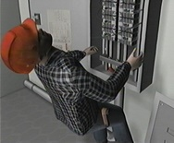
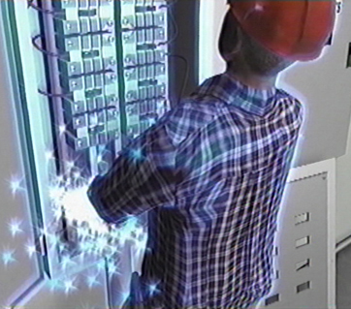
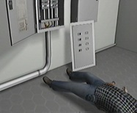
Electrical Hazards
U.S. Bureau of Labor Statistics:
156 electrocutions for 2014
Up from 141 in 2013
Source of graphics: OSHA
Notes:
NOTES:
For the most current statistical data, or for more detail, see: http://www.bls.gov/iif/

Slide 19
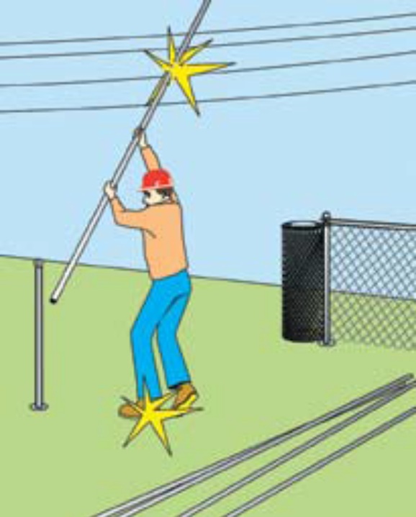
Types of Electrical Hazards
Contact with overhead power lines:
Overhead and buried
power lines carry
extremely high voltage
Risks
  Electrocution (main risk)
  Burns and falls
Source: NIOSH
Notes:
Contact with overhead power lines
Overhead and buried power lines are especially hazardous because they carry extremely high voltage.
Fatalities are possible as electrocution is the main risk; however, burns and falls from elevations are also hazards that workers are exposed to while working in the vicinity of high voltage power lines.

Slide 20
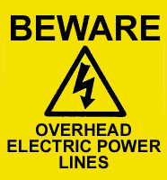
Types of Electrical Hazards
Cranes are not the only equipment that can reach overhead power lines.
Use of ladders or suspension in a man-basket under or near power lines are risks.
Source: OSHA
Notes:
Workers may not realize that cranes are not the only equipment that reaches overhead power lines.
Working on a ladder or in a man-basket suspended under or near power lines also poses a risk of electrocution.

Slide 21
Types of Electrical Hazards
Important: the covering on an overhead power line is primarily for weather protection; therefore, workers need to know that if they touch a power line, covered or bare, death is probable.
Ladders near powerlines
Notes:
Important to note: The covering on an overhead power line is primarily for weather protection; therefore, workers need to know that if they touch a power line, covered or bare, death is probable.
Voltages of overhead lines range from 120 to 750,000 volts. The most reliable way to know the voltage is to ask the utility company that owns the line.
Video: Electrocution: Work Safely with Ladders Near Power Lines (Runtime: 00:05:39)

Slide 22
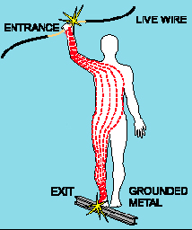
Types of Electrical Hazards
Contact with energized sources:
Live parts
  The major hazards
    Electrical shock and burns
    Electrical shock occurs
    when the body becomes
    part of the electric circuit
Source: OSHA
Notes:
The major hazards regarding contact with energized sources are electrical shock and burns. Electrical shock occurs when the body becomes part of the electric circuit, either when an individual comes in contact with both wires of an electrical circuit, one wire of an energized circuit and the ground, or a metallic part that has become energized by contact with an electrical conductor.

Slide 23
Types of Electrical Hazards
  Severity and effects of an electrical shock depend on a number of factors
    Pathway through the body
    Amount of current
    Length of time of the exposure
    Whether skin is wet or dry
  Water
    Great conductor
    Allows current to flow more easily in wet conditions and through wet skin
Notes:
The severity and effects of an electrical shock depend on a number of factors, such as the pathway through the body, the amount of current, the length of time of the exposure, and whether the skin is wet or dry.
Water is a great conductor of electricity, allowing current to flow more easily in wet conditions and through wet skin.

Slide 24
Chart
(1,000 milliamperes = 1 amp; therefore, 15,000 milliamperes = 15 amp circuit)
Current | Reaction
Below 1 milliampere | Generally not perceptible
1 milliampere | Faint tingle
5 milliampere | Slight shock felt; not painful but disturbing. Average individual can let go. Strong involuntary reactions can lead to other injuries
6-25 milliamperes (women) | Painful shock, loss of muscular control
9-30 milliamperes (men) | The freezing current or “let-go” range. Individual cannot let go, but can be thrown away from the circuit if extensor muscles are stimulated.
50-150 milliampres | Extreme pain, respiratory arrest, severe muscular contractions. Death is possible.
1,000-4,300 milliamperes | Rhythmic pumping action of the heart ceases. Muscular contraction and nerve damage occur; death likely
10,000 milliamperes | Cardiac arrest, severe burns; death probable
This table shows the body’s reaction when exposed to various levels of current. Source: OSHA

Slide 25
Types of Electrical Hazards
Damaged or bare wires
  Fault current may travel through a body, causing electrical burns or death, if
    Power supply is not grounded
    Path has been broken
    There are live parts or bare wires
  Extreme conditions and rough treatment can change electrical equipment from safe to hazardous
Notes:
If power supply to electrical equipment is not grounded or the path has been broken, or if there are live parts or bare wires, a fault current may travel through a worker's body, causing electrical burns or death.
Even when the power system is properly grounded, electrical equipment can instantly change from safe to hazardous because of extreme conditions and rough treatment.

Slide 26
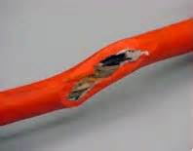
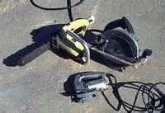
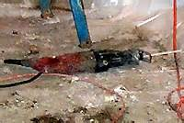
Types of Electrical Hazards
Defective equipment or tools
These photos show examples of defective equipment/tools. Source of photos: OSHA

Slide 27
Types of Electrical Hazards
Improper repairs
  Examples of incidents
    Ballast strap not replaced after repair = Electrocution of 11 year old boy
    Cutting off bleed resistor on capacitor= causes 370-volt shock
    Removing and leaving off terminal insulator on capacitor = causes 440-volt shock
Notes:
Mercury vapor light fixture on the wood pole was repaired and the ballast strap was not replaced causing the ballast to short from movement the secondary wiring energizing the connecting electrical conduit.
Bleed resistors are used to bleed off potential electrical stored energy from capacitors.
Rubber insulators are required over capacitor terminals in locations of contact.

Slide 28
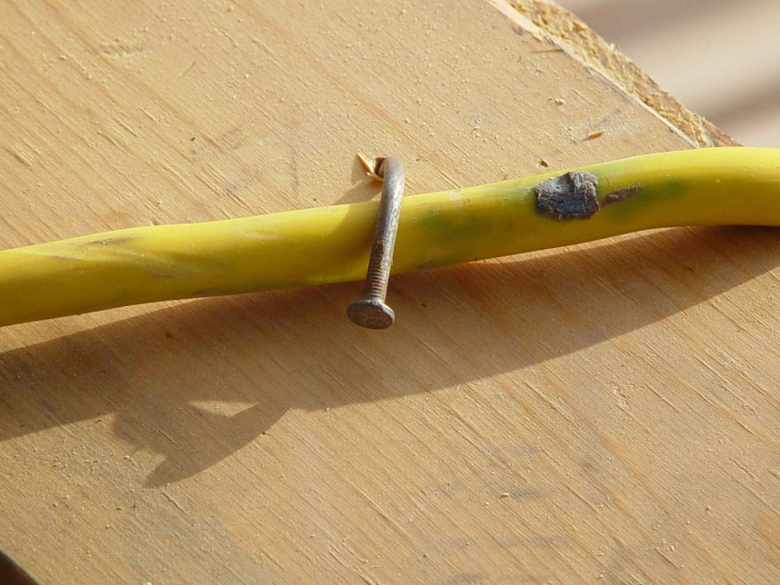
Types of Electrical Hazards
Improper use:
Extension and flexible cords
  Care
  Connection
  Capacity
Source: TEEX SH 46F1-HT06
Notes:
Because they are exposed, flexible, and unsecured, extension and flexible cords are more susceptible to damage than fixed wiring. Hazards are created when cords, cord connectors, receptacles, and cord- and plug connected equipment are improperly used and maintained.
To reduce hazards, flexible cords must connect to devices and to fittings in ways that prevent tension at joints and terminal screws. A flexible cord may be damaged by door or window edges, staples and fastenings, abrasion from adjacent materials, or simply by aging. If the electrical conductors become exposed, there is a danger of shocks, burns, or fire.
Overloading extension cords can cause them to overheat. Capacity of the extension cord should be labeled on the UL tag.

Slide 29
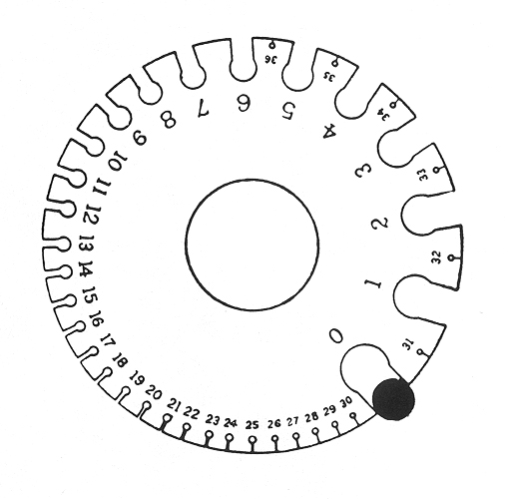
Types of Electrical Hazards
  Capacity affected by
    Size of wire
      14 gauge = 15 amps
      12 gauge = 20 amps
    Length of the cord
      UL tag capacity
      In general any cord over 100 ft. requires one size larger cord
      (14 gauge to 12 gauge)
Source: OSHA
Notes:
The higher the wire gauge number of the wire in the cord the less current it can carry.
Length of the cord also effects its capacity. The UL tag capacity is related to it length. In general any cord over 100 ft. requires one size larger cord. (14 gauge to 12 gauge)

Slide 30
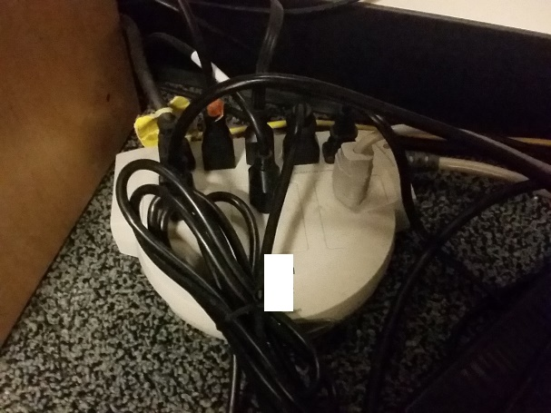
Types of Electrical Hazards
Power strips:
  Can be over loaded
  because of multiple
  plug arrangement
  Most have overload protection
  but often malfunction causing fire
  Use fixed wiring when possible
Source: UBATC
Notes:
Power strips capability to be over loaded because of the multiple plug arrangement. Most have overload protection but often malfunction causing fire. Use fixed wiring when possible.

Slide 31
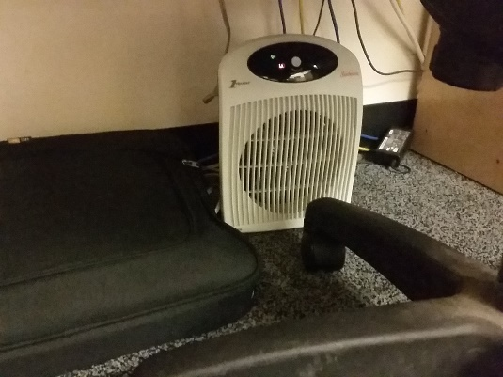
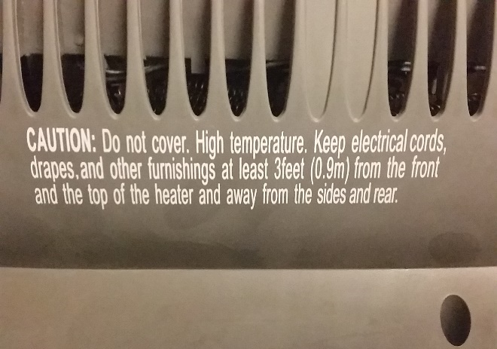
Types of Electrical Hazards
Portable heaters and appliances:
  Manufacturer recommendations
  not followed
  Do not plug into a power strip!
  This causes overloads and fires.
Source of photos: UBATC
Notes:
Portable heaters and appliances are often not used as the manufacturer recommends. Do not plug into a power strip! This causes overloads and fires.

Slide 32
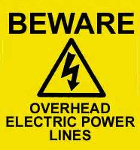
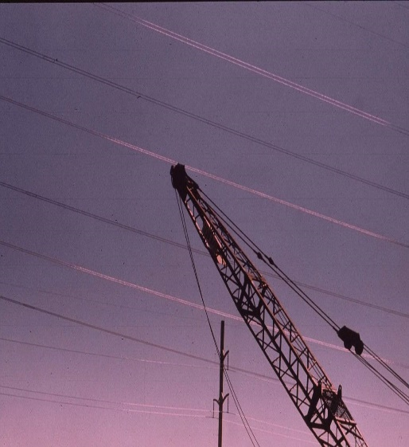
Electrical Protection Methods
Maintain safe distance from
overhead power lines:
Staying away
Following table shows the safe power line clearance distance for various line voltages.
Safe Distance Video
Source of graphics: OSHA
Notes:
Maintain safe distance from overhead power lines
Staying away from power lines is the best option.
The following table shows the safe power line clearance distance for various line voltages.

Slide 33
Electrical Protection Methods
Voltage (nominal, kV, alternating current) | Minimum Clearance Distance (feet)
Up to 50 | 10
Over 50 to 200 | 15
Over 200 to 350 | 20
Over 350 to 500 | 25
Over 500 to 750 | 35
Over 750 to 1000 | 45
Over 1000 | (As established by the power line owner/operator or registered professional engineer who is a qualified person with respect to electrical transmission and distribution)
This table shows the minimum clearance distances, in feet, for different power line voltages. Source: OSHA
Notes:
29 CFR 1926.1408 provides requirements for safe distances.
“Note: The value that follows "to" is up to and includes that value. For example, over 50 to 200 means up to and including 200kV.”

Slide 34
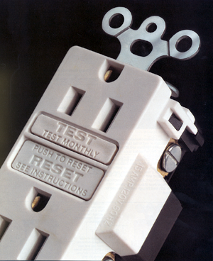
Electrical Protection Methods
Use ground-fault circuit interrupters (GFCI):
Designed to protect people from electrical shock
Detects ground faults and interrupts electric current
Limits duration of electrical shock
Source: OSHA
Notes:
A "GFCI" is a ground fault circuit interrupter that is designed to protect people from severe and sometimes fatal electrical shock. A GFCI detects ground faults and interrupts the flow of electric current, and is designed to protect the worker by limiting the duration of an electrical shock.
NOTE:
If the light or tool [other product] remains “ON” when the “Test” button is pushed, the GFCI is not working properly or has been incorrectly installed (miswired). If this is the case, a qualified electrician (equivalent to qualified electrician is a ‘licensed’, ‘certified’, and/or ‘registered’ electrician) needs to be contacted to properly wire or replace the GFCI device.

Slide 35



Electrical Protection Methods
Three types of GFCI:
Receptacle GFCI
Temporary/portable GFCI
Circuit Breaker GFCI
These photos show examples of the three types of GFCI. Source of photos: OSHA
Notes:
1. Receptacle GFCI: Often found on construction work sites, outdoor areas and other locations where damp conditions do or could exist.
2. Temporary/portable GFCI: AP portable GFCI is an extension cord combined with a GFCI. It adds flexibility in using receptacles that are not protected by GFCls. Extension cords with GFCI protection incorporated should be used when
permanent protection is unavailable.
3. Circuit Breaker GFCI: The GFCI circuit breaker controls an entire circuit, and is installed as a replacement for a circuit breaker on the main circuit board. Rather than install multiple GFCI outlets, one GFCI circuit breaker can protect the
entire circuit. At sites equipped with circuit breakers, this type of GFCI might be installed in a panel box to give protection to selected circuits. Circuit breaker GFCIs should be tested monthly. Keep in mind that the test will disconnect power to
everything on the circuit.

Slide 36
Electrical Protection Methods
Inspect portable tools and extension cords:
Workers need to inspect extension cords prior to their use for any cuts or abrasion.
Electric hand tools that are old, damaged, or misused may have damaged insulation inside.
Notes:
Extension cords may have damaged insulation. Sometimes the insulation inside an electrical tool or appliance is damaged. When the insulation is damaged, exposed metal parts may become energized if a live wire inside touches the metal parts

Slide 37
Electrical Protection Methods
Use power tools and equipment as designed:
Follow tool safety tips to avoid misusing equipment
Follow manufacturer’s instructions
Notes:
OSHA standards:
- Use only equipment that is approved [29 CFR 1926.403(a)]
- Use all equipment according to the manufacturer's instructions [29 CFR 1926.403(b)(2)]

Slide 38
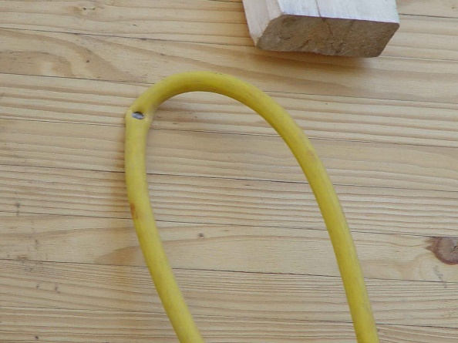
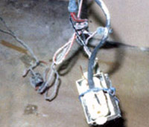
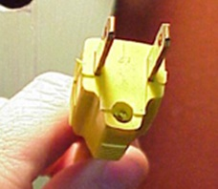
Electrical Protection Methods
Common examples of misused equipment
Source: TEEX SH 46F1-HT06
Source of photos: OSHA
Source of photos: OSHA
These photos show examples of equipment misuse.
Notes:
Common examples of misused equipment
• Using multi-receptacle boxes designed to be mounted by fitting them with a power cord and placing them on the floor.
• Fabricating extension cords with ROMEX wire.
• Using equipment outdoors that is labeled for use only in dry, indoor locations.
• Attaching ungrounded, two-prong adapter plugs to three-prong cords and tools.
• Using circuit breakers or fuses with the wrong rating for over-current protection, e.g., using a 30-amp breaker in a system with 15 or 20 amp receptacles. Protection is lost because it will not trip when the system’s load has been exceeded.
• Using modified cords or tools, i.e., ground prongs removed, face plates, insulation, etc.
• Using cords or tools with worn insulation or exposed wires.

Slide 39
Electrical Protection Methods
Tool safety tips
Never carry a tool by the cord.
Never yank the cord to disconnect it.
Keep cords away from heat, oil, and sharp edges.
Disconnect when not in use and when changing accessories such as blades and bits.

Slide 40
Electrical Protection Methods
Avoid accidental starting. Do not hold fingers on the switch button while carrying a plugged-in tool.
Use gloves and appropriate footwear.
Store in dry a place when not using.

Slide 41
Electrical Protection Methods
Don’t use in wet/damp environments.
Keep working areas well lit.
Ensure that cords do not cause a tripping hazard.
Remove damaged tools from use.
Use double-insulated tools.

Slide 42
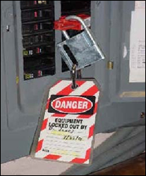
Electrical Protection Methods
Follow lockout/tagout (LOTO) procedures:
Lockout/tagout
  Essential safety procedure
  Protects workers from injury while working on or near electrical circuits and equipment
  Prevents contact with operating equipment parts such as, blades, gears, shafts, etc.
Source: OSHA
Notes:
Source: NIOSH Electrical Safety Manual [2009-113]: http://www.cdc.gov/niosh/docs/2009-113
Lockout/tagout is an essential safety procedure that protects workers from injury while working on or near electrical circuits and equipment. In addition, lockout/tagout prevents contact with operating equipment parts such as, blades, gears, shafts, etc.

Slide 43
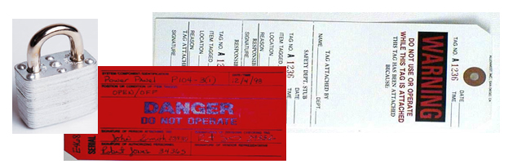
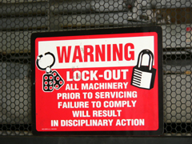
Electrical Protection Methods
  LOTO prevents the unexpected release of hazardous gases, fluids, or solid matter in areas where workers are present.
Source of photos: OSHA
Notes:
To protect against being electrocuted, workers need to follow lockout/tagout procedures. When performing lockout/tagout on circuits and equipment, the following checklist can be used:
• Identify all sources of electrical energy for the equipment or circuits in question
• Disable backup energy sources such as generators and batteries
• Identify all shut-offs for each energy source
• Notify all personnel that equipment and circuitry must be shut off, locked out, and tagged out (Simply turning a switch off is not enough)
• Shut off energy sources and lock switch gear in the OFF position. Each worker should apply his/her individual lock and keys kept with the worker
• Test equipment and circuitry to ensure they are de-energized. This must be done by a qualified person
• Deplete stored energy (for example, in capacitors) by bleeding, blocking, grounding, etc.
• Apply a lock or tag to alert other workers that an energy source or piece of equipment has been locked or tagged out
• Make sure all workers are safe and accounted for before equipment and circuits are unlocked and turned back on. Only a qualified person may determine when it is safe to re-energize circuits.

Slide 44
Electrical Protection Methods
Power source identification:
Mark all breakers accordingly for the circuits they protect
Mark all disconnect means accordingly for the equipment they service
Identify all voltages with proper labeling
Notes:
Power source identification
Make sure that all breakers are marked accordingly for the circuits they protect.
Make sure that all disconnect means are marked accordingly for the equipment they service.
Make sure that all voltages are identified with proper labeling.

Slide 45
Employer Requirements
Employer requirements to protect workers:
Ensure overhead power line safety
Isolate electrical parts
Supply ground-fault circuit interrupters (GFCI) protection
Establish and implement an AEGCP
Ensure power tools are maintained in a safe condition
Notes:
(AEGCP) assured equipment grounding control program.

Slide 46
Employer Requirements
Ensure proper guarding
Provide training
Enforce LOTO safety related work practices
Ensure proper use of flexible cords and power strips
Ensure proper identification of power sources

Slide 47
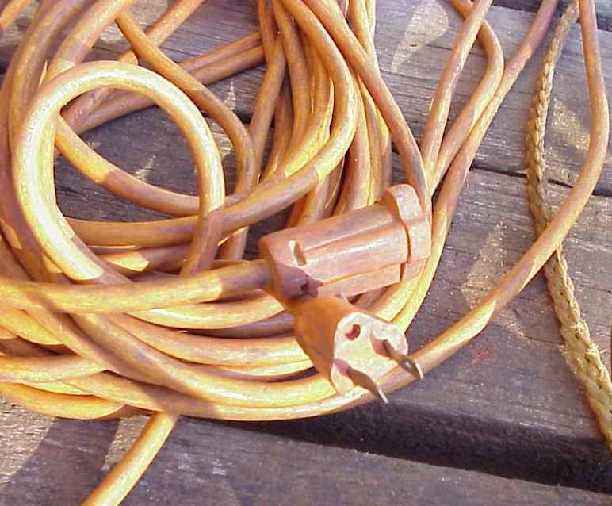
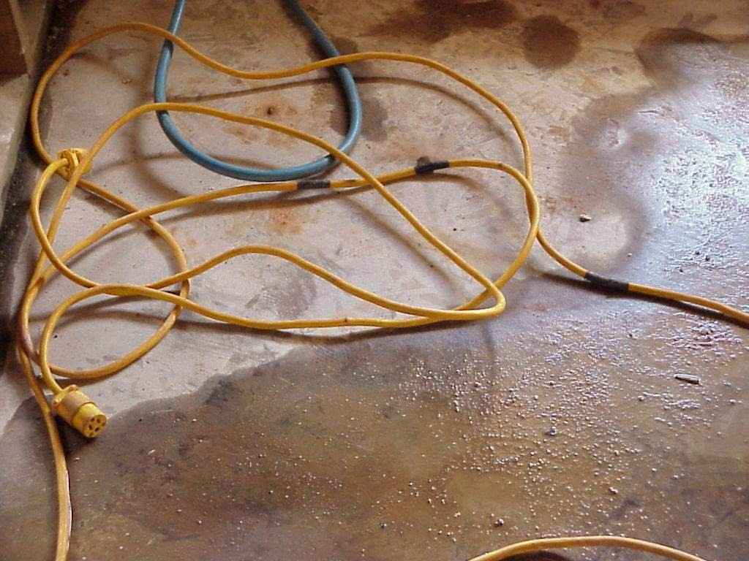
What’s Wrong?
Identify the hazards in these photos. Source of photos: TEEX SH 46F1-HT06
Notes:
Photo on left: ground missing
Photo on right: cord in water; cord taped to repair
Source: TEEX Susan Harwood Grant # 46F1-HT06

Slide 48
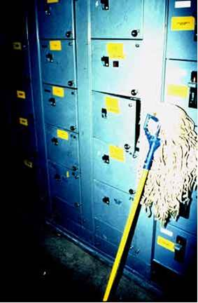
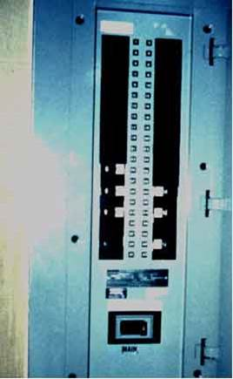
What’s Wrong?
Identify the hazards in these photos. Source of photos: OSHA
Notes:
Photo on left: open electrical panel in motor control room; wet mop stored at electrical disconnect.
Photo on right: breakers in panel not identified
Source: https://www.osha.gov/SLTC/etools/poultry/general_hazards/elec_hazards.html

Slide 49
Knowledge Check
What is electricity?
  The movement of atoms within an object
  The movement of free electrons between atoms
  Solid mass
  Movement within the nucleus of an atom
Answer: b. The movement of free
electrons between atoms

Slide 50
Knowledge Check
“Electrocution” means ___.
  received a mild electrical shock
  killed by electrical shock
  exposed to electrical current
  any accident involving electricity
Answer: b. killed by electrical shock
R.I.P.

Slide 51
Knowledge Check
Arc flash/arc blast can reach maximum temperatures up to 350˚F?
  True
  False
Answer: b. False - temperatures
can reach up to 3,500˚F

Slide 52
Knowledge Check
Which gauge of wire will carry the most current?
  14 gauge
  12 gauge
  10 gauge
  00 gauge
Answer: d. 00 gauge – the lower the
wire gauge number, the
more current it can carry

Slide 53
Knowledge Check
What does GFCI stand for?
  Ground Flexible Conduit Insulator
  Ground Flow Current Interceptor
  Ground Fault Circuit Interrupter
  Ground Floor Connection Intersector
Answer: c. Ground Fault Circuit
Interrupter

Slide 54
Knowledge Check
Which of the following is a safe practice?
  Carrying power tool by the cord
  Holding fingers on switch button while carrying a plugged-in tool
  Keeping cords away from heat, oil, and sharp edges
  Yanking cord to disconnect plug from outlet
Answer: c. Keeping cords away from
heat, oil, and sharp edges

Slide 55
Knowledge Check
Who is responsible for ensuring that overhead power lines are de-energized?
  Power company
  Employer
  Employee
  Municipality
Answer: b. Employer

