Slide 1
Grand Coulee Dam and Its Impacts on Indigenous Plateau Peoples
Laurie Arnold (Sinixt), PhD, Gonzaga University

Slide 2
Framing Conversations
Module One: Cultural Context, the Indigenous Plateau
Module Two: The Dam and (some of) its impacts
Module Three: Legacies
Module Four: Resources for further inquiry

Slide 3
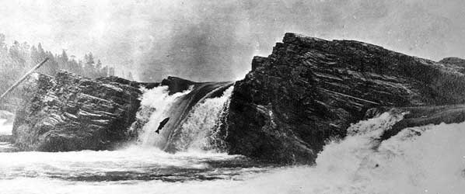
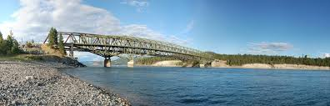
One: Cultural Context
Kettle Falls, ancestral fishing site for Plateau peoples, before and after Grand Coulee Dam

Slide 4
One: Cultural context “Why Does This Matter? How Can I Understand?”
Homeland informed/informs PLACE-BASED identity and spiritual practices, which is why Native peoples are so tied to land bases and landscapes.
Plateau peoples had responsibilities to care for, protect, and respect their homelands, including all beings, because the homelands fostered them.
Seasonal round: ancestral subsistence practices of food collection (fishing, gathering, hunting) which also informed spiritual practices. Medicine came from the land, just as food did. Food and medicine must be understood together.
Consequently, Plateau peoples had deep cultural and practical knowledge of homelands.
Their knowledge of where and when to gather the natural materials they used in Indigenous structures meant they created adaptable designs while also practicing nearly invisible land use

Slide 5
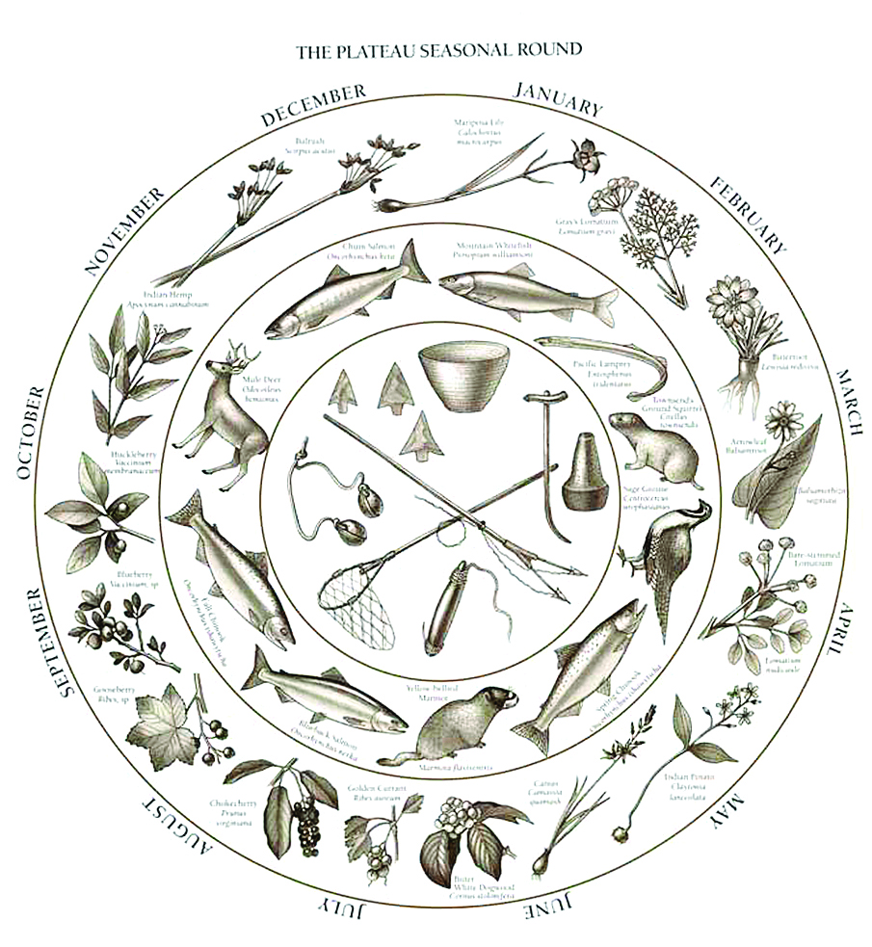

Slide 6
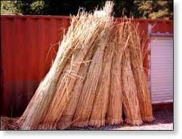
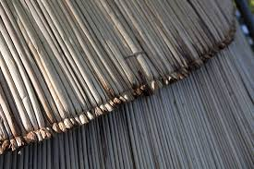
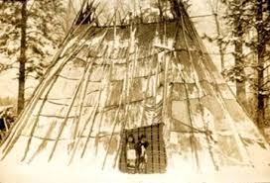
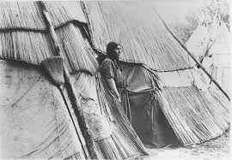

Slide 7
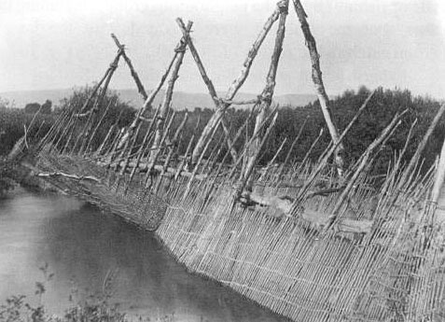
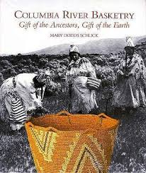
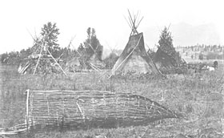

Slide 8
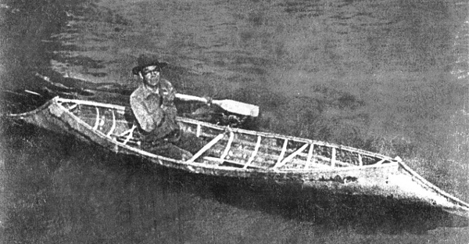
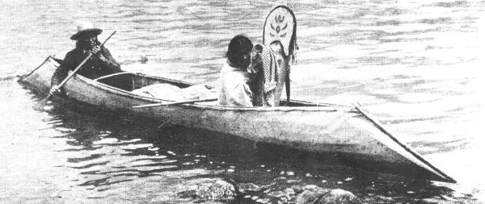
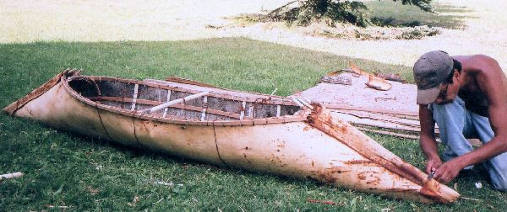

Slide 9
One: Cultural context
Culture informs community; homeland informs identity
Questions for students
  What does Indigenous mean?
  What is homeland?
  What is culture?
  How would the loss of your home or your safe place affect you?
  What would happen to you if someone took away your food and you didn’t know where to get food?
  What is a belief system and how does it inform the way you live each day? What do you do when you meet someone with different beliefs? Are you curious, interested, fearful?
  Is one group more important than another? Who decides that and how?
  What questions does this conversation make you ask? How will you find the answers to those questions?

Slide 10
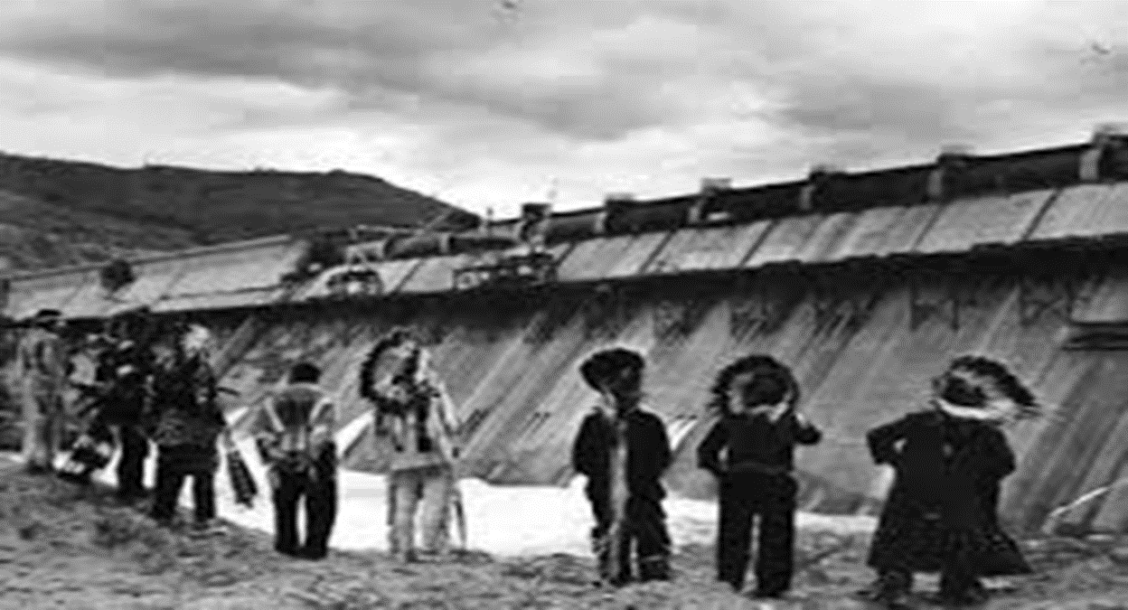
Two: The Grand Coulee Dam and (some of) its impacts

Slide 11
Two: (some of) its impacts
“I should like to see the pictures taken by the Ball & Dodd Funeral Home sent back to Washington with the [Colville tribal] delegation….This picture shows where the Indians did fish and camp, and shows the dam and that there will be no fish going over it. Mr. Ball is going to write and let me know what he can do.” Councilmember Runnels, Colville Business Council meeting, July 11, 1941.
“The irrigated agriculture of the Columbia Basin Project and the additional development spurred by Grand Coulee’s hydropower destroyed much Native plant life on the Plateau….Creation of Lake Roosevelt also made crossing the Columbia far more difficult [than when the smaller river could be crossed in canoes and small ferries].” World Commission on Dams, Grand Coulee Dam and Columbia Basin Project USA, Final Report Annexes, 2000, A 9-13.
“[Local individuals] saw the Native American tribes as the primary cost bearers, but felt that the tribes also benefitted from the project (e.g. through tourism) and that the tremendous net positive impacts of the project far outweighed the costs to this one group.” World Commission on Dams, Grand Coulee Dam and Columbia Basin Project USA, Final Report, 2000, 5-9.

Slide 12
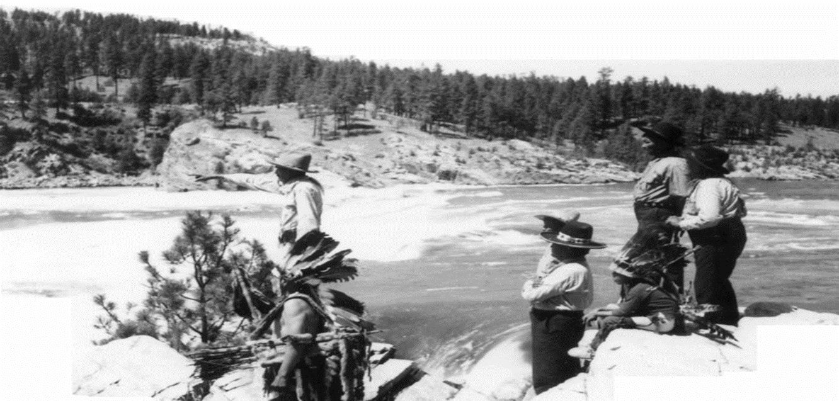
Two: (some of) its impacts Ceremony of Tears, June 1940

Slide 13
Two: (some of) its impacts
Congress did not formally authorize the acquisition and clearing of Indian lands along the river until June 29, 1940. About 2,000 members of the Colville Confederated Tribes and about 250 members of the Spokane Tribe had been forced to leave their homes weeks earlier. Within a year, Kettle Falls would be 90 feet below the surface of what is today called Lake Roosevelt.
Near the construction site, the towns of Grand Coulee and Coulee Dam in particular, as well as Elmer City and Electric City boomed.
In-migration, including workers from other states, countries, cultures.
Employment, not just on the construction, but in service industries which before hadn’t existed.
Housing shortages, high rents, Plateau peoples had an advantage in this situation because of families but also because they knew where to camp (in sites away from rattlesnakes).
Increase in crime, particularly public drunkenness, violence, prostitution, gambling.

Slide 14
Two: (some of) its impacts
Economic boom, yes: locally, regionally, eventually across the West as power was sold to states manufacturing for the war industries and post-war industries. California is the largest beneficiary of this hydropower.
This was a public works project, and while it is impossible to argue that Plateau peoples did not benefit from it, it is also true that this homeland—the Columbia Plateau—bore the cost in ways that can never be assessed, counted, or compensated.
Loss of access to ancestral foods, including salmon, created nutritional, social, cultural, and spiritual disruption. This can be framed through the lens of historical and intergenerational trauma. The impacts of the Dam created psychological trauma for Plateau peoples who directly experienced the trauma of the Ceremony of Tears, for example, and their descendants often inherit that trauma, creating successive generations of traumatized communities.
Moral Injury is another way to frame these impacts. Moral injury is a wound resulting from perpetrating, or merely witnessing, acts — or failures to act — that transgress deeply held, communally shared moral beliefs. In this context, Colville tribal leaders were unable to prevent construction of Grand Coulee Dam, which in turn led to the loss of salmon and disruptions of Plateau cultural values.

Slide 15
Two: (some of) its impacts
Questions for students
  How do we stress the importance of asking cultural and community questions before a project begins?
  How can we help leaders understand that cultural concerns are equally as important as financial project constraints, and even more important from a community’s perspective?
  If a project interrupts cultures, is proceeding the right thing to do?
Context from a global perspective:
  “In this sense, it is essential to show special care for indigenous communities and their cultural traditions. They are not merely one minority among others, but should be the principal dialogue partners, especially when large projects affecting their land are proposed. For them, land is not a commodity but rather a gift from God and from their ancestors who rest there, a sacred space with which they need to interact if they are to maintain their identity and values.” Pope Francis, Encyclical Letter, #146, 109-110, May 24, 2015.

Slide 16
Three: Legacies
Lake Roosevelt receives more than one million tourist visitors per year, roughly the same number as the White House.
More embedded federal presence on the Plateau.
Colville Tribe engaged in energy conversations and, for better or worse, is an integral partner in regional agricultural enterprises.
In this decade, the Tribe has become a leader in conversations about the Columbia River Treaty. The CRT is a State Department level agreement, negotiated between Canada and the U.S., and it is now undergoing the process of modernization.
Community leaders, whether elected to tribal office or working in divisions across tribes or First Nations organizations, or tribally-supported organizations such as the Upper Columbia United Tribes (UCUT) and the Columbia River Intertribal Fish Commission (CRITFC), have been collaborating for several years to ensure Indigenous voices are included in the modernized Columbia River Treaty. These perspectives call for cultural consultation as well as ecosystem practices which serve the river rather than reclamation or hydropower.
Tribal and First Nation consultation and input has the potential to create one of the CRT’s most significant legacies, which in turn will be a legacy of the Grand Coulee Dam.

Slide 17
Three: Legacies
Public awareness of the Columbia Plateau, the place and the peoples
Cooperation
Innovation
  https://www.youtube.com/watch?v=kICS32kady4
Intellectual work, such as we are doing right now
  The legacies of that intellectual work will include broader public comprehension, cultural awareness, an appreciation that the Indigenous Plateau has existed for more than 10,000 years, and an understanding that the Indigenous Plateau persists as a co-occupied space to which Plateau peoples are still responsible.

Slide 18
Four: Resources, primary & secondary sources
Archival documents, federal reports
Scholarly reports, e.g. anthropologist interviews (note: The Colville Tribe plans to update the David Chance book, People of the Falls, from a tribal perspective)
Books on the Columbia River, including your reading list
Teaching Resources
  ASEH http://aseh.net/teaching-research/teaching-unit-the-intermountain-west
Art
  Nespelem Art Colony, Worth Griffin and Clyfford Still (painters)
  Paul Kane (painter)
  Basket weavers
  Canoe makers
Videos
  Hydropowerlessness
  Treaty Talks

