Slide 1
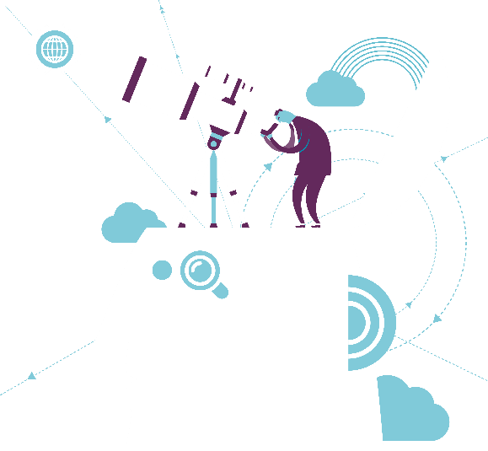
That Dam(n) Modernity:
The United States and the material and moral aspirations of Grand Coulee
Vincent Lagendijk
NEH / EWU Grand Coulee
July 2017

Slide 2
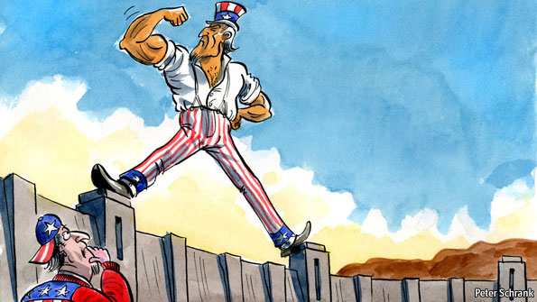
The American Dam Legacy
What is Modernity and have dams to do with it?
What was the set of morals and aspirations in dam-building mid-20th century?
What is the American legacy of dam-building? How quintessentially “American” is it?

Slide 3
What is Modernity?
Order, progress, stability, control (social science & policy)
Planning, rationality, efficiency (engineering)
Uniformity, measurable, calculation (Fordism, Taylorism)
Speed, scale, and size (popular culture)

Slide 4
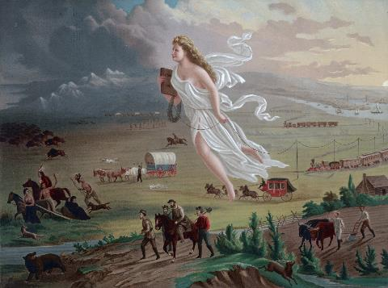
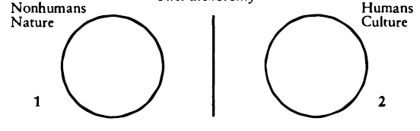
What is Modernity?
Man and society is placed outside of nature (Latour)
Process of modernization & nation-building go hand-in-hand (Gellner)
Liberal democracy & economic-technological modernization (Herbert)

Slide 5
Building a Modern Nation
Surveying, knowing, controlling (Scott)
  Territority (national parks), infrastructures, inhabitants
Agents of the modern state: Engineers
  Army Corps of Engineers (1775)
  Bureau of Reclamation (1902)

Slide 6
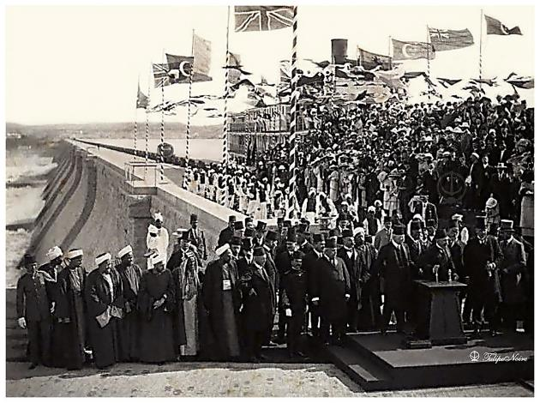
Building Dams
Controlling Nature
Reconfiguring Resources and Spaces
The Western Frontier
“Machine in the Garden”

Slide 7
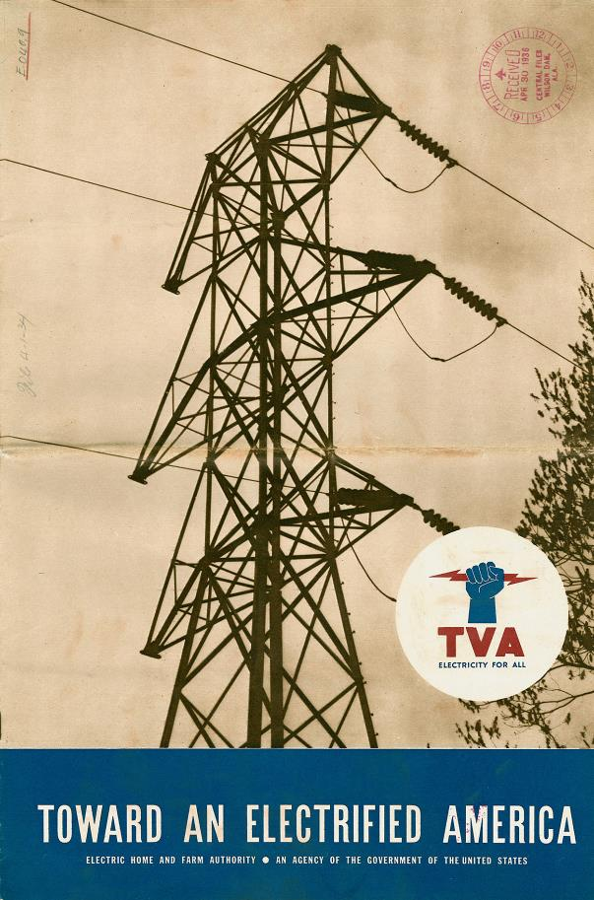
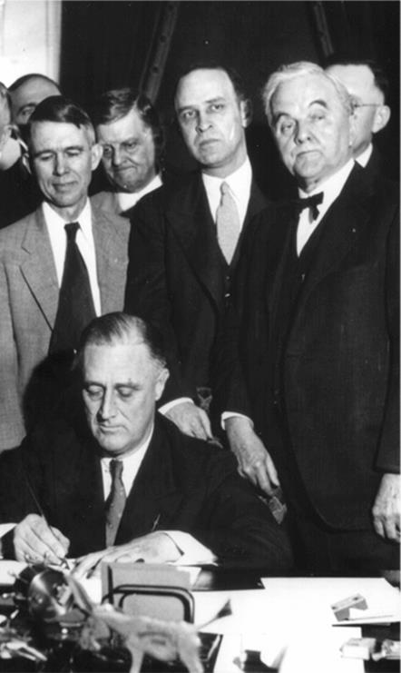
Multipurpose & Public Power

Slide 8
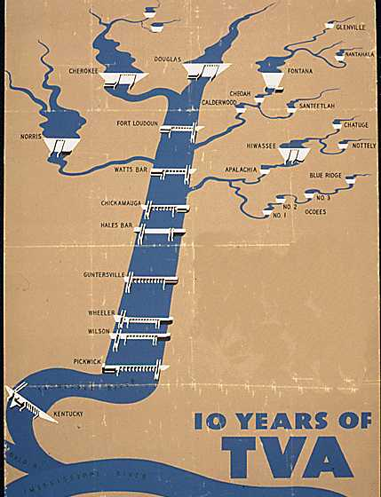
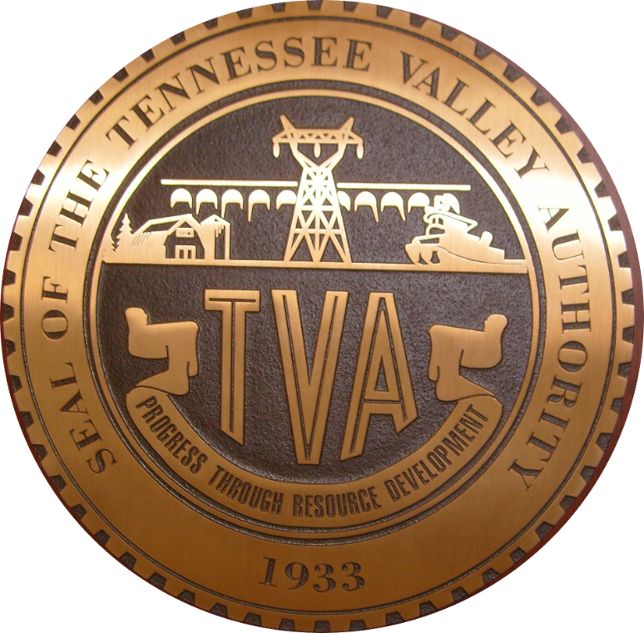
Tennesssee Valley Authority (1933)

Slide 9
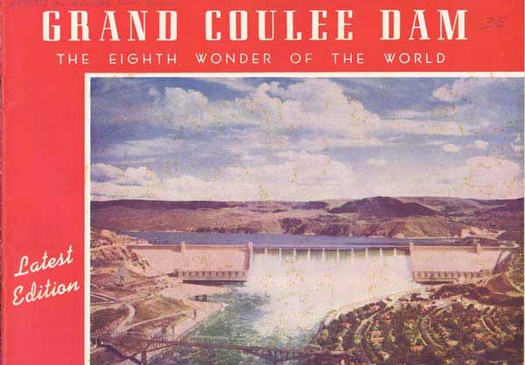
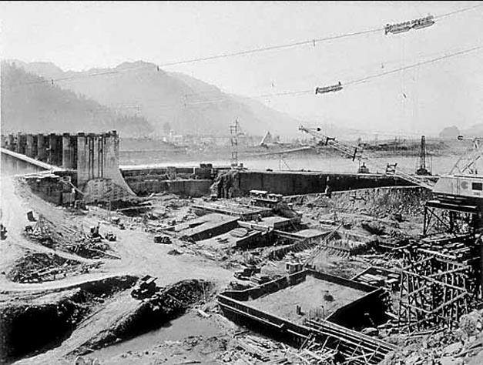
Bonneville Power Administration

Slide 10
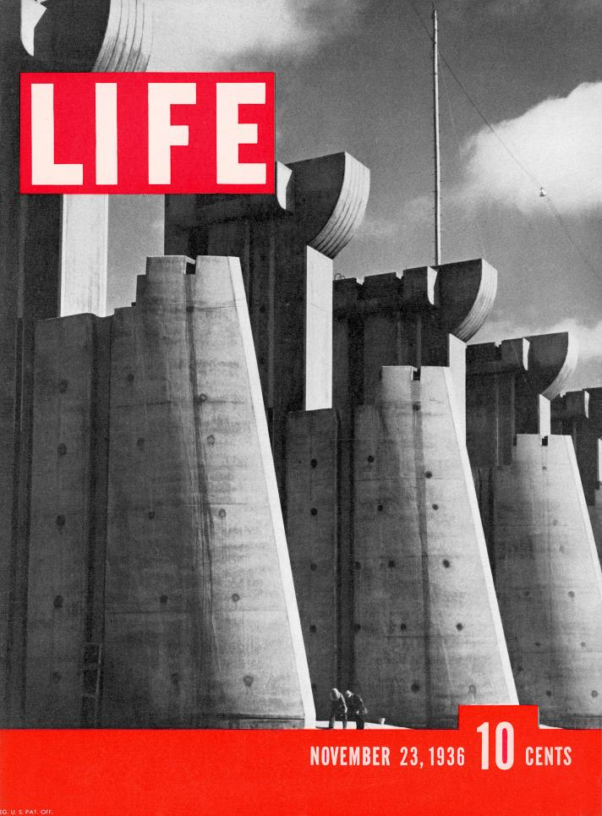
The American Century?
Henry Luce, Life
The American Mission (Ekbladh)

Slide 11
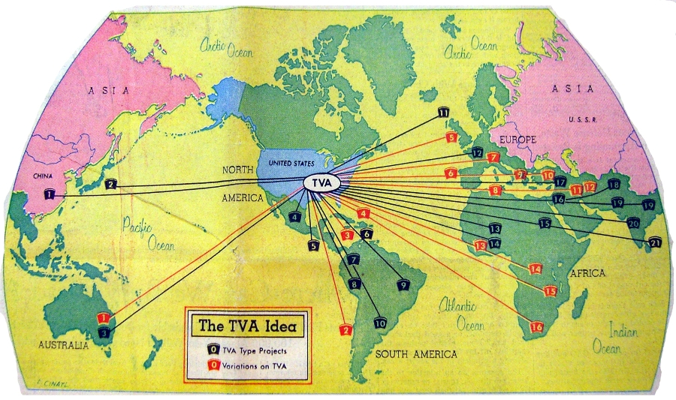
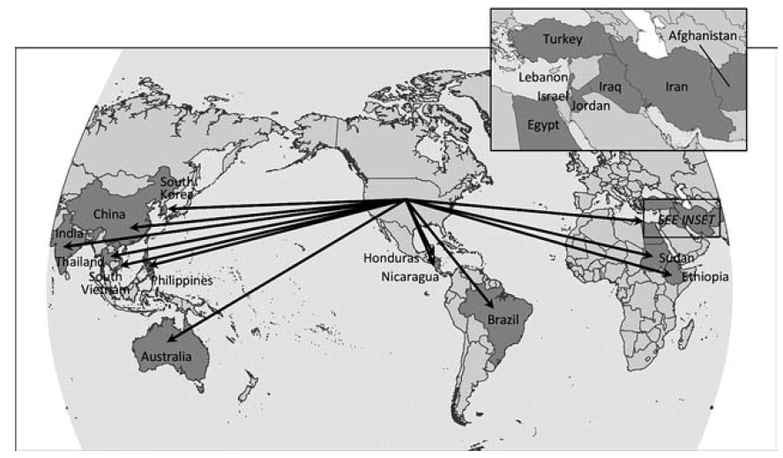
The American Century?

Slide 12
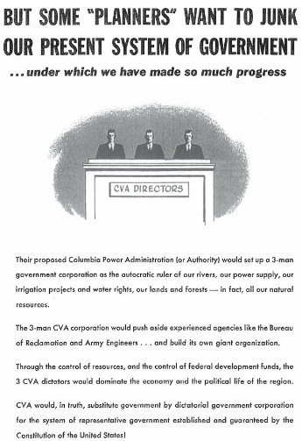
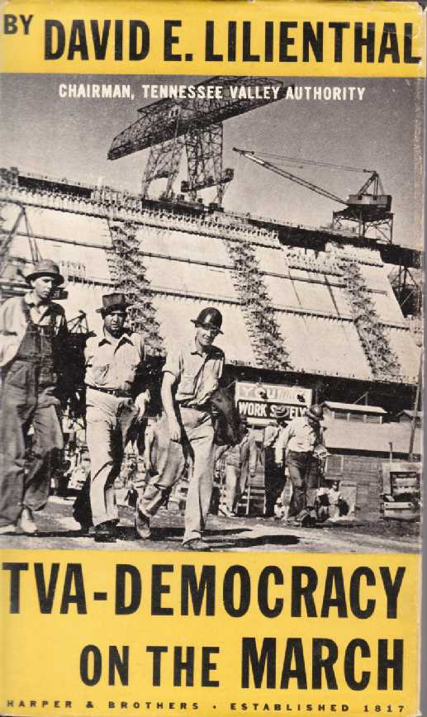
The American Century?: Two tensions
Democratic values vs imperialist tendencies

Slide 13
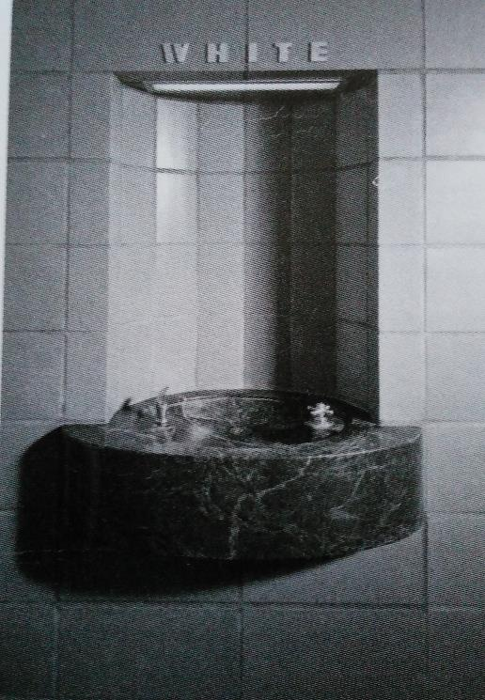
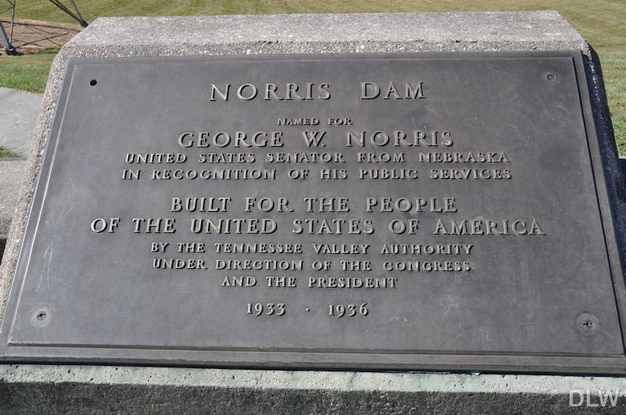
The American Century?: Two tensions
“Built for the People” vs racial segregation

Slide 14
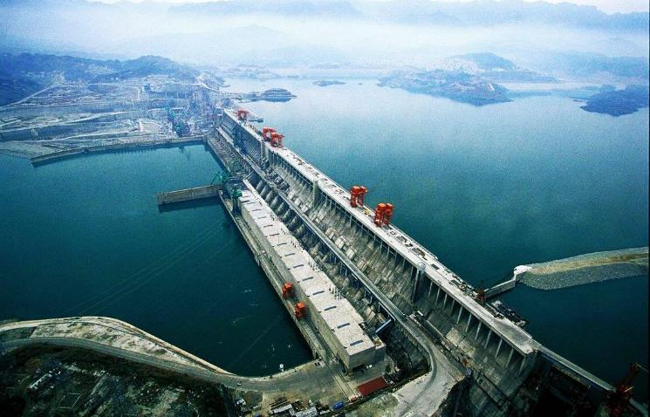
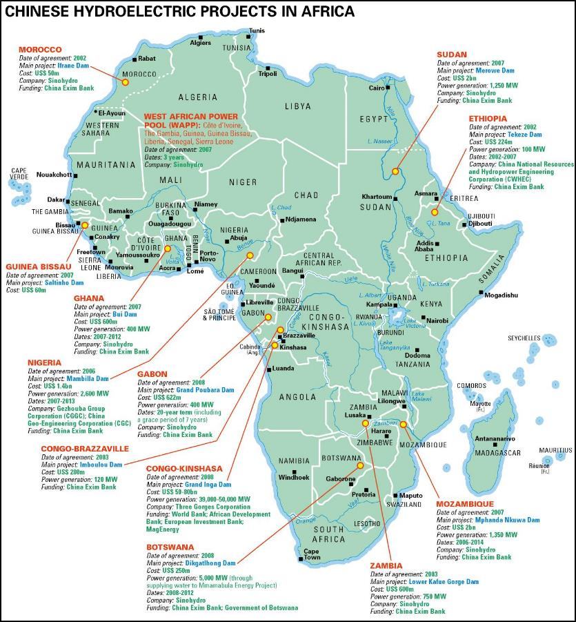
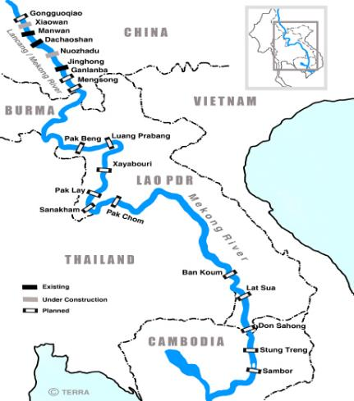
The End of Dams (& the American Century?)

Slide 15
That Dam(n) Modernity Revisited
Tension between Democracy & Planning
For the masses, but not all-inclusive (Common Good? Nature?)
Nation-state, but also international (competitive!)
Dam Age?
or DamAge?

