Slide 1

Cristin Haake
Los Alamos High School
Los Alamos, NM

Slide 2
Possible Themes
1. Efficiency, Control, and the Command of Nature:
Los Alamos Manhattan Project and the Grand Coulee Dam

Slide 3

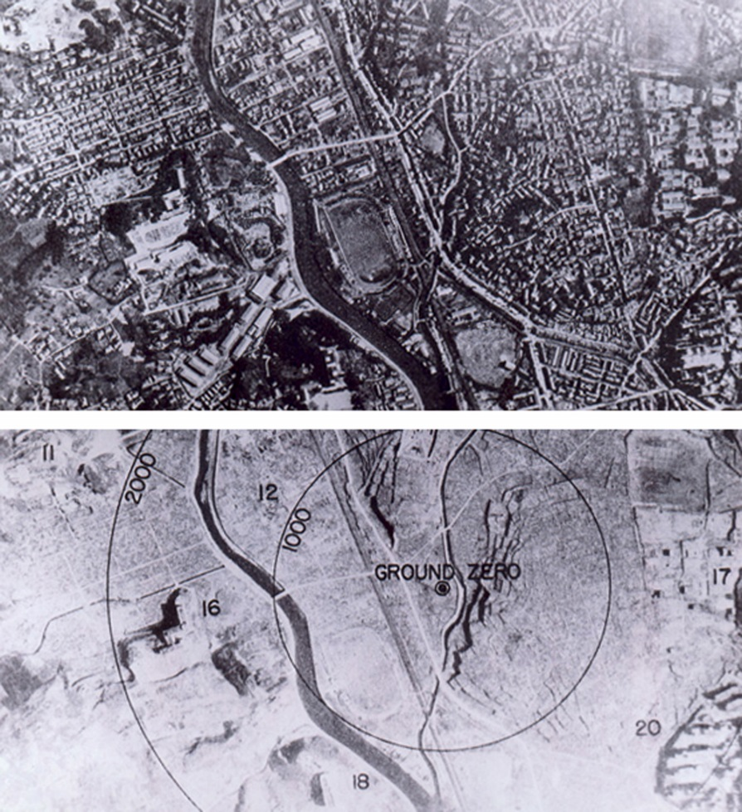
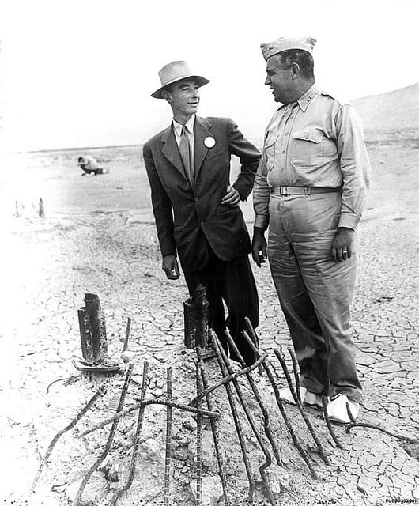
Los Alamos is the perfect example of the idea of control over nature – a perfect case study of individuals obsessed with creating/crafting/manipulating minerals/materials in order to destroy nature.

Slide 4
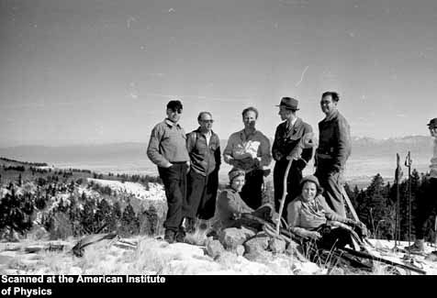
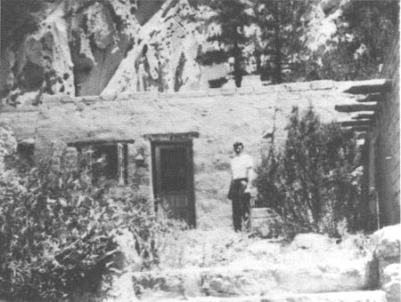
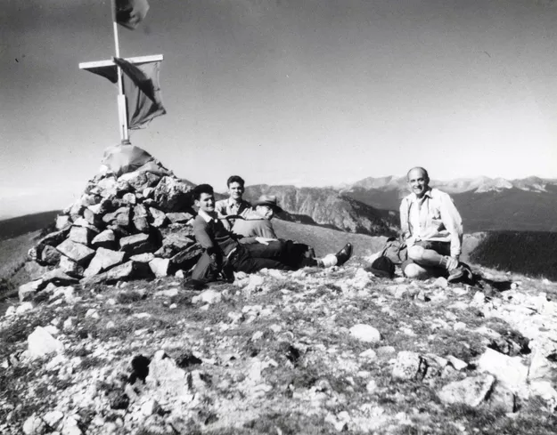
It is important to examine and dissect the dichotomies of Fermi, Segre, and other scientists and engineers enjoying and loving and participating with nature while working on the greatest tool of the destruction of nature.
Can we dominate/control/love/dismantle nature at the same time?

Slide 5
Possible Themes
2. Private or Public Ownership and Control?:
Los Alamos National Laboratories and the Grand Coulee Dam

Slide 6


Los Alamos National Laboratories as a case study in private, for-profit ownership
In 2006, the Department of Energy put the lab up for bid, with the idea of having a for-profit, incentive-based model to help streamline operations and end management waste.
Because of a record of non-performance and safety concerns, the Federal Government has put out to bid the contract for the Los Alamos National Laboratories (to be decided by September of 2018 when the current contract expires).
What is the best solution for the public good in terms of federal works, agencies, and services?

Slide 7
Possible Themes
3. Class Division, Social Engineering, and Urban Development:
Los Alamos Townsite and the Engineering Town and Mason Town of the Grand Coulee Dam

Slide 8
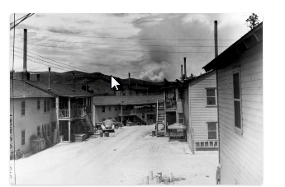
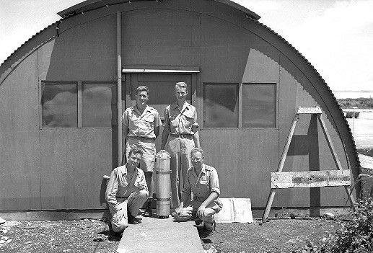
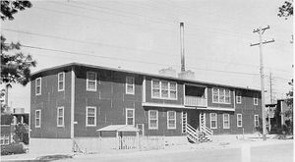
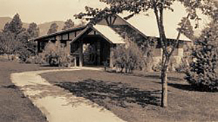
The Los Alamos townsite developed in conjunction with the Manhattan Project. The original townsite was the former Ranch School, chosen because of its remote location yet solid structures of a lodge and assorted other buildings.
The Ranch School, along with 26 properties owned by others, eventually became the 9,000 acres of Los Alamos proper and over 6,000 people lived on the “base.”
Quonset huts, Quads, Sundt-Kruger apartments were all semi-permanent structures/homes to the working class. Scientists and engineers enjoyed living on Bathtub Row, which were permanent structures that included indoor plumbing and bathtubs.
In examining class divisions, who has the power and how is that power displayed?

