Slide 1
(1) Rights by treaty
(2) Salmon ecology
Joe Hartley
Larchmont Charter School
Los Angeles, CA
joe.hartley@larchmontcharter.org

Slide 2
“[T]he cession by the Indians . . .furthered the national program of transforming wilderness into populous, productive territory…”
Tulee v. State of Washington (1942) 315 U.S. 681, 683

Slide 3
Cherokee Nation v. Georgia (1830) 30 U.S. 1, 15
“If Courts were permitted to indulge their sympathies, a case better calculated to excite them can scarcely be imagined. A people once numerous, powerful, and truly independent, found by our ancestors in the quiet and uncontrolled possession of an ample domain, gradually sinking beneath our superior policy, our arts and our arms, have yielded their lands by successive treaties, each of which contains a solemn guarantee of the residue, until they retain no more of their formerly extensive territory than is deemed necessary to their comfortable subsistence. To preserve this remnant, the present application is made.”

Slide 4
but....
“ [Indian tribes] may, more correctly, perhaps, be denominated domestic dependent nations. They occupy a territory to which we assert a title independent of their will, which must take effect in point of possession when their right of possession ceases. Meanwhile they are in a state of pupilage. Their relation to the United States resembles that of a ward to his guardian.”

Slide 5
and more....
“They look to our government for protection; rely upon its kindness and its power; appeal to it for relief to their wants; and address the President as their Great Father. They and their country are considered by foreign nations, as well as by ourselves, as being so completely under the sovereignty and dominion of the United States that any attempt to acquire their lands, or to form a political connexion with them, would be considered by all as an invasion of our territory and an act of hostility.”

Slide 6
“We took away their country and their means of support, broke up their mode of living, their habits of life, introduced disease and decay among them and it was for this and against this they made war. Could anyone expect less?”
-General Philip H. Sheridan
— Gen. Philip H. Sheridan

Slide 7
Limitations of assignments
This type of historical negotiation is Euro-centric and legalistic in a Western-European sense
“Negotiations” fail to account for disparities in power
“Negotiations” were “conducted” in Chinook patois, which the Nez Perce may well not have understood
Treaty embodied Western European concepts of property deeply rooted in medieval feudalism that don’t apply to a more egalitarian society like the indigenous peoples of the plateau
OTOH, Western Civ, for better or worse, is what we’re stuck with for now, even if we’re behaving in a colonial manner

Slide 8
Goals of assignment
Students relate treaty restrictions to their own lives through simulation of restricting freedoms
Negotiations between unequals and different cultures produce unfavorable results
Use of original documents to answer (and raise) questions (compare and constrast)

Slide 9
History of Nez Perce treaties
Oral agreements with Lewis & Clark, 1805
Stevens treaty of 1855
Revision of treaty following gold discovery, 1863
Further revision, 1868
Dawes allotment act of 1877

Slide 10
Necessary background on the Nez Perce
Foods:
  Salmon
  Roots (camas, bitterroots, wild onions, wild carrots, sunflower)
  Berries
Horses (since 1740’s)
Movement around the Columbia Plateau (Basin)—migratory with the seasons
Social structure and governance
Spirituality and sense of place

Slide 11
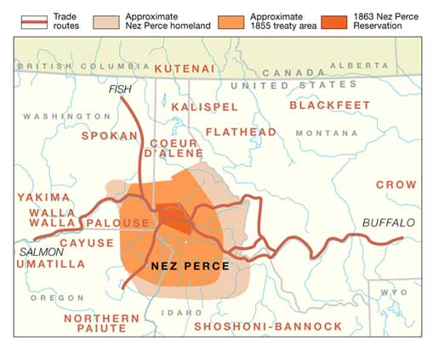
Territorial limitation of Nez Perce treaties

Slide 12
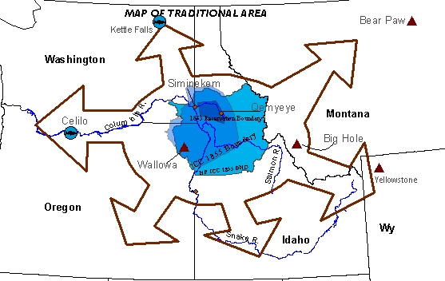
Another way to conceive Nez Perce “territory”

Slide 13
Making it real for the middle-school student

Slide 14
Set-up: hypotheticals relevant to middle-schoolers
Initial stage (equivalent of pre-1855 treaty):
You can roam all floors of the building
Complete access to outside lunch area
Complete access to basketball courts and play yard

Slide 15
Set-up: first treaty limitation (1855 treaty)
This is the equivalent in middle-school to the 1855 treaty
High schoolers are being added to the school. They can be dangerous to you. Therefore, we are taking the following actions to protect you:
You cannot go to the 4th floor.
You should not spend much time on the 3rd floor, but can go there whenever high school students aren’t present.
You continue to have full access to the 2nd floor, though high school students may be passing through it on their way to class, and you cannot interrupt them.
You continue to have full access to the lunch tables, the basketball courts, and the play yard.
To compensate you for what you are ceding, we will provide you with marital counseling, career advice if you are laid off from work, and detailed consultations with a financial advisor to plan for your retirement.

Slide 16
Questions for student groups to answer after first treaty
Do we have enough room that we can continue to survive (ie, pursue our education?
If not, what can we do? Can we resist? Make war?
If we have enough room, what can we give up without losing who we are?

Slide 17
Set-up: equivalent to treaty of 1863
The high school students need more space of their own. They have threatened violence to middle-school students if the middle-school students are not out of the high-school students’ space. Therefore:
Middle school students are prohibited to go above the 2nd floor.
Middle school students will be allowed to use the basketball courts and play areas only when at PE or at middle-school lunch.
Middle-school students may only use two-thirds of the lunch area at lunch; the remainder is reserved for high-school students at all times.
All other rules, however, remain in effect

Slide 18
Questions about the second change
Which of the original rules remain in effect?
What are the new limitations?
How does that affect our education?
Should we resist? What can we do?

Slide 19
Set-up: equivalent of 1868 revisions
Middle-school students can only use the basketball courts when the high-school students are not around. Further access to the play area is forbidden.
High-school students may pass through the second floor without hindrance by middle-school students. We will cut your lunch and PE if you interfere with the high-schoolers.
Though we haven’t yet provided you with the professionals promised in the original agreement, we really will, and real soon now. Your cellphones are annoying and will not be tolerated in the future.
All other agreements remain in effect

Slide 20
Set-up specifics
Students are accustomed to working in groups of 2-4 students.
This exercise envisions group work to work collaboratively on responses and to record them.
Each group will post their response, followed by a group walk with annotations with post-its, followed by a group discussion/debate about the outcomes.

Slide 21
Analysis of Nez Perce treaties
1855, 1863, and 1868, plus the Dawes Allotment Act of 1877

Slide 22
Treaty of 1855: cessation and reservation of lands for tribe
Article 1: cedes of all Nez Perce lands:
  Nez Percé give up all lands to US (17 million acres)
Article 2: reservation of lands for the Nez Perce:
  Nez Perce retain 7.5 million acres

Slide 23
Treaty of 1855: transportation
Article 3:
  “And provided that, if necessary for the public convenience, roads may be run through the said reservation, and, on the other hand, the right of way, with free access from the same to the nearest public highway, is secured to them, as also the right, in common with citizens of the United States, to travel upon all public highways. The use of the Clear Water and other streams flowing through the reservation is also secured to citizens of the United States for rafting purposes, and as public highways.”
  Continuing issue: who decides? How does that affect sovereignity?

Slide 24
Treaty of 1855: food-gathering rights
Article 3, paragraph 2:
“The exclusive right of taking fish in all the streams where running through or bordering said reservation is further secured to said Indians; as also the right of taking fish at all usual and accustomed places in common with citizens of the Territory; and of erecting temporary buildings for curing, together with the privilege of hunting, gathering roots and berries, and pasturing their horses and cattle upon open and unclaimed land.”
Follow-up: similar treaty provisions are the basis for litigating Indian rights well into the 21st century

Slide 25
Treaty of 1855: compensation
Article 4: $200,000 to be paid to tribe:
  $60,000 in first year for removal to reservation
  Rest paid in 5-year increments:
    $10,000/year for first 5 years
    $8,000/year for second 5 years
    $6,000/year for third 5 years
    $4,000/year for fourth 5 years
  President of the US has complete discretion on what to spend the money on for the benefit of the tribe, but can be advised by Indian superintendent and tribes about their wishes

Slide 26
Treaty of 1855: US to provide civilizing services
In addition to the indemnity provided by Article 4, the US promises to build, maintain, and pay the expenses of staff for 20 years:
2 schools, including furniture, books, and stationery (One school to be agricultural and industry)
2 blacksmiths’ shops, 1 of which attached to tinsmith, 1 to gunsmith
1 carpenter's shop, 1 wagon and plough maker's shop plus necessary tools
1 saw-mill and 1 flour mill
1 hospital

Slide 27
Treaty of 1855: people US to employ on reservation to help Indians
To help in the instruction of the Indians:
1 superintendent and 2 teachers
1 superintendent of farming and 2 farmers
2 blacksmiths
1 tinner
1 gunsmith
1 carpenter,
1 wagon and plough maker
1 physician

Slide 28
Treaty of 1855: more help from US
All expenses of Article 4 to be in addition to the “annuities” of Article 4
No charge for shipping goods purchased for Indians under Article 4 annuities.
Chief to be paid $500/year for his services, and given house and 10 acres as long as he’s chief.

Slide 29
Treaty of 1855: annuities aren’t personal (Article 7)
Article 4 can’t be used to satisfy personal debts of Indians

Slide 30
Treaty of 1855: prohibition
“The Nez Perces desire to exclude from their reservation the use of ardent spirits, and to prevent their people from drinking the same; and therefore it is provided that any Indian belonging to said tribe who is guilty of bringing liquor into said reservation, or who drinks liquor, may have his or her proportion of the annuities withheld from him or her for such time as the President may determine. ”

Slide 31
Treaty of 1855: Indian promises (Article 8)
In general, Nez Perce promise the following:
To be dependent on the US and be friendly to US citizens
Will not make war on other Indian bands or nations except in self-defense
Will permit withholding of annuities for payment of damages to property of US citizens or other Indians
Won’t shelter or conceal criminals and will give them up to authorities for trial

Slide 32
Treaty of 1863:
Drafted after gold on Nez Perce land discovered in 1860
Article 1:
  Cedes 7.5 million acres
Article 2:
  Retains 750,000 acres

Slide 33
Treaty of 1863: Article 3 and 4
Article 3: President to have reservation surveyed and divided
Article 4: Additional $265,500 provided

Slide 34
Treaty of 1863: Article 5
Buildings and personnel promised in 1855 treaty haven’t been provided, but will be, real soon now….
NEW: tribe will elect head chief and two sub-chiefs with whom US authorities can deal

Slide 35
Treaty of 1863: Article 8
All other provisions of treaty of 1863 reaffirmed

Slide 36
Treaty of 1868
Bizarrely short
Main provision is article 2:
  It is further agreed between the parties hereto that the stipulations contained in the 8th article of the treaty of June 9th, 1863, relative to timber, are hereby annulled as far as the same provides that the United States shall be permitted to use thereof in the maintaining of forts or garrisons, and that the said Indians shall have the aid of the military authorities to protect the timber upon their reservation, and that none of the same shall be cut or removed without the consent of the head-chief of the tribe, together with the consent of the agent and superintendent of Indian affairs, first being given in writing, which written consent shall state the part of the reservation upon which the timber is to be cut, and also the quantity, and the price to be paid therefor.

Slide 37
Comparison of 1863 to 1868 timber language
1868
1863 language concerning timber
Repeal of: said Indians shall have the aid of the military authorities to protect the timber upon their reservation, and that none of the same shall be cut or removed without the consent of the head-chief of the tribe, together with the consent of the agent and superintendent of Indian affairs, first being given in writing, which written consent shall state the part of the reservation upon which the timber is to be cut, and also the quantity, and the price to be paid therefor.
All timber within the bounds of the reservation is exclusively the property of the tribe, excepting that the U. S. Government shall be permitted to use thereof for any purpose connected with its affairs, either in carrying out any of the provisions of this treaty, or in the maintaining of its necessary forts or garrisons.

Slide 38
Application and extension of analysis of Nez Perce treaties

Slide 39
Possibilities
Simulation of negotiations (history conditional, not deterministic)
  4-member negotiation teams, with one member recording negotiations
  Most effective when given certain facts (secret) with which to negotiate
  Results posted with notes by both sides; gallery walk
Development of increasing restrictions (land, timber, sale of tribal lands)—states acting against native peoples
Who promises what?
What does it mean to be “sovereign”? What did the bands give up that made them less sovereign? (high school)
Fishing and hunting outside the reservation (rich legal history)

Slide 40
Extensions
Calculating ceded areas by cutting out maps and weighing them
Linking to senior-level high-school courses in government, comparing structure and egalitarian nature of society (particularly for women)
Researching relative populations (immigrants v. Plateau Indians) using sources such as the US Census data online

Slide 41
Sources for treaties
Treaty of 1855:
http://digital.library.okstate.edu/kappler/vol2/treaties/nez0702.htm
Treaty of 1863:
http://digital.library.okstate.edu/kappler/Vol2/treaties/nez0843.htm
Treaty of 1868: http://digital.library.okstate.edu/kappler/vol2/treaties/nez1024.htm
Generally: Oklahoma State: http://digital.library.okstate.edu/kappler/index.htm
(organized by time period)
Dawes Act of 1877 (allotment act):
  NB: Dawes Act was simultaneous with end of Reconstruction in the South

Slide 42
Salmon ecology
Based on David Montgomery’s “The King of Fish: the Thousand-Year Run of the Salmon”

Slide 43
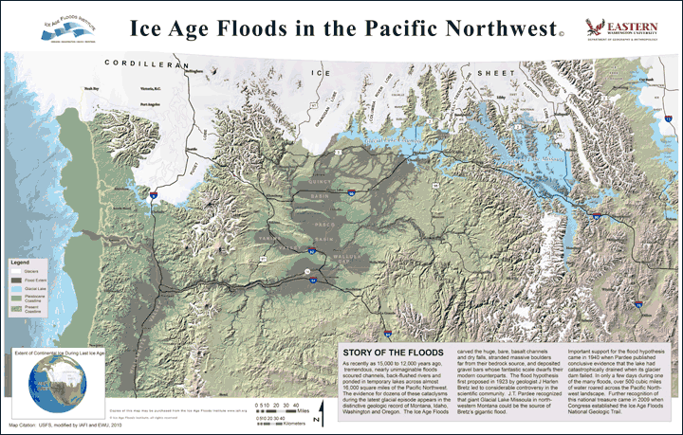
Salmon recolonize the Columbia River after the last ice age (~14,000 years bp)

Slide 44
Background reading for students (can substitute other sources)
Chapter 3 (basic salmon biology)
Chapter 5 (“Old World Salmon”)
Chapter 6 (“New World Salmon” [Atlantic salmon]
Common themes:
Salmon sensitive to human intrusions in environments (mills, pollution, overfishing)
Salmon goes from plentiful food for peasants to rare and increasingly expensive food for the rich as supplies collapse

Slide 45
Students apply Atlantic salmon facts to West Coast
Teacher slowly adds aggravating factors:
  Saw mills
  Flour mills
  Gill nets
  Canneries
  Gasoline-powered boats
  Dams
  Hatcheries
Students work in groups and produce written product of probable effect on salmon populations and why

