Slide 1
Grand Coulee Dam
To what extent is progress helpful?
To what extent is progress harmful?

Slide 2
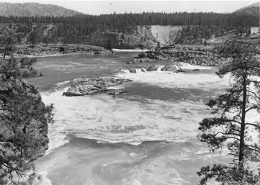
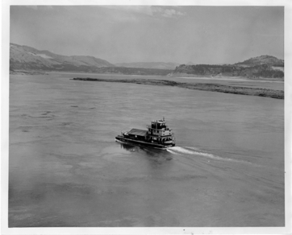
Guiding Questions
Day 1 - Coyote primary sources
What is a narrative?
What is a homeland?
Day 2 - Kettle Falls/Lake Roosevelt image comparisons
Can the voice of one group of people be more “important” than another group?
Day 3 - Salmon, treaties, displacement, DamNation
How has the Grand Coulee dam been helpful? Who has benefitted from this and how?
How has the Grand Coulee dam been harmful? Who has benefitted from this and how?

Slide 3
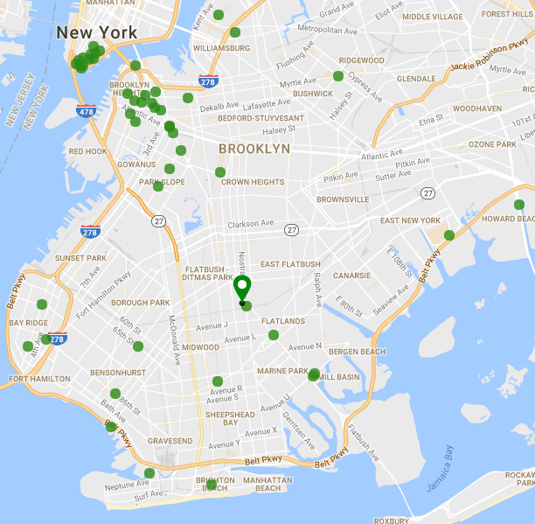
Guiding Questions
Day 1 - BHS podcast, oral history
Whose homeland is Crown Heights?
Day 2 - map-based
What and where is gentrification?
Day 3 - point/counterpoint news articles
Is gentrification helpful/harmful?
Who does it help/harm and how?

Slide 4
Final Assignment
How do we stress the importance of listening to a community before/during a project?
Training/session from Brooklyn Movement Center, Weeksville Heritage Center
Aim of assignment: applying unit concepts to hands-on activist experience
  Assignment options: letter writing to local politicians, submission of op-ed to local publications, create poster campaign, teach-in at school assembly

