Slide 1
Literature Circles Using The Absolutely True Diary of a Part-Time Indian
Lori Perreault

Slide 2
Creating Essential Questions
Using the TABa Method
Part 1
Resources (or Poverty)
Examples of resources: | Non examples of resources:
Therefore: (based on the patterns you see in examples and non-examples what are some generalizations that are true most or all of the time) | Essential Questions: (now turn those generalizations into questions – with scaffolding stems) Why is What would happen if How would How is Why are

Slide 3

Introducing The Author,
Sherman Alexie
Students will explore the author’s website to familiarize themselves with the author and the setting.
www.fallsapart.com
Students will prepare a list of 10 facts they learn about the author and 5 things that they found surprising.
Students will present their findings to their small group.

Slide 4
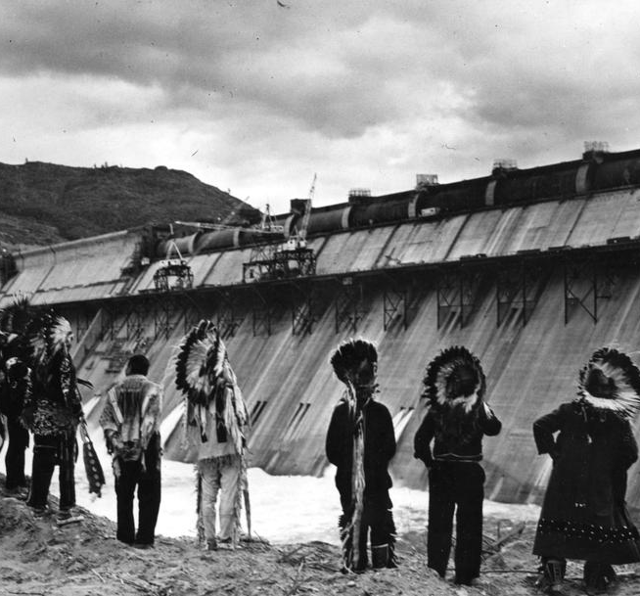
Visual Entry – Photo Analysis
In groups complete an analysis which would include:
What is the subject of the photograph? What does the photograph reveal about its subject?
Describe is the setting for the photograph? What details do you notice that give you an indication of time and place?
What is the message of the photo?
How would you describe the photographer’s point of view?

Slide 5
Discussion Director
Literary Luminary
Meeting of the Minds
Research Captain
Connector

Slide 6
Cold-Read Assessment
“Address at the Dedication of the Grand Coulee Dam” by Harry S. Truman
“God Damn, God Dam” from You Don’t Have to Say You Love Me: A Memoir by Sherman Alexie

Slide 7
Alternate / Additional Assessment
Student independent book project.
Students will select a method .) which the student feels will address the essential questions determined by the group
essay
Graphic Novel
presentation
display
Chautauqua

