Slide 1
Key “Ahas” from NEH
Encouraging an emotional response to historical events "feeling history”
- Exploring multiple perspectives and hearing diverse narratives
Telling the "story of refusal" and providing proactive
optimism

Slide 2
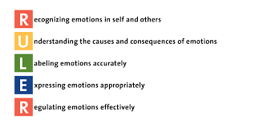
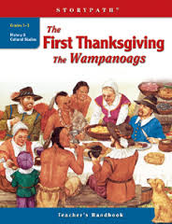


Slide 3
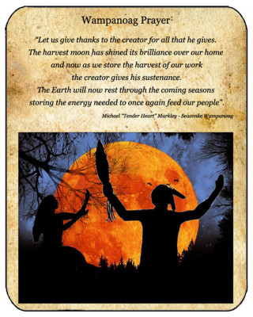
Lesson 1:The Power of Place and Consequences of Colonization:
How Native Populations Experienced the Taking and Changing of their Homeland
Learning Goals:
students begin to grasp what "colonization" is
students build empathy by identifying and articulating emotions related to having something of value invitingly altered or taken away

Slide 4
Lesson 2 - Native Americans Today:
Working toward Cultural Revitalization
Learning Goals:
Students will understand how places change over time and how changes affect lifeways.
Students will identify problems and solutions in the current salmon situation in the Columbia River.
Students will evaluate the effectiveness of current solutions to environmental restoration and culturalization.

Slide 5
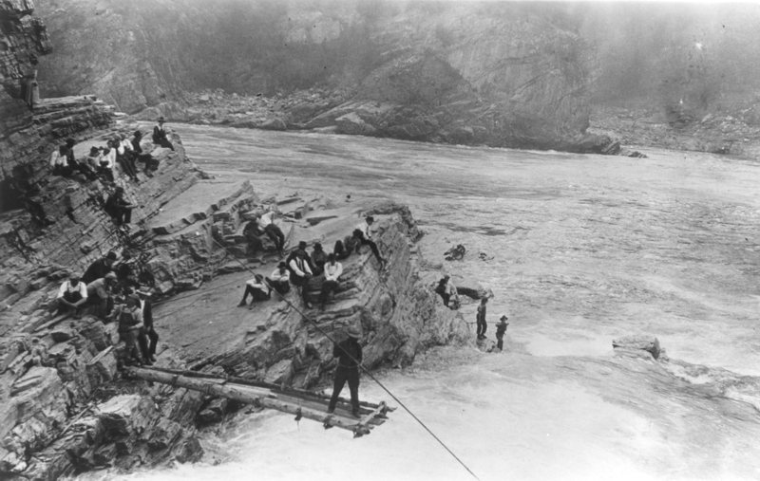
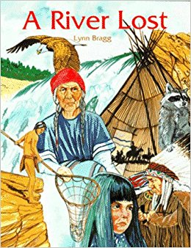
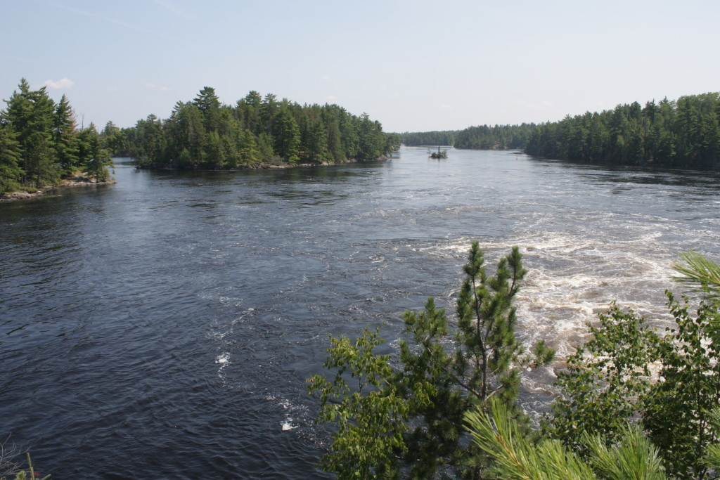

Slide 6
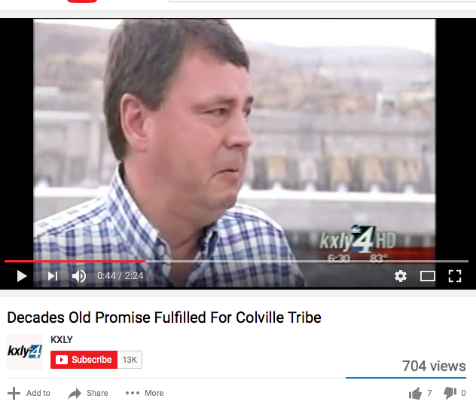
https://www.youtube.com/watch?v=2TmqL5qrEpY

Slide 7
Discussion Questions
What feelings do you identify in the characters/people?
How do you feel? Why?
What problems can you find in A River Lost?
What solutions can you identify to these problems in the book? Can you think of other ways these problems can be solved?
What problems/solutions do you see in the video?
In your opinion, is the problem of ___ solved? How do you know?

