Slide 1
Grade Six Geography
Human Interaction with the Environment

Slide 2
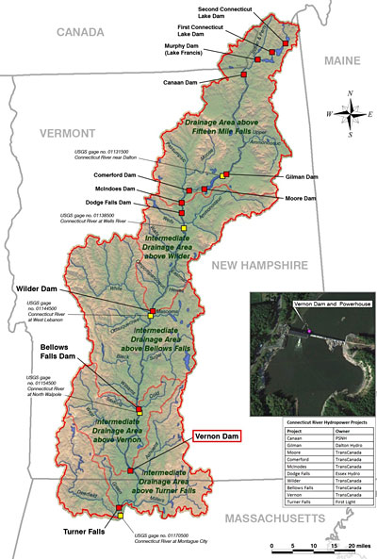
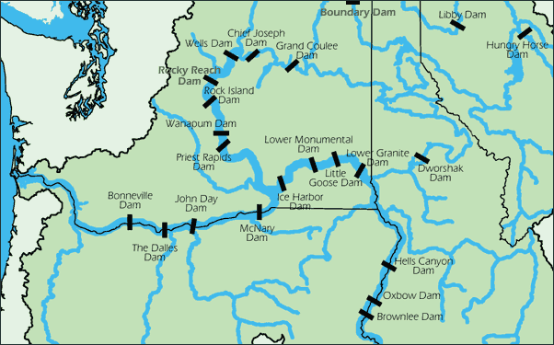

Slide 3
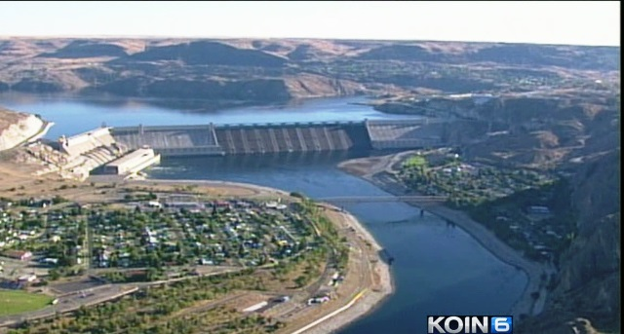
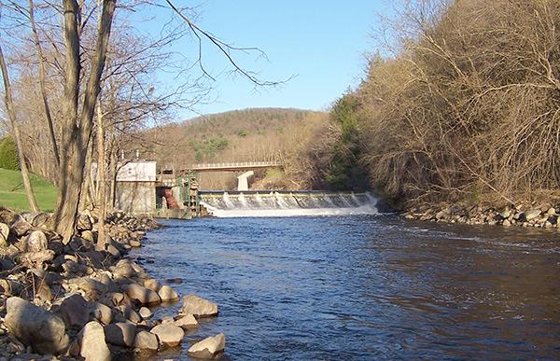
Transformation of place by human interaction
1. How have rivers influenced settlements?
2. How have river systems been affected by human development of dams?
3. How does place influence various perspectives of cultural beliefs?

Slide 4
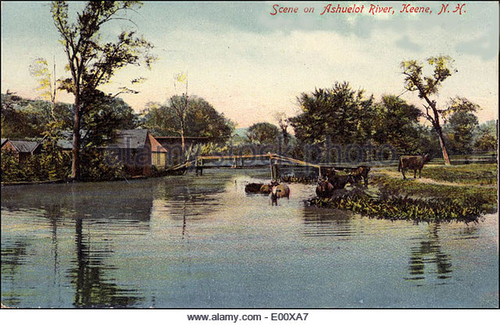
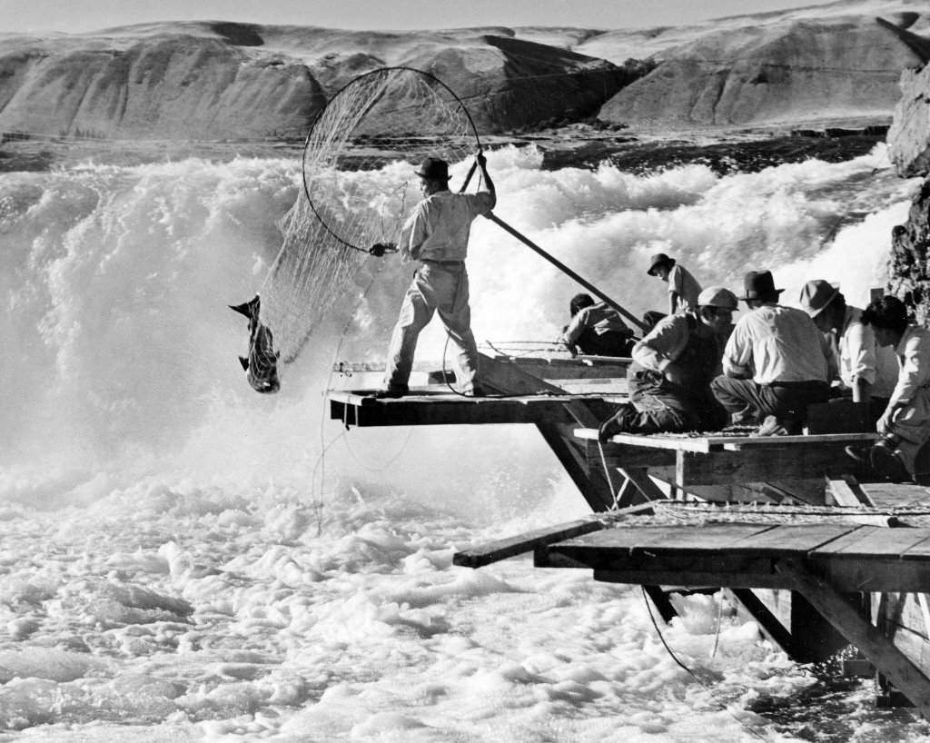
National Geography Standard 12
The processes, patterns, and functions of human settlement
Students will analyze maps and images and compare different types of settlement patterns observed across regions (e.g., linear rural settle­ment along roadways, railways, and rivers)

Slide 5
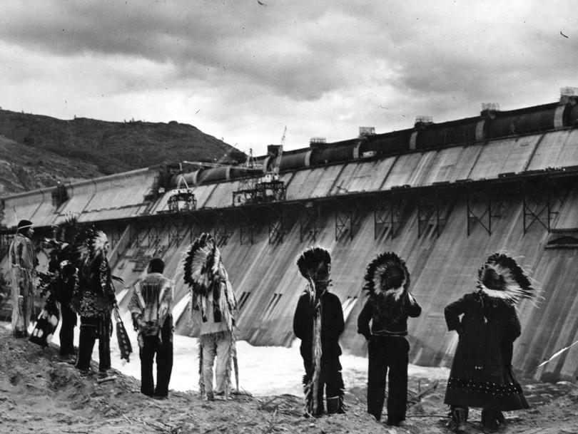
National Geography Standard 14
How human actions modify the physical environment
Human modifications of the physical environment in one place often lead to changes in other places
Describe and explain how the construction of dams and levees on rivers in one region affects places downstream (e.g., water availability for human consumption and agriculture, flood control, electricity generation, aquatic and riparian ecosystems).

Slide 6
Objectives
Students will analyze settlements along the Connecticut and Columbia Rivers
Students will recognize the impact of development along rivers
Students will compare the impact of human development of dams on rivers in their own community and the Columbia River basin.
Students will prepare a presentation demonstrating various perspectives regarding development of dams along the Connecticut and Columbia Rivers to share with classmates and another grade of students.
Students will write an opinion paper explaining their views on the future interaction between humans and rivers.

Slide 7
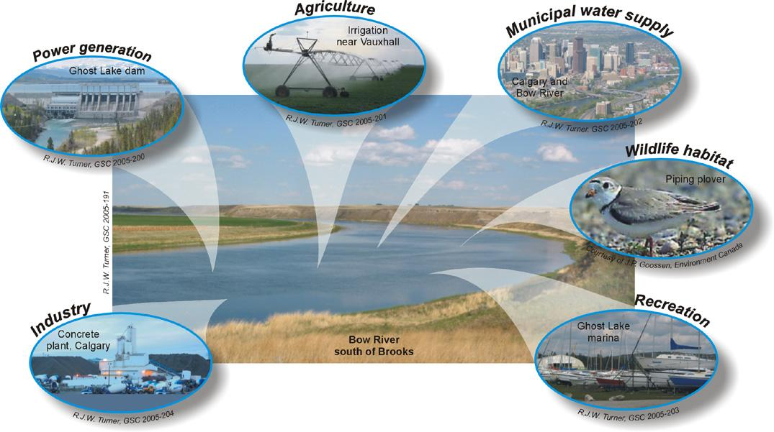

Slide 8
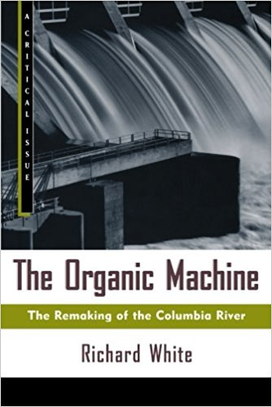
Materials
Excerpts from The Organic Machine
Excerpts from FDR
Excerpts from Great River of the West: Essays on Columbia River
Excerpts from Harry Truman address and dedication of Grand Coulee Dam
Primary sources from confederated tribes book of legends
Videos on Coulee Dam
Readings on Connecticut River settlements and development

Slide 9
Procedures
Provide visual images of settlements and dams along the Connecticut and Columbia Rivers
Provide images of dams along the Connecticut and Columbia Rivers
View videos on dam construction
Have students read excerpts from various reading materials and primary source documents.
Visit a local dam currently producing hydroelectricity
In groups have students write skits on the various perspectives regarding building of dams along rivers (indigenous, farmers, corporations, government, immigrants)

Slide 10
Assessments
Perform skits to classmates and third grade class that complements their study of community and geography.
Write an essay providing suggestions of how humans should interact with rivers in the future. (Dam removal, restoration, species revitalization, water quality and use)

Slide 11
