Slide 1

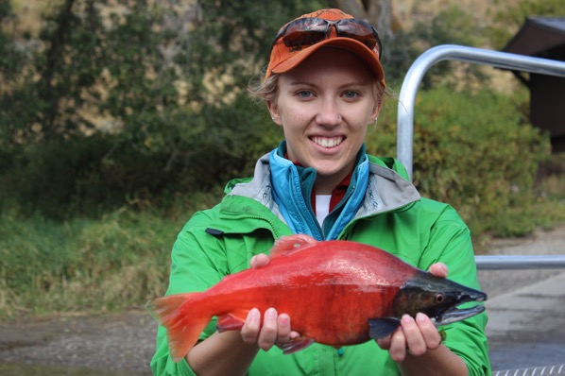
INTRODUCTION TO
ANIMAL CARE AND USE

Slide 2
TABLE OF CONTENTS
Part 1: Animals as Research Models
Part 2: Animal Welfare Matters
Part 3: The Institutional Animal Care and Use Committee (IACUC)

Slide 3
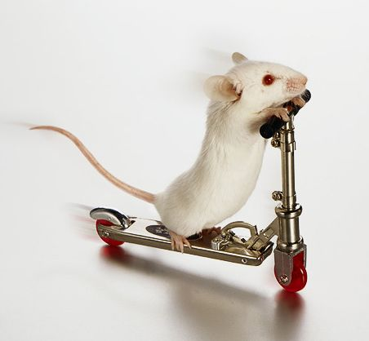
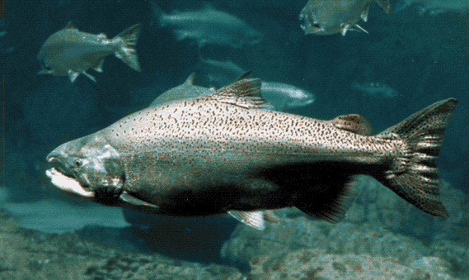
Part 1:
ANIMALS
AS
RESEARCH MODELS

Slide 4
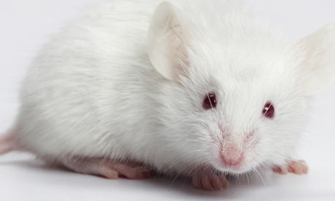
Why are animals used in research and teaching?
To learn about general principles that apply to many species of animals
To learn about the specific species of animal being studied
To learn principles that can be used in human medicine, but that cannot be studied with human subjects

Slide 5
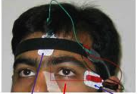
Why not use human subjects?
Often we can, and do.
Ideally we want to isolate, and manipulate, just one variable, and keep everything else the same. This is the best way to do science. It often is impossible with human subjects.
Some necessary manipulations cannot be done with human subjects, such as injection of experimental drugs, gene mutation, removal of organs, or euthanasia.

Slide 6
Why use animals at all?
Some things can be studied in vitro, with cells or tissues in a dish. Sometimes this is the best approach. The cells or tissues had to come from somewhere though – either an animal or a human.
Computer simulations can be used for some things. But before a computer program is designed, scientists need to learn the basics from animal studies.
Animals are full of surprises. In a living animal, multiple physiological systems interact, and sometimes this interaction produces results that could not be predicted from in vitro or computer studies.

Slide 7
Which animal species should we study?
If we’re interested in general principles that apply to all or most animals, we choose the “least sentient” species that has the characteristic we are studying. This means the species with the least conscious awareness.
If we’re interested in a particular species or type of animal, we choose that species or type.
If we’re interested in applications to human medicine, we choose the species that is closest to humans in the characteristic we are studying.
Species with short life spans are useful for studies that involve progression from one life stage to another.
Availability and cost also are considered, along with ease of housing and handling. Often it helps to choose a species that already has been studied thoroughly.

Slide 8
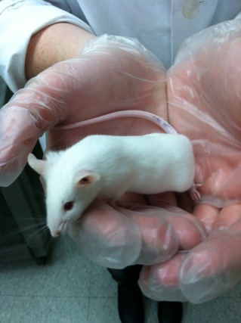
References
Contemporary Science, Values and Animal Subjects in Research, North Carolina State University
  http://ori.dhhs.gov/education/products/ncstate/index.htm

Slide 9
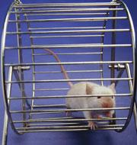
Part 2:
ANIMAL WELFARE MATTERS

Slide 10
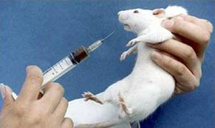
Seven principles for the care and use of animals used in testing, research, and training
The U.S. Interagency Research Animal Committee prepared seven principles for the care and use of animals used in testing, research, and training.
The committee's principal concerns are the conservation, care, and welfare of research animals.

Slide 11
Seven principles for the care and use of animals used in testing, research, and training
The transportation, care, and use of animals should be in accordance with the Animal Welfare Act and other applicable federal laws, guidelines, and policies.
Procedures involving animals should be designed and performed with due consideration of their relevance to human or animal health, the advancement of knowledge, or the good of society.

Slide 12
Seven principles for the care and use of animals used in testing, research, and training
The animals selected for a procedure should be of an appropriate species and quality and the minimum number required to obtain valid results. Methods such as mathematical models, computer simulation, and in vitro biological systems should be considered.
Proper use of animals, including the avoidance or minimization of discomfort, distress, and pain when consistent with sound scientific practices, is imperative. Unless the contrary is established, investigators should consider that procedures that cause pain or distress in human beings may cause pain or distress in other animals.

Slide 13
Seven principles for the care and use of animals used in testing, research, and training
Procedures with animals that may cause more than momentary or slight pain or distress should be performed with appropriate sedation, analgesia, or anesthesia. Surgical or other painful procedures should not be performed on unanesthetized animals paralyzed by chemical agents.
Animals that would otherwise suffer severe or chronic pain or distress that cannot be relieved should be painlessly killed at the end of the procedure or, if appropriate, during the procedure.

Slide 14
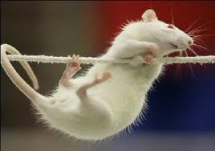
Seven principles for the care and use of animals used in testing, research, and training
The living conditions of animals should be appropriate for their species and contribute to their health and comfort. Normally, the housing, feeding, and care of all animals used for biomedical purposes must be directed by a veterinarian or other scientist trained and experienced in the proper care, handling, and use of the species being maintained or studied. In any case, veterinary care shall be provided.

Slide 15
The 3 R’s: an easy way to remember and apply the seven principles
Replacement - Animals may be used only if the investigator's best efforts to find a replacement by which to obtain the required information have failed.
Reduction - The fewest animals appropriate to provide valid information and statistical significance should be used.
Refinement - The most humane, least invasive techniques must be used with the goal of minimizing pain and/or distress.

Slide 16
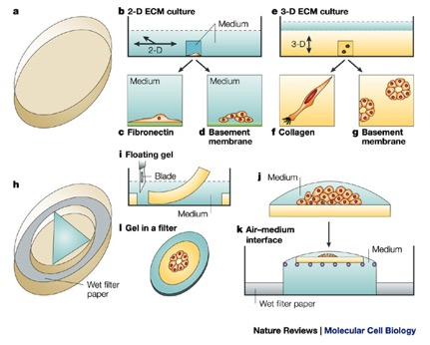
Replacement
Replacement, the first of the 3R's, is defined as the substitution for conscious living higher animals of insentient material. There are a number of alternative methods that can be used to replace the use of live animals in either all or part of a project. Replacement may be relative, where animals are still required to provide cells or tissue, but experiments are conducted in vitro:
      tissue culture
      perfused organs
      tissue slices
      cellular fractions
      subcellular fractions
These methods are well-suited to studies at the tissue, cellular or subcellular level and, in these circumstances, can be cost-effective and time-saving. They also provide a level of knowledge that complements studies in whole animals.

Slide 17

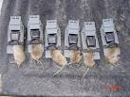
Reduction
The goal of reduction, the second of the 3R's, is to reduce the numbers of animals used to obtain information of a given amount and precision. To achieve this:
  studies are designed to be scientifically and statistically valid
  only the minimum numbers of animals are used
  studies should not be repeated unnecessarily.
  There are two important caveats:
    the principle of reduction of numbers of animals should not be applied at the expense of greater suffering to individual animals
    the number of animals used must satisfy statistical requirements - neither too few nor too many.
Remember - if reducing the numbers of animals makes it impossible to reach a valid conclusion from the experiment, this does NOT achieve the goal of Reduction. To proceed with such an experiment is inherently unethical.

Slide 18
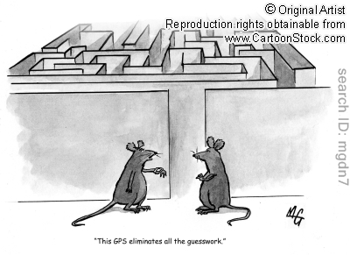
Refinement
The third of the 3R's – Refinement - is any decrease in the incidence or severity of 'inhumane' procedures applied to those animals that still have to be used.
There are two key issues:
1) To assess the impact of any procedure or condition on the well-being of the animal.
2) To develop strategies to eliminate or minimize that impact.

Slide 19
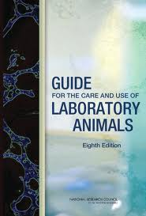
References
U.S. Department of Health and Human Services, Office of Extramural Research National Institutes of Health, Office of Laboratory Animal Welfare, Public Health Service Policy on Humane Care and Use of Laboratory Animals http://grants.nih.gov/grants/olaw/references/phspol.htm
Guide for the Care and Use of Laboratory Animals http://www.nap.edu/catalog.php?record_id=12910

Slide 20

Part 3:
THE
INSTITUTIONAL ANIMAL
CARE AND USE COMMITTEE (IACUC)

Slide 21
The IACUC
An Institutional Animal Care and Use Committee (IACUC) is required by federal law for all institutions that use animals in research, teaching, and testing.
The IACUC has a key oversight role, including the review and approval of animal use activities, and inspection of animal facilities.
Faculty, staff, and students are responsible for understanding and following the regulations, as well as institutional policies, governing animal care and use.

Slide 22
IACUC requirement
In 1985 the U.S. Congress passed two laws requiring an IACUC at institutions using animals:
  Health Research Extension Act
  Amendments to the Animal Welfare Act, which originally was created in 1966
Both laws led to statutory requirements for the composition and responsibilities of the IACUC.

Slide 23
IACUC membership requirements
An IACUC must include at least one of each:
  Veterinarian
  Practicing scientist experienced in research involving animals
  Non-scientist
  An individual who is not affiliated with the institution in any way other than as a member of the IACUC, and is not a member of the immediate family of a person who is affiliated with the institution

Slide 24
Required Functions of the IACUC
Review at least once every six months the institution's program for humane care and use of animals.
Inspect at least once every six months all of the institution's animal facilities.
Prepare reports of the IACUC evaluations and submit the reports to the Institutional Official (EWU President). If program or facility deficiencies are noted, the reports must contain a reasonable and specific plan and schedule for correcting each deficiency.
Review concerns involving the care and use of animals at the institution.
Make recommendations to the Institutional Official regarding any aspect of the institution's animal program, facilities, or personnel training.
Review and approve, require modifications in, or withhold approval of activities related to the care and use of animals.
Review and approve, require modifications in, or withhold approval of proposed significant changes regarding the use of animals in ongoing activities.
Be authorized to suspend an activity involving animals.

Slide 25
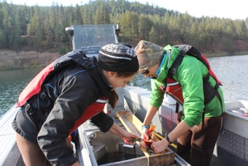
Resources for IACUCs
IACUC members have many resources available to help them, such as:
  Animal Welfare Act regulations http://www.aphis.usda.gov/animal_welfare/index.shtml
  Guide for the Care and Use of Laboratory Animals
  http://www.nap.edu/catalog.php?record_id=12910
  Public Health Service Policy for the Humane Care and Use of Laboratory Animals
  http://grants1.nih.gov/grants/olaw/references/phspol.htm
  The Report of the American Veterinary Medical Association Panel on Euthanasia provides guidelines on euthanasia methods http://www.avma.org/issues/animal_welfare/euthanasia.pdf

Slide 26

The IACUC at EWU
All vertebrate animals are covered.
Protocols are submitted and reviewed electronically.
A protocol is discussed at a convened IACUC meeting only if there are issues that cannot be resolved by electronic communication between IACUC members and investigators.
Investigators are notified of protocol approval by e-mail.
EWU IACUC members include three biology professors, one veterinarian, one representative of the EWU grants office, and one community representative.

Slide 27
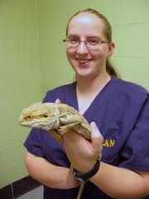
The veterinarian
Every IACUC must have a veterinarian.
At EWU, the vet has final approval authority for projects reviewed by the IACUC.
The vet is our expert on comparative medicine, that is, the biology and clinical medicine for each of the species that we use.
The vet is our expert on healthful living conditions for our animals.
The vet is our expert on diseases that occur in our animals - their recognition and treatment.

Slide 28
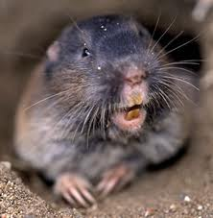
At EWU all projects using vertebrate animals must be approved by the IACUC before they can begin
Changes to a protocol must be approved by the IACUC before implementation
Projects lasting more than one year must be reviewed by the IACUC annually

Slide 29
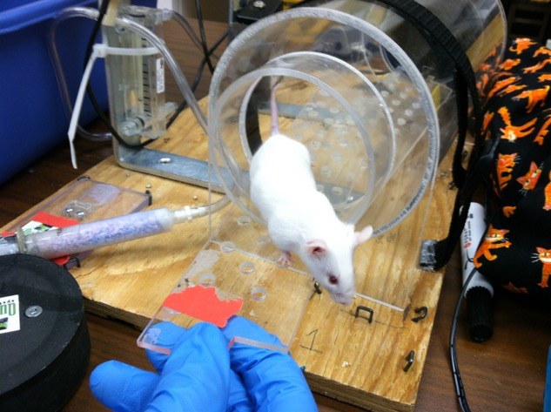
The EWU IACUC has the responsibility to:
Withhold approval of a project until it meets IACUC requirements
Suspend a project that violates IACUC rules or
performs procedures without IACUC approval

Slide 30
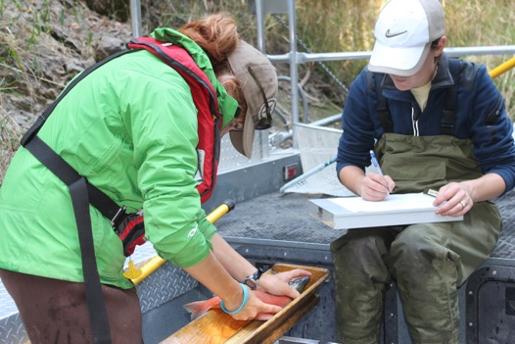
Working with the IACUC at EWU
Protocol review forms may be initiated only by faculty members
Protocol review forms are completed and submitted electronically
Write your protocol in language that can be understood by a non-scientist
Include all details that IACUC members need to know in order to understand exactly what will be experienced by the animals
Ask an IACUC member for help when needed

Slide 31
EWU IACUC review of protocols
IACUC members are required to consider the following when reviewing a protocol:
  The number of animals is sufficient to achieve the goal of the project, but not excessive
  The project is designed in a way that will provide fruitful results
  Pain and distress are minimized insofar as possible; occurrence of injury and infection is minimized; analgesics or anesthetics are used as necessary
  People handling animals are sufficiently trained to perform relevant procedures on animals

Slide 32
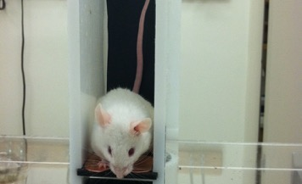
Review of concerns about animal care and use
One responsibility of an IACUC is to review concerns about animal care and use.
Anyone can submit a complaint about the way animals are used or cared for at EWU.
No individual may be discriminated against or be subject to any reprisal for reporting violations of any regulations or standards.
Reports of problems may be anonymous.
Complaints may be submitted to the EWU President, EWU veterinarian, or any EWU IACUC member. Contact information for these people is posted on the EWU vivarium bulletin board.

Slide 33
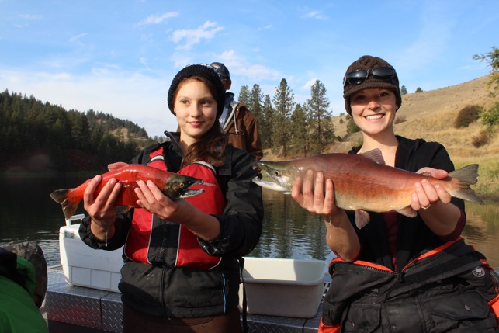
References
Contemporary Science, Values and Animal Subjects in Research, North Carolina State University http://ori.dhhs.gov/education/products/ncstate/index.htm

