Slide 1
Sampling Bird and Mammal Populations in the Field
EWU IACUC

Slide 2
Permits

Slide 3
Sampling bird and mammal populations
PERMITS
Federal
  Capture of any migratory bird requires a permit from the US Fish and Wildlife Service.
  To be issued a permit for mist-netting birds requires demonstration of proficiency and an application to the US Fish and Wildlife Service
  Any research conducted on a national wildlife refuge (e.g. Turnbull National Wildlife Refuge) requires a special use permit; permit holder must file report with refuge at end of study
Permits should be obtained by instructor

Slide 4
Sampling bird and mammal populations
PERMITS
  State – To trap birds and mammals in Washington, Department of Fish and Wildlife requires an annual scientific collecting permit. The permit specifies location of trapping and animals to be collected; must file report.
Landowner permission – if private land; best to get in writing.

Slide 5
Birds

Slide 6
Capturing Birds – not feasible for most class projects
Permits from US Fish and Wildlife Service for any migratory bird species is mandatory
Permits from State Department of Fish and Wildlife necessary for “game” birds
Notes:
MIST NETS; SNARES, DRIVE NETS (mammals); GILL NETS (fish); STICKY BOARDS (insects) LEG HOLD AND SNAP TRAPS (mammals)
Have knowledge to be able to target correct organism

Slide 7
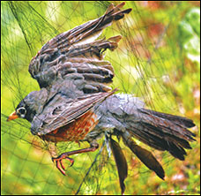
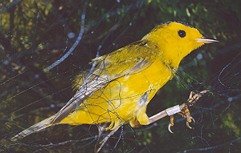
Capturing Birds – not feasible for most class projects
Mist nets – thin nets strung between poles where birds fly – monitor continually
Birds banded (numbered ring around leg) for future identification
Information on species, sex, age, reproductive condition
Notes:
MIST NETS; SNARES, DRIVE NETS (mammals); GILL NETS (fish); STICKY BOARDS (insects) LEG HOLD AND SNAP TRAPS (mammals)
Have knowledge to be able to target correct organism

Slide 8
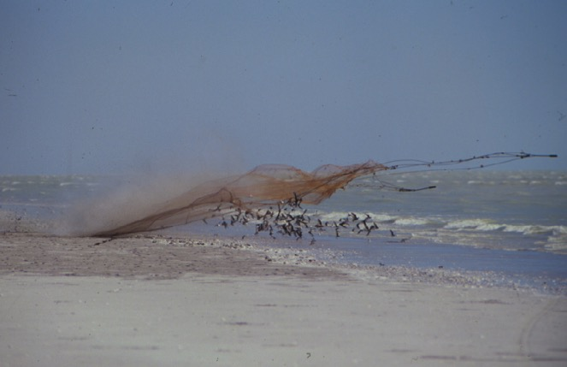
Capturing Birds – not feasible for most class projects
Cannon nets – often bait birds so that they congregate
Larger birds than in mist nets
Notes:
MIST NETS; SNARES, DRIVE NETS (mammals); GILL NETS (fish); STICKY BOARDS (insects) LEG HOLD AND SNAP TRAPS (mammals)
Have knowledge to be able to target correct organism

Slide 9
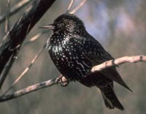
Capturing Birds – not feasible for most class projects
Toxicants:
  Lethal
  Used to collect large numbers of “nuisance birds”
  Need permits
  Not recommended for any student project

Slide 10
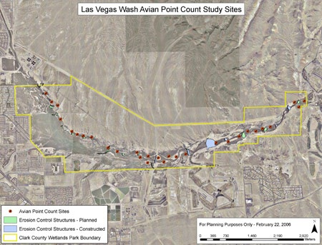
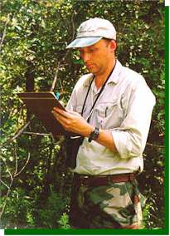
Observational Approaches – recommended for student projects
Point count surveys:
Observer counts all birds seen or heard at designated locations during breeding season
Yields species richness and an index of abundance

Slide 11
Observational Approaches – recommended for student projects
Spot mapping:
Observer maps individual bird (usually male) territories during breeding season
Yields species richness and density

Slide 12
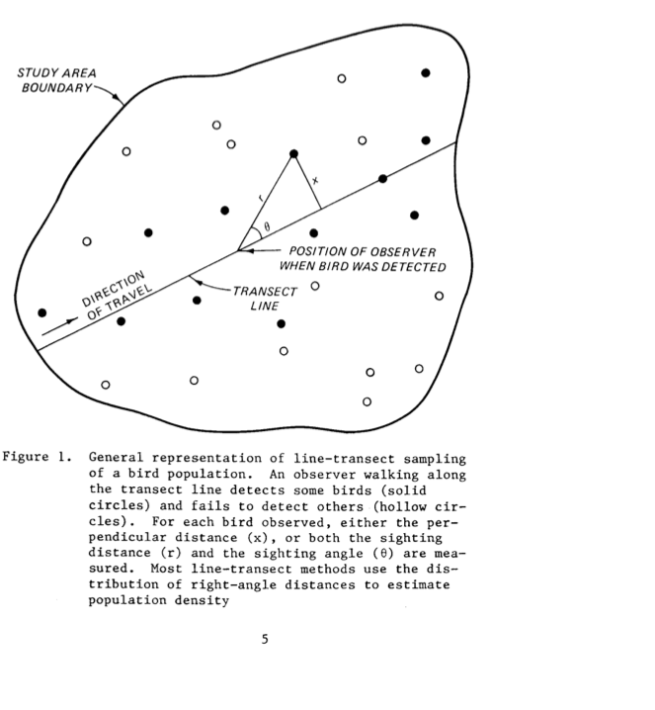
Observational Approaches – recommended for student projects
Line transect:
Observer walks designated route and counts birds encountered
Yields species richness and density estimate
http://el.erdc.usace.army.mil/elpubs/pdf/EL87_5.pdf

Slide 13
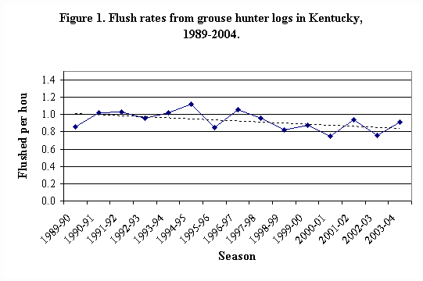
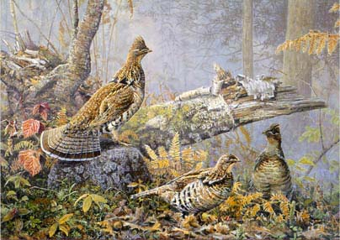
Observational Approaches – recommended for student projects
Line transect:
Observer walks designated route and counts birds encountered
Yields species richness and density estimate

Slide 14
Mammals

Slide 15
Capturing Mammals
Special Use Permits from US Fish and Wildlife Service if working on national wildlife refuge
Permits from State Department of Fish and Wildlife necessary for all small mammal trapping; allow 2 months; $117 annual fee
Permits should be obtained by instructor
Notes:
MIST NETS; SNARES, DRIVE NETS (mammals); GILL NETS (fish); STICKY BOARDS (insects) LEG HOLD AND SNAP TRAPS (mammals)
Have knowledge to be able to target correct organism

Slide 16
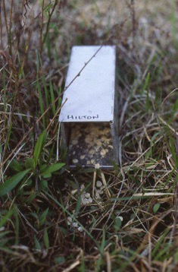
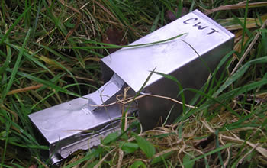
Live capturing small mammals – can be feasible and effective for class projects
Provide sufficient bait and bedding (polyester batting) in trap
Cover trap with tar paper if rainy or hot
Check often (2x per day; more if cold or hot – close during day if really hot)
Clean soiled traps
Sherman live trap
Longworth live trap
Notes:
PIT FALL TRAPS, FISH HOOPS, CULVERT TRAPS, CORRAL TRAPS, BOX TRAPS, FUNNEL TRAPS

Slide 17
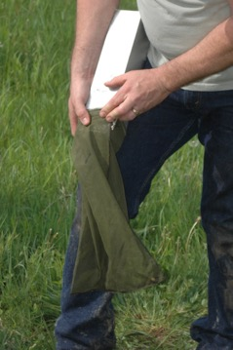
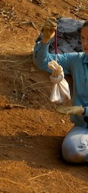
Live capturing small mammals – can be feasible and effective for class projects
Handling:
Remove animal from trap; depending upon species:
  Gently shake animal into bag or bucket
  Reach in and pull out (use gloves)
  Identify, weigh, examine for sex and reproductive condition (external)
Instructor should provide training
Notes:
PIT FALL TRAPS, FISH HOOPS, CULVERT TRAPS, CORRAL TRAPS, BOX TRAPS, FUNNEL TRAPS

Slide 18
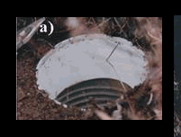
Kill trapping small mammals – can be feasible and effective for class projects
Pitfall Traps
Two No. 10 cans, bottom of one removed, taped together with margarine tub as collar.
Set in ground
Fill with water
Cover so non-target species are less likely to enter
Pitfall trap
Notes:
PIT FALL TRAPS, FISH HOOPS, CULVERT TRAPS, CORRAL TRAPS, BOX TRAPS, FUNNEL TRAPS

Slide 19
Kill trapping small mammals – can be feasible and effective for class projects
Pitfall Traps
Fill with water, if amphibians likely to be trapped as well
Fill with 70% ethanol if only small mammals will be trapped
Cover so non-target species are less likely to enter
Check regularly
Pitfall trap
Notes:
PIT FALL TRAPS, FISH HOOPS, CULVERT TRAPS, CORRAL TRAPS, BOX TRAPS, FUNNEL TRAPS

Slide 20
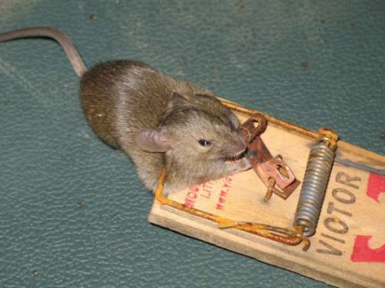
Kill trapping small mammals – can be feasible and effective for class projects
Break-back traps, must be set correctly to quickly break vertebrae (equivalent to cervical dislocation)
Check regularly
Provides information on species identification and, when specimens are autopsied, accurate reproductive condition (e.g., placental scars → past reproduction)
Wash traps before storing for future use
Break-back mouse/rat trap
Notes:
PIT FALL TRAPS, FISH HOOPS, CULVERT TRAPS, CORRAL TRAPS, BOX TRAPS, FUNNEL TRAPS

Slide 21
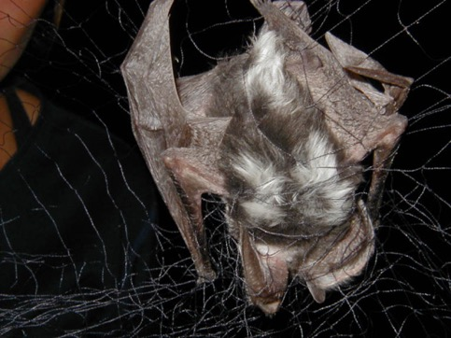
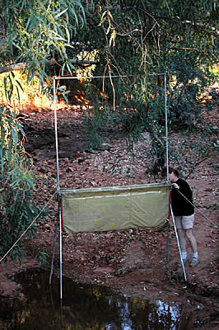
Live capturing bats
Mist Nets
Harp Traps
Both must be monitored continually while nets are set up
Anyone handling bats should have rabies vaccination
Notes:
MIST NETS; SNARES, DRIVE NETS (mammals); GILL NETS (fish); STICKY BOARDS (insects) LEG HOLD AND SNAP TRAPS (mammals)
Have knowledge to be able to target correct organism

Slide 22
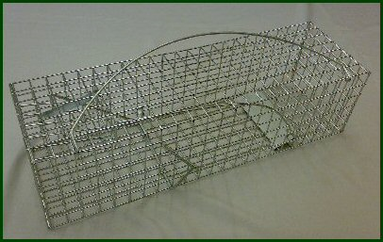
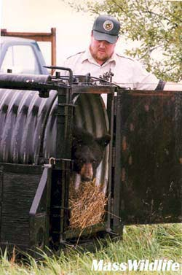
Capturing medium to large mammals – not as feasible for class projects
Tomahawk trap –
larger rodents, small carnivores
Culvert trap for bears
Notes:
PIT FALL TRAPS, FISH HOOPS, CULVERT TRAPS, CORRAL TRAPS, BOX TRAPS, FUNNEL TRAPS

Slide 23
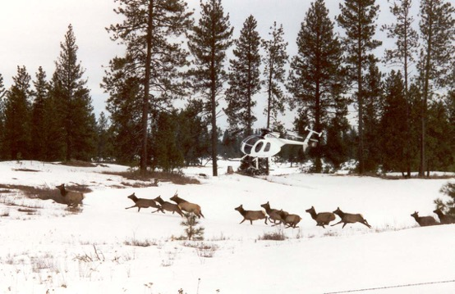
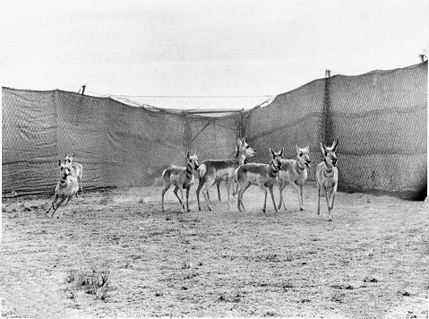
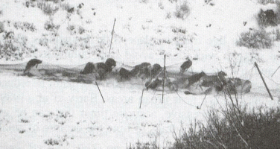
Live capturing large mammals – not feasible for class projects
Net guns for ungulates
Corral trap for ungulates
Cannon nets for ungulates
Notes:
PIT FALL TRAPS, FISH HOOPS, CULVERT TRAPS, CORRAL TRAPS, BOX TRAPS, FUNNEL TRAPS

Slide 24
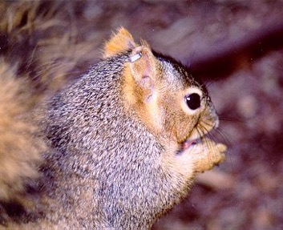
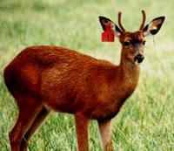
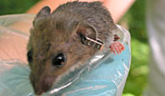
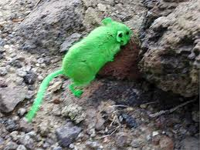
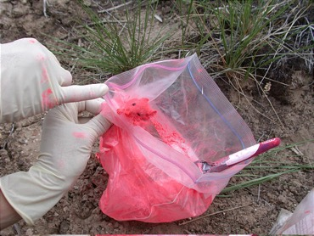
Marking mammals
Numbered ear tags – need tags and pliers to attach (= ear piercing)
Fluorescent dye – short term; can be used with black light at night to follow movements

Slide 25
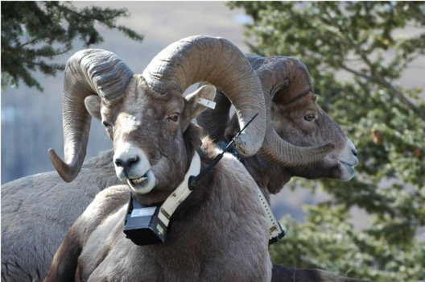
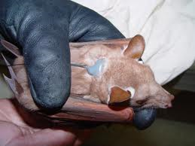
Marking mammals
Radio collars: expensive, but if other agency has collared animals, tracking can be effective for class projects

Slide 26
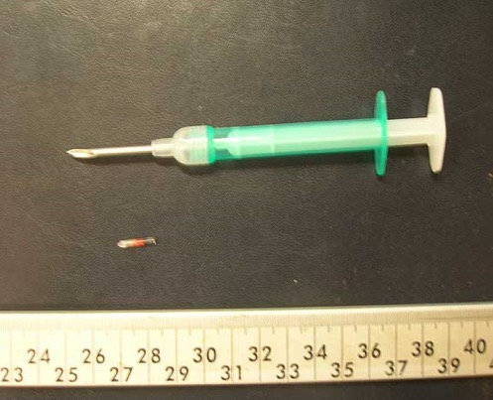
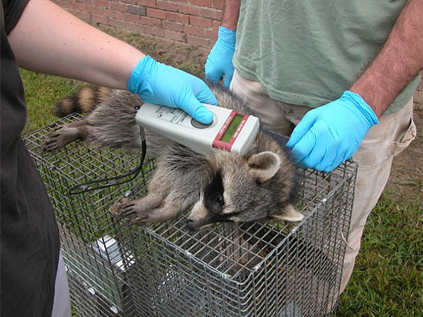
Marking mammals
PIT Tags (Passive Integrated Transponders)
  Tag injected subcutaneously with syringe
  PIT tag reader required
  Animal must be captured or consistently pass through small opening (e.g. burrow opening, exit hole of nest box) to use reader

Slide 27
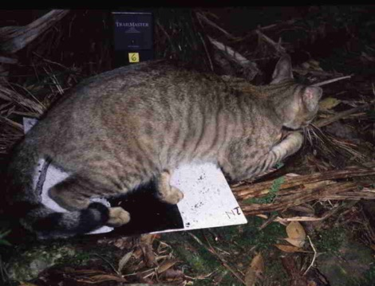
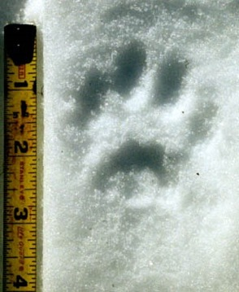
Noncapture sampling
Tracks:
Track plates placed where animals likely to go
Establish transects during winter and monitor for tracks
Notes:
Track Plates = monitoring feral cat
Snow tracking = bobcat track

Slide 28
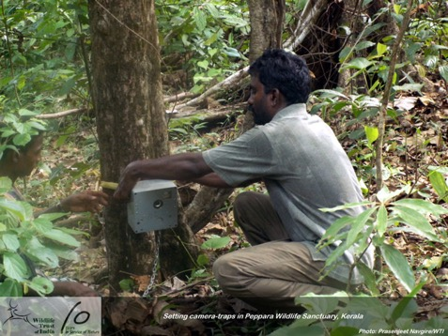
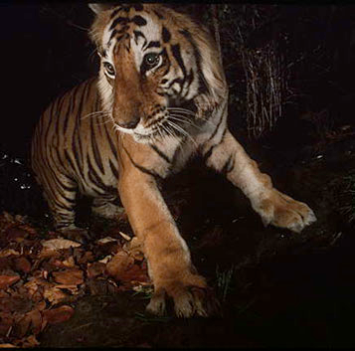
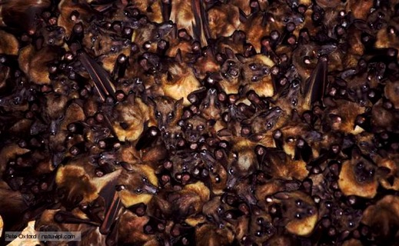
Noncapture sampling
Camera “trapping”

Slide 29
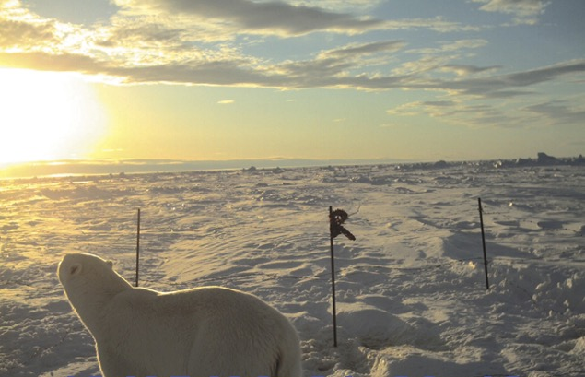
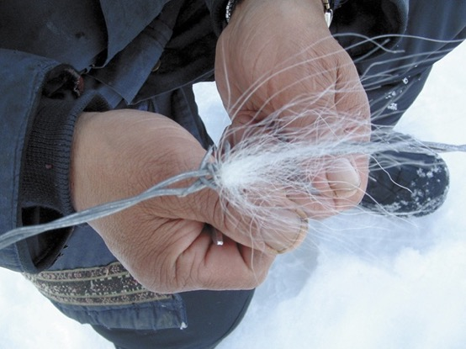
Noncapture sampling
Hair “traps”:
  Can identify hair to species
  Can extract DNA

Slide 30

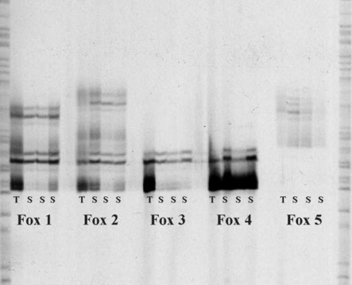
Noncapture sampling
Scat analysis:
Establish transects, remove all pellets, monitor transects at designated intervals
Collect scat for DNA analysis

Slide 31

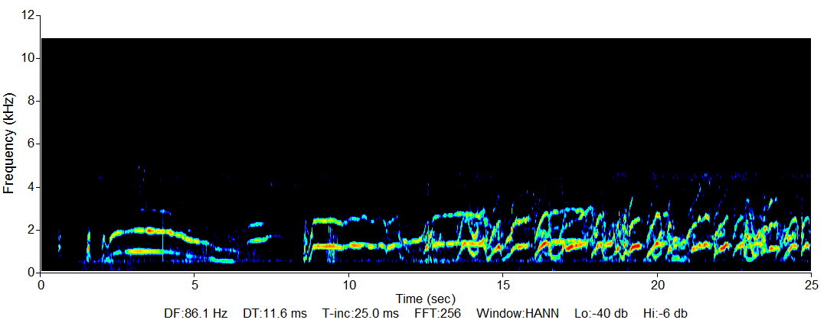
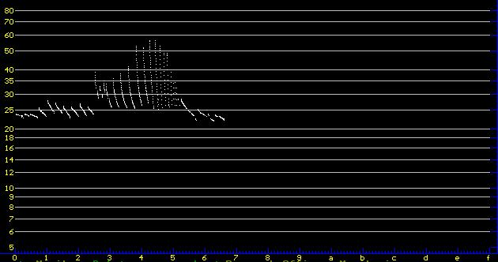
Noncapture sampling
Acoustical sampling:
Place species-specific recording devises at designated locations for consistent periods of time
Requires computer software to analyze

Slide 32
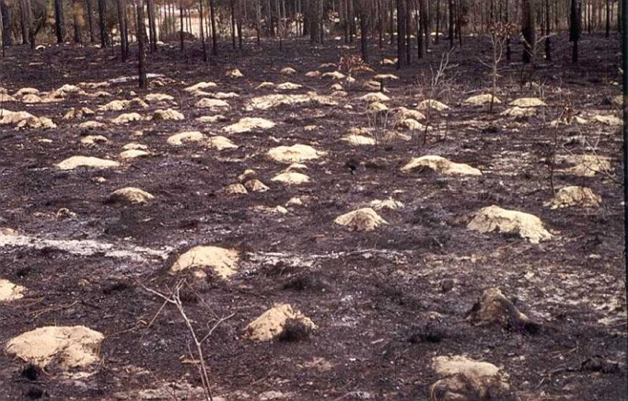
Noncapture sampling
Counting burrows and dens
Notes:
INFO = den # family
Mounds = number per individual
Pellets #/day/animal # days since pellets dropped

Slide 33
Reference:
Guidelines of the American Society of Mammalogists for the use of wild mammals in research
Robert S. Sikes, William L. Gannon, and THE ANIMAL CARE AND USE COMMITTEE OF THE AMERICAN SOCIETY OF MAMMALOGISTS
Journal of Mammalogy 92:235-253, 2011
Notes:
MIST NETS; SNARES, DRIVE NETS (mammals); GILL NETS (fish); STICKY BOARDS (insects) LEG HOLD AND SNAP TRAPS (mammals)
Have knowledge to be able to target correct organism

