Slide 1
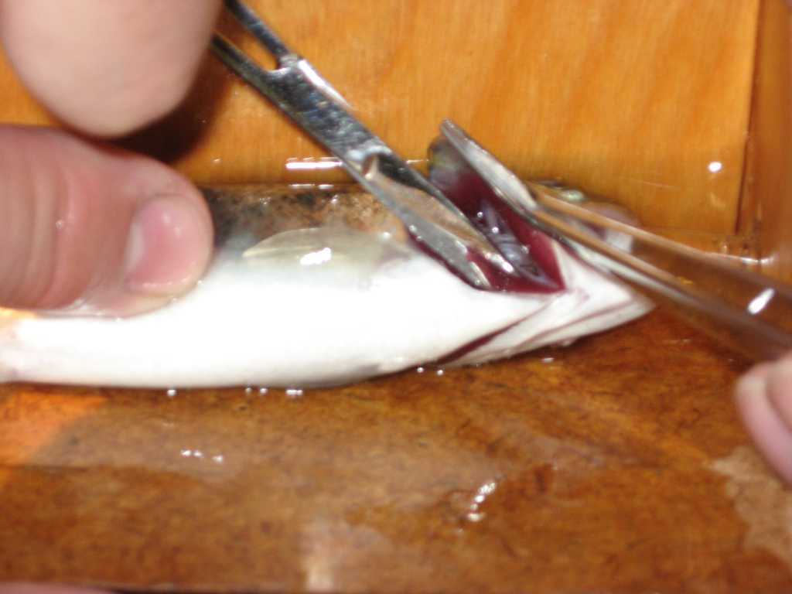
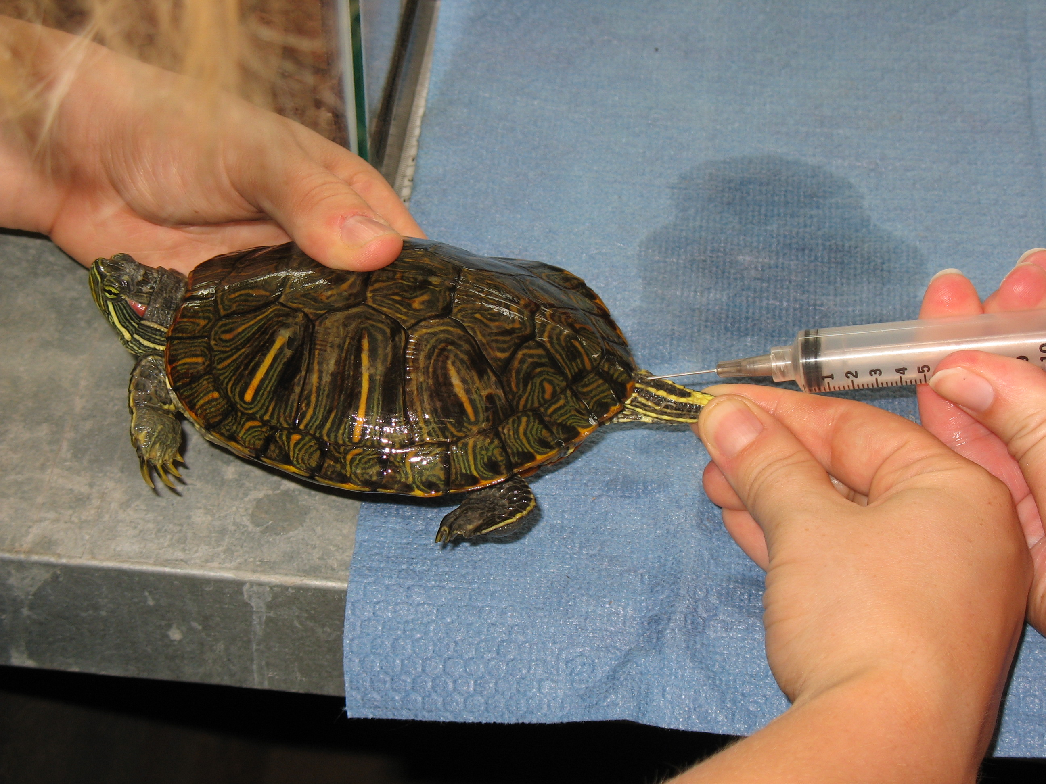
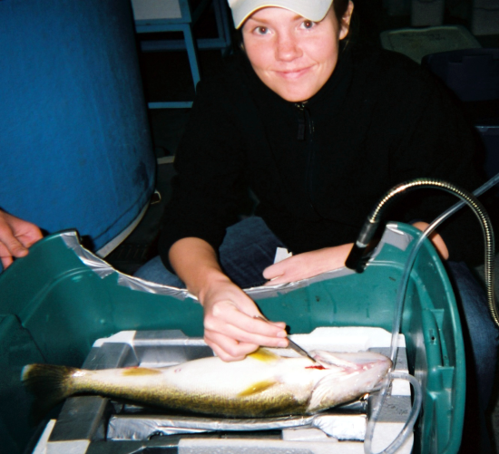
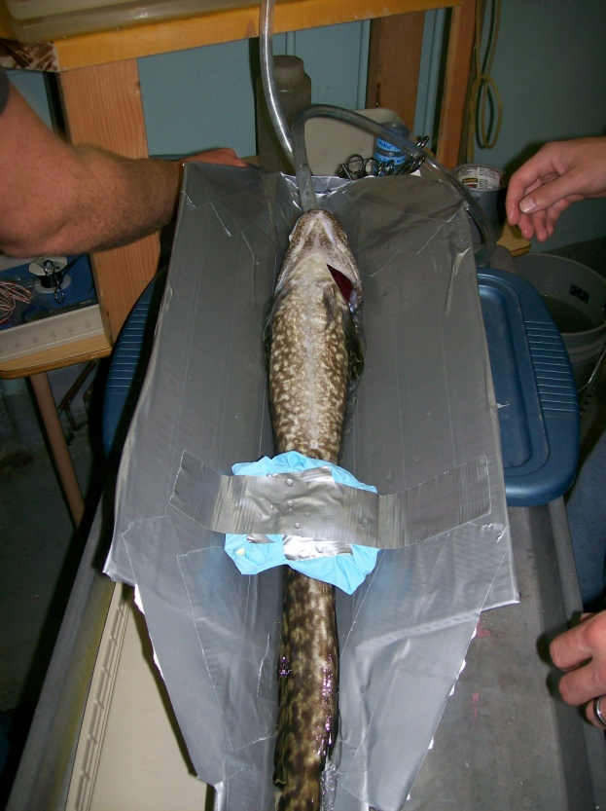
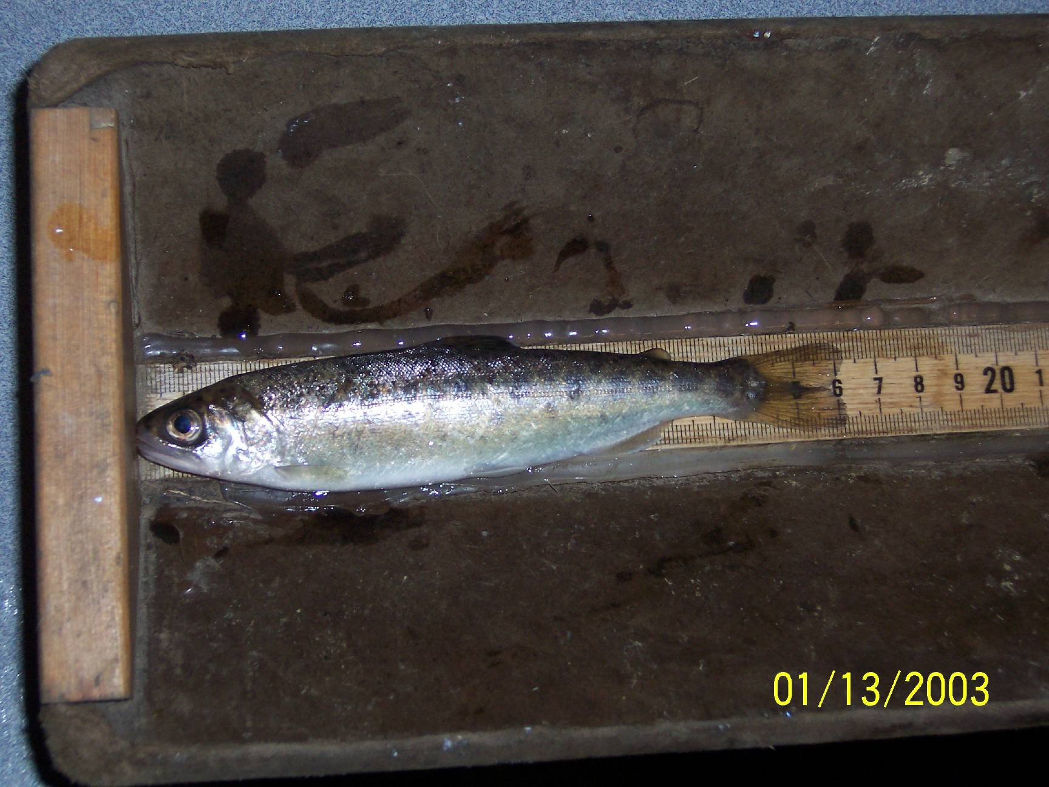
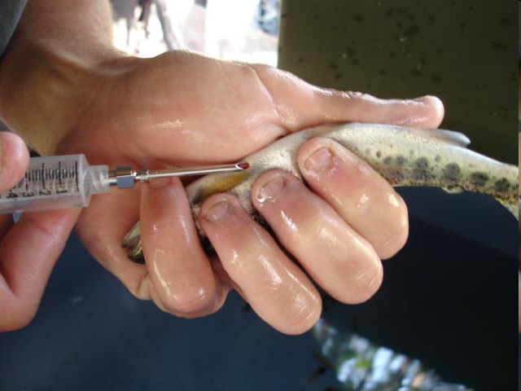
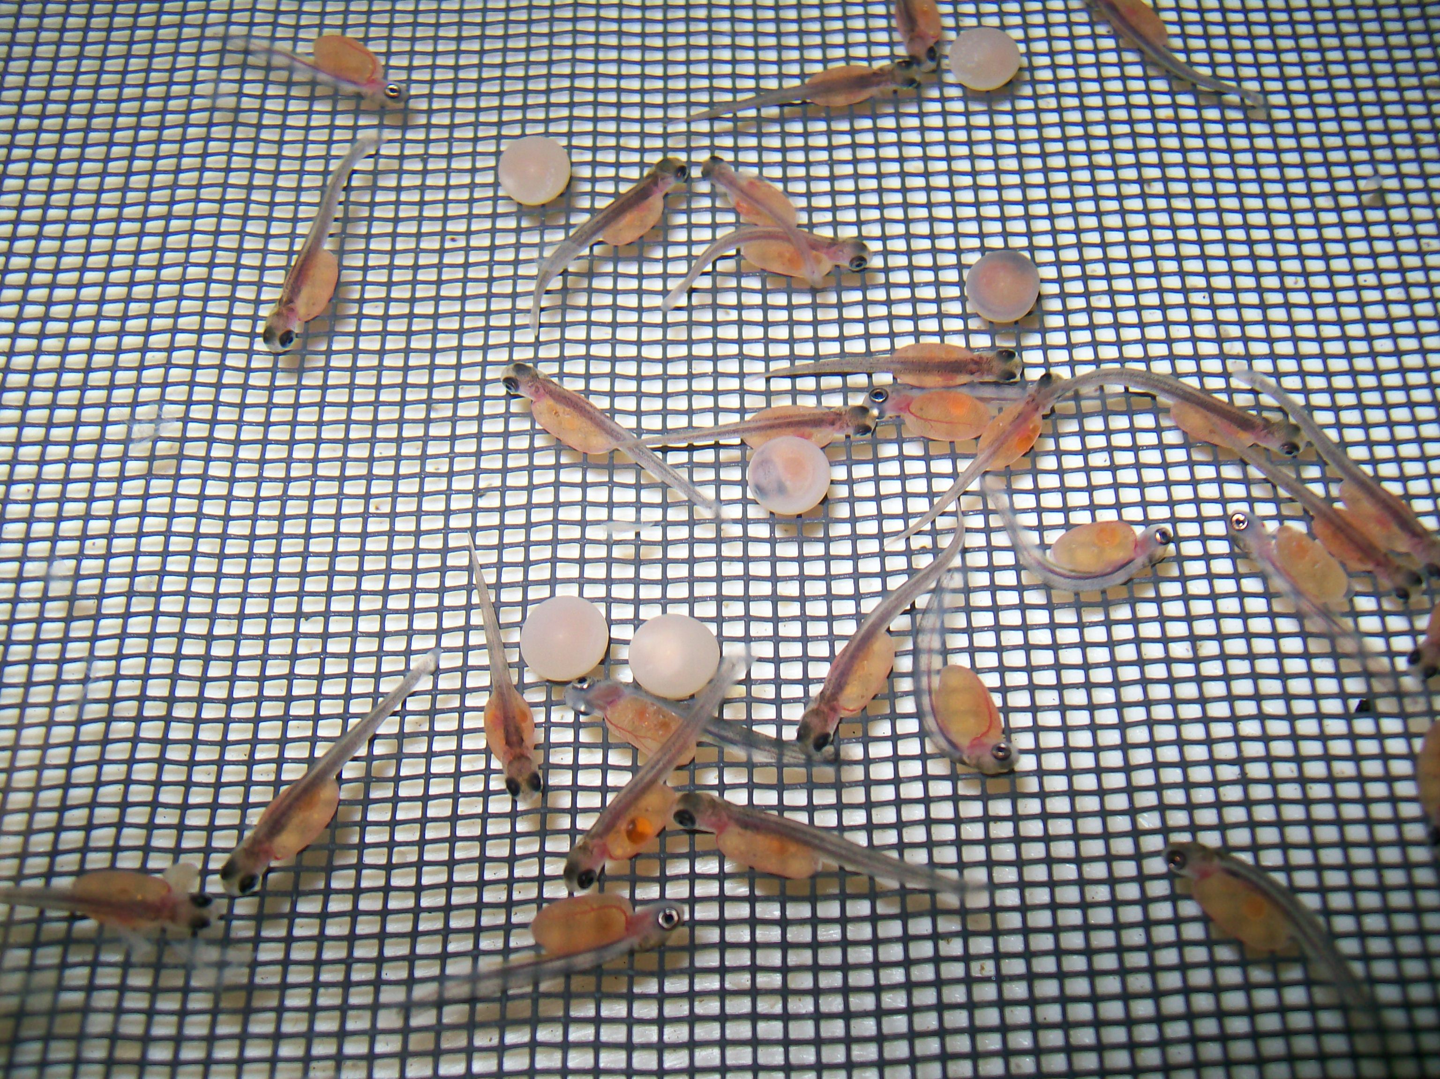
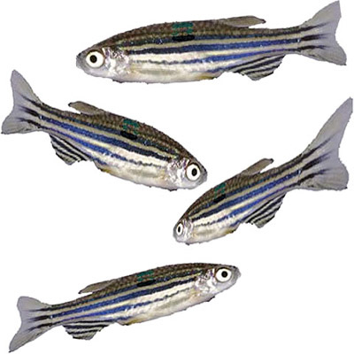
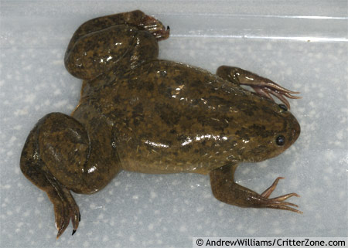
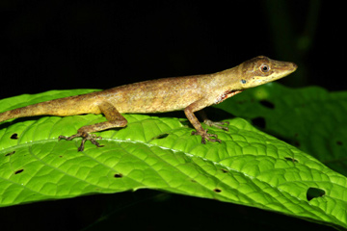
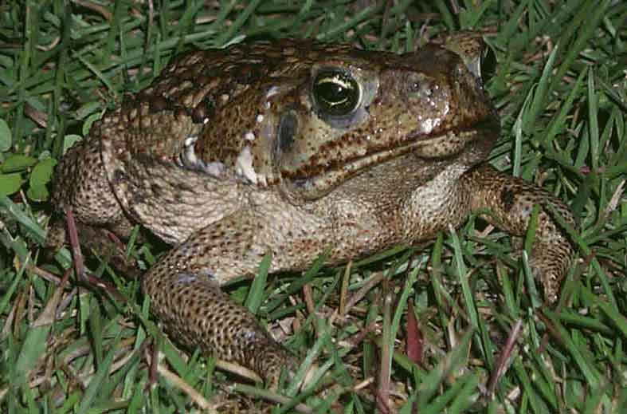
Ectothermic Vertebrates In Research Projects
Care and Use of
Fish, Amphibians and Reptiles at
Eastern Washington University

Slide 2
Care and Use of Fish, Amphibians and Reptiles at Eastern Washington University
Introduction:
Rodents, non-human primates, dogs, cats, and farm animals have long been the preferred animal models in biomedical research.
Their behavioral repertoire and physiological responses to stimuli are more similar to human systems than are those of lower organisms.

Slide 3
Care and Use of Fish, Amphibians and Reptiles at Eastern Washington University
Introduction:
As reptiles, amphibians, and fish become better understood in the field and laboratory, their advantages as alternative animal models are being revealed.
Collectively, this group can be referred to as ectothermic vertebrates.
In contrast to mammals and birds that are endothermic (their body temperature is regulated and maintained internally), reptiles, amphibians, and fish are ectothermic with body temperature primarily regulated by ambient temperatures.
Since metabolism is driven by body temperature, the rate of normal body functions in these species may be artificially increased or decreased.
Thus endocrine, immunological, inflammation, cell physiology, and many other pathways can be easily manipulated.

Slide 4
Care and Use of Fish, Amphibians and Reptiles at Eastern Washington University
Introduction:
While there are about 5,400 known species of mammals, there are over 6,000 species of amphibians, 8,000 species of reptiles, and more than 20,000 species of fish.
Such diversity allows for a wide range of research on specific organs, tissues, and systems that are similar in function, but often less complex than in mammals.
A great number of investigators are also interested in the specific adaptations of these organisms, both anatomical and physiological, to their own unique environments.
Some people simply find that working with ectothermic vertebrates is less objectionable than working with mammals.
Regardless of the motivation, thousands of investigators commonly use ectothermic vertebrates in research.

Slide 5
Care and Use of Fish, Amphibians and Reptiles at Eastern Washington University
Introduction:
For example:
Due to differential rates of ova maturation and numbers of gametes produced, elasmobranchs (sharks, skates, rays) are used to study fetal nutrition and toxicology as well as gametogenesis.
The monkfish is an important insulin resource for researchers since it contains 20 to 40 times more insulin-producing tissue than the laboratory rat.
The zebrafish is another very common research model in fishes and is utilized in hundreds of laboratories in the United States for studies of vertebrate development and gene function and has allowed advances in the fields of developmental biology, oncology, toxicology, reproductive studies, teratology, genetics, neurobiology, environmental sciences, stem cell and regenerative medicine, and evolutionary theory.

Slide 6
Care and Use of Fish, Amphibians and Reptiles at Eastern Washington University
Introduction:
Reptiles and amphibians contribute to studies in genetics, embryology, developmental biology, ethology, endocrinology, and immunology.
Salamanders and newts are models for limb regeneration.
Fetal heart cells of the axolotl (Mexican salamander) will divide and beat in vitro.
Frogs have played a major role in the development of communication theory.
The African clawed frog (Xenopus sp.) is one of the most common amphibian model systems for gene and protein expression, with large oocytes that are easy to culture and use in experiments.
The common anole lizard is used in behavioral studies and can be induced to produce the symptoms of Parkinson's disease or to model the effects of malaria.
Typical reptile and amphibian studies include aggression, stress physiology, reproductive cycles and dysfunction, and the effects of neurotoxins.
Perhaps the most exciting aspect of working with ectothermic vertebrates is how much of their function is still unknown, allowing for more novel and groundbreaking experiments.

Slide 7
Care and Use of Fish, Amphibians and Reptiles at Eastern Washington University
Laboratory Use:
A major concern to those who might use these species is the necessity of providing a suitable laboratory environment.
Unlike mammals and birds, reptiles, amphibians, fish, and cephalopods require very specific microenvironments.

Slide 8
Care and Use of Fish, Amphibians and Reptiles at Eastern Washington University
Laboratory Use:
For reptiles and amphibians, basking sites, water source and water temperature, relative humidity, photoperiod and type of lighting, ambient temperature, group density, cover, method of food preparation and presentation are all factors that influence whether or not the animals will function normally in the laboratory.
Fish and cephalopods live in a totally aqueous environment. Type of water (fresh, salt, brackish), pH, salinity, school density, cover, dissolved oxygen, lighting, and filtration are necessary considerations that require monitoring.
The animals’ needs are often species-specific and failure to meet them results in stress-induced diseases, low growth rate, poor feed efficiency, cannibalism, and failure to reproduce.

Slide 9
Care and Use of Fish, Amphibians and Reptiles at Eastern Washington University
Laboratory Use:
This means that you will probably need to research the specific needs of your species of interest.
The following sections give you some general information on things to be aware of and a list of our available resources.

Slide 10
Care and Use of Fish, Amphibians and Reptiles at Eastern Washington University
Major Considerations for Fish:
Water: Fresh and clean water is obviously necessary. Our well water is chlorinated so tap water must be allowed to dechlorinate overnight (bubbling can speed this process). Alternatively, artificial water conditioners (available at local fish supply stores) can be used if immediate use is necessary.
If using tanks, you should be prepared to change out part of the water on a regular basis or use filtration methods.
Avoid plants, gravels, and accessories that could provide places for bacteria to grow.

Slide 11
Care and Use of Fish, Amphibians and Reptiles at Eastern Washington University
Major Considerations for Fish:
Oxygen: Water must be bubbled continuously to supply oxygen to the animals.
Bubblers are available for all fish holding facilities.

Slide 12
Care and Use of Fish, Amphibians and Reptiles at Eastern Washington University
Major Considerations for Fish:
Density: Obviously common sense can tell you when there are too many fish in a tank, but common aquarium guidelines assume less than one inch of fish per gallon of water.
Attempt to keep your densities well below this and sacrifice sample size if necessary to ensure adequate density.

Slide 13
Care and Use of Fish, Amphibians and Reptiles at Eastern Washington University
Major Considerations for Fish:
Temperature: This is a critical factor to be considered as it affects all functions in ectothermic vertebrates.
Warmer temperatures are not tolerable to many fish and colder temperatures are not tolerable for others.
Research your animals for the appropriate temperature.
Obviously, room temperature (about 18˚C) is the easiest to maintain, but heating coils are available and easily obtained and cooling equipment (more difficult) can be arranged if necessary.
Fish must not be forced to face large fluctuations in water temperature and must be allowed to acclimate to a new temperature before they can be considered as stabilized and experimentation can begin.
Generally a change greater than 1˚C per day is considered excessive.

Slide 14
Care and Use of Fish, Amphibians and Reptiles at Eastern Washington University
Major Considerations for Fish:
Photoperiod: Keeping any animal on a stable photoperiod is critical to any experimentation and fish are no exception.
There are several rooms in the Science Building that have a maintained (or adjustable) photoperiod.

Slide 15
Care and Use of Fish, Amphibians and Reptiles at Eastern Washington University
Aquatic Housing Facilities:
The availability of these facilities must be established in advance before plans are made to use them.
Each type of tank system is unique and individuals using these facilities must be trained by their supervisor before they will be allowed to use the facilities.
The first and only rule to remember is: Don’t touch anything you haven’t been trained to use.

Slide 16
Care and Use of Fish, Amphibians and Reptiles at Eastern Washington University
Aquatic Housing Facilities:
Fish tanks: We have acquired a large collection of fish tanks for use in student projects, primarily 10-20 gallon tanks.
Multiple tanks can be used and are appropriate for experimental designs where different groups are subject to different conditions.
These tanks can be set up wherever appropriate though you should consider the lighting conditions (see above).
Fish tanks are also appropriate for housing reptiles or amphibians.

Slide 17
Care and Use of Fish, Amphibians and Reptiles at Eastern Washington University
Aquatic Housing Facilities:
The large fish holding facility consists of eight 300-gallon circular flow-through holding tanks (150 cm diameter and 76 cm deep) that are on two separate circuits with temperature control and biological filtration ongoing.
Aeration bubblers are available in each of the tanks.
The temperature of each circuit (4 tanks) can be heated or cooled independently but all four tanks on each circuit are at the same temperature.

Slide 18
Care and Use of Fish, Amphibians and Reptiles at Eastern Washington University
Aquatic Housing Facilities:
Two tank rack systems are available.
One rack consists of smaller tanks (30 x 3 - 6 L) and is used for fish only.
The other rack can be used for fish or amphibians (18 x 16 – 30 L).
Each tank has a flow through waste removal system that must be plumbed to the large fish holding facility or to living streams.

Slide 19
Care and Use of Fish, Amphibians and Reptiles at Eastern Washington University
Aquatic Housing Facilities:
The department has numerous 130 gallon Living Stream® aquaria equipped with charcoal filtration.
Many of these have chilling units to decrease water temperature and heating coils that can elevate water temperature.
Several can be subdivided into smaller compartments.

Slide 20
Care and Use of Fish, Amphibians and Reptiles at Eastern Washington University
Euthanasia:
Ensure that all individuals responsible for euthanasia:
  a. Receive appropriate training to perform the procedure.
  b. Adhere to IACUC-approved protocols and institutional policies.
  c. Are knowledgeable in species differences in their metabolism, respiration, and tolerance to cerebral hypoxia. Euthanasia of ectothermic animals must take into account these differences as it is often more difficult to ascertain in these species when an animal is dead.

Slide 21
Care and Use of Fish, Amphibians and Reptiles at Eastern Washington University
Euthanasia:
All fishes and amphibians at EWU should be euthanized by a two-step method:
Tricaine methane sulfonate (MS-222) may be administered by various routes to euthanize. For fish, this chemical may be placed in water (80 mg/L). Large fish may be removed from the water, a gill cover lifted, and a concentrated solution from a syringe flushed over the gills. Amphibians may be placed in a shallow concentrated solution (400 mg/L), but must be left there for up to an hour to obtain complete anesthesia.
Follow this with a physical method of euthanasia to ensure death. Fish may be struck over the head (cranial concussion or stunning) followed by spinal transection directly behind the head. Amphibians should be doubly-pithed following anesthesia. Pithing requires dexterity and skill and should only be done by trained personnel. The pithing site in frogs is the foramen magnum, and it is identified by a slight midline skin depression posterior to the eyes with the neck flexed.

Slide 22
Care and Use of Fish, Amphibians and Reptiles at Eastern Washington University
Euthanasia:
Other Acceptable Methods:
For reptiles, Sodium pentobarbital (60 to 100 mg/kg of body weight) can be administered by intravenous or intraperitoneal injection in most species.
Subcutaneous lymph spaces may be used in frogs and toads.
Time to effect may be variable, with death occurring in up to 30 minutes.
Barbiturates other than pentobarbital can cause pain on injection.
This is the most appropriate method for reptiles and can be followed by blunt trauma to the head and decapitation.

Slide 23
Care and Use of Fish, Amphibians and Reptiles at Eastern Washington University
Euthanasia:
Other Acceptable Methods:
Amphibians, reptiles, and fish may be euthanized with CO₂.
Loss of consciousness develops rapidly, but exposure times required for euthanasia are prolonged.
This technique is more effective in active species and those with less tendency to hold their breath. These include lizards, snakes, and fish.
Many reptiles and amphibians, including chelonians, are capable of holding their breath and converting to anaerobic metabolism, and can survive long periods of anoxia (up to 27 hours for some species). Because of this ability to tolerate anoxia, induction of anesthesia and time to loss of consciousness may be greatly prolonged when inhalants are used. Death in these species may not occur even after prolonged inhalant exposure.

Slide 24
Care and Use of Fish, Amphibians and Reptiles at Eastern Washington University
Disease and Distress in Fish:
Fish ailments can be separated into 4 general types:
Bacterial Diseases: Bacterial diseases are usually characterized by red streaks or spots and/or swelling of the abdomen or eye. These are best treated by antibiotics such as penicillin, amoxicillin, or erythromycin. Consider the negative effect of antibiotics in our environment by minimizing immediate flushing of these compounds within water to the sewage system
Fungal Diseases: Common fungal infections often look like gray or white fluffy patches. Commercial antifungals are available.
Parasitic Diseases: The most common parasitic disease is called "Ich". This disease and other parasites can be treated with antiparasitics that contain copper as an ingredient.
Physical Ailments: Physical ailments, including actual pain felt by the animal, are often the result of the environment. Poor quality water conditions can lead to fish gasping, not eating, jumping out of the tank, and more. Crowding and mixing of species or fish of dramatically different sizes can result in damaged fins and other bite wounds.
Treatment: Any specific treatment you choose to use to address a problem with your fish(es) needs to be researched and presented to your supervisor before proceeding.

Slide 25
Care and Use of Fish, Amphibians and Reptiles at Eastern Washington University
Minimization of Disease and Damage to Fish:
Quarantine new fish before adding them to healthy fish already in the aquarium. A hospital tank can be used for this.
Avoid stressing the fish with rough handling, sudden changes in conditions, or "bully" tankmates.
Provide a shaded refuge where fish can feel “safe.”
Don't overfeed your fish and remove any excess/uneaten food from the tanks.
Remove sick fish to a hospital tank for treatment.
Disinfect nets used to move sick fish.
Don't transfer water from the quarantine tank to the main aquarium.
Don't let any metal come in contact with the aquarium water.

Slide 26
References
AVMA Guidelines on Euthanasia, 2007.
  http://www.avma.org/issues/animal_welfare/euthanasia.pdf
Guidelines for the Use of Fishes in Research, 2004, American Fisheries Society.
Laboratory Animals: Recommendations for euthanasia of experimental animals. Royal Society of Medicine Press, London, U.K. 1996.

