Slide 1
Strategic Resource Allocation – Town Hall
Data Walkthrough & Discussion
Jake Morrison: Interim Executive Director – Institutional Effectiveness
Toni Habegger: Associate Vice President – Chief Financial Officer
Admir Djulovic: Manager – Data Analytics
SRA Town Hall - 04/25/2023

Slide 2
Contents
Process Overview
Sources of Data
Template Walk-through
  History, Development, and Expectations
    Program Provided Data
  External Demand
  Internal Demand
  Quality Inputs and Processes
  Quality Outcomes
  Size, Scope, and Productivity
  Financial Data
  Impact, Justification, and Overall Essentiality
SRA Town Hall - 04/25/2023

Slide 3
Process Overview
  The facilitation team provides the two task forces with a catalog of centrally available data
  The facilitation team in consultation with task forces determines data set for inclusion with the templates
  The facilitation team and the task forces spent many hours working collaboratively to smooth out the data and its presentation
SRA Town Hall - 04/25/2023

Slide 4
Sources of University Provided Data
  Banner Student
  Banner Finance
  Banner HR/Payroll
SRA Town Hall - 04/25/2023

Slide 5
Academic programs

Slide 6
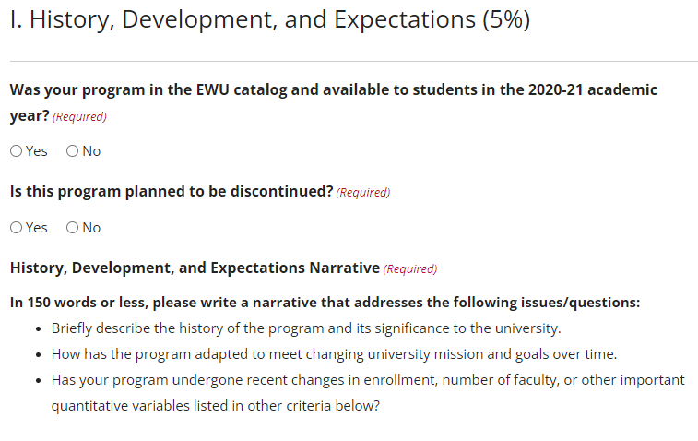
I. History, Development, and Expectations
Data in this section to be provided by the template completer
SRA Town Hall - 04/25/2023

Slide 7
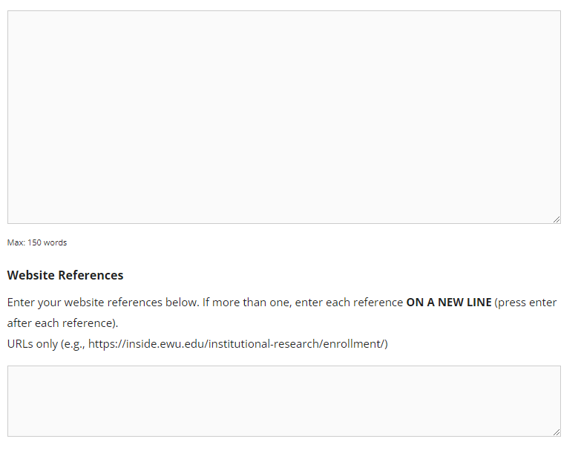
Program Provided Data
The template completer will insert their narrative in a text box like this
The template completer will insert website reference here like this:
https://data.bls.gov/cew/apps/data_views/data_views.htm#tab=Tables
SRA Town Hall - 04/25/2023

Slide 8
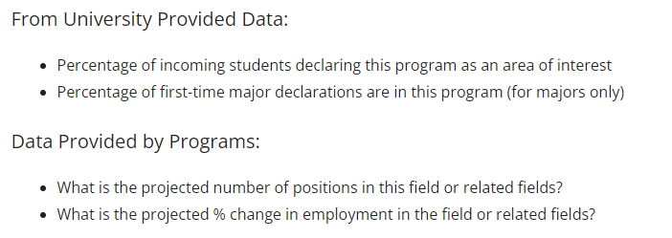
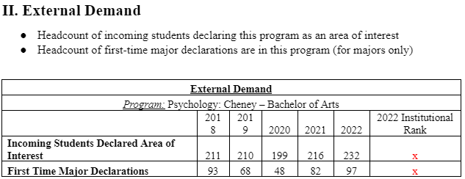
II. External Demand
SRA Town Hall - 04/25/2023

Slide 9
II. External Demand
Incoming Students Declared Area of Interest: When students apply, they have the option to submit an area of interest. This is stored as an undeclared major on the student’s record.
- Not all majors are associated with an undeclared major
- Some majors have “pre” majors, which have specific requirements for a student to declare
First Time Major Declaration: The number of students who formally declared this major program during the indicated academic year; it only includes those who declare a major for the first time, not those who add or change a major
SRA Town Hall - 04/25/2023

Slide 10
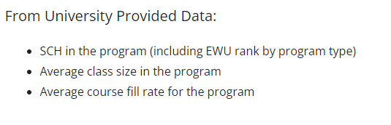
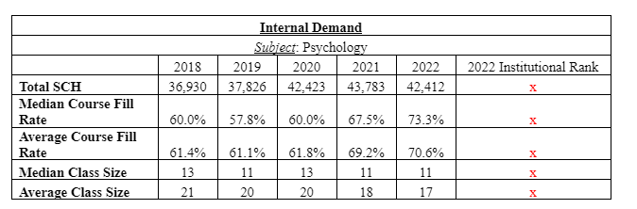
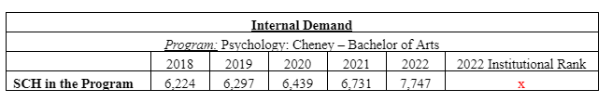
III. Internal Demand
SRA Town Hall - 04/25/2023

Slide 11
III. Internal Demand
Total SCH (Student Credit Hours): This is also reported at the program level below. It includes all SCH for the subject code (rarely multiple subject codes) for that academic year
Fill Rate: The median and average (mean) fill rate of classes in this subject code. It will include all undergraduate (100-400 level) or all graduate (500-600 level) classes – depending on whether the program is undergraduate or graduate – offered in that subject during that academic year. This calculation excludes one-on-one courses, like independent studies, thesis credits, internships, music lessons, practicums, etc.
SRA Town Hall - 04/25/2023

Slide 12
III. Internal Demand
Class Size: The median/average size classes in this subject code. This measure will include all undergraduate (100-400 level) or all graduate (500-600 level) This calculation is done two ways: one includes all classes, the second excludes one-on-one courses, like independent studies, thesis credits, internships, music lessons, practicums, etc
SRA Town Hall - 04/25/2023

Slide 13
III. Internal Demand
SCH in Program: Includes all SCH taken by students in this program within this Department code for the academic year.
SRA Town Hall - 04/25/2023

Slide 14
III. Internal Demand
(Example)
Enrolled students and their major
Department A
- Program X
- Program Y
- General Education
- Service
1 credit class – Total of 10 SCH
Program X – 5 students – 5 SCH
Program Y – 5 students – 5 SCH
General Education – 1 student – 1 SCH
Service – 1 student – 1 SCH
Program X
Program X
Program X
Program X
Program Y
Program Y
Program Y
Program Y
General Education
Service
SRA Town Hall - 04/25/2023

Slide 15
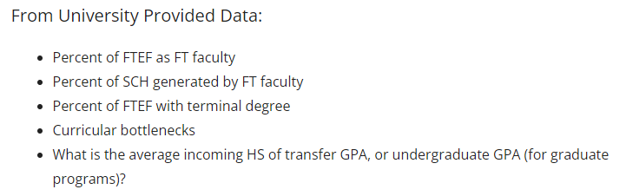
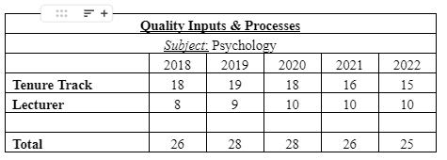
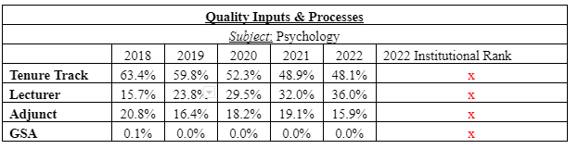
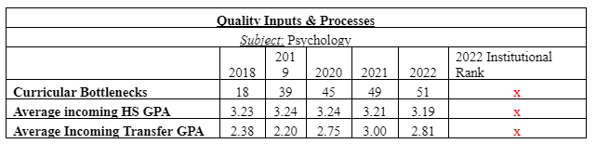
IV. Quality Inputs and Processes
SRA Town Hall - 04/25/2023

Slide 16
IV. Quality Inputs and Processes
Faculty by Type: The number of full-time faculty with primary appointments in this subject area. Tenure track faculty includes tenured faculty (assistant professor, associate professor, and professor) while lecturer includes lecturer, senior lecturer, and visiting assistant professor. These numbers are reported in October of each academic year (so 2022 is the number of faculty in October 2021).
SRA Town Hall - 04/25/2023

Slide 17
IV. Quality Inputs and Processes
Percent of SCH by Faculty Type: Within the subject area, the percentage of student credit hours delivered by: tenure track and tenured faculty, lecturers and senior lecturers, adjunct instructors, and GSAs (graduate student assistants)
SRA Town Hall - 04/25/2023

Slide 18
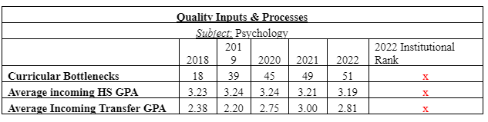
IV. Quality Inputs and Processes
Curricular Bottlenecks: A class with a fill rate over 90% and a DFW (“D,” ”F,’ ”Withdrawal) rate over 20% is a bottleneck
Average Incoming HS GPA: the high school GPA of undergraduate students in that program that year.
Average Incoming Transfer GPA: the GPA of transfer students from their previous institution(s) for all undergraduate students in that program that year
SRA Town Hall - 04/25/2023

Slide 19
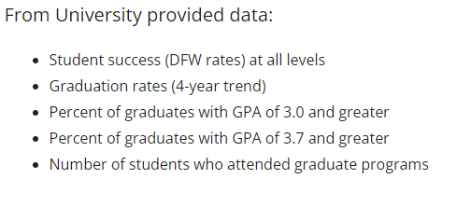
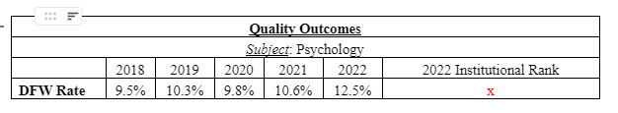
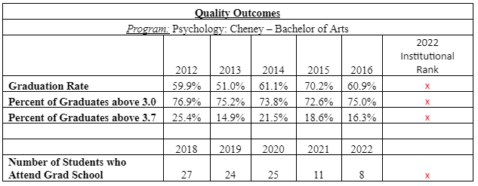
V. Quality Outcomes
SRA Town Hall - 04/25/2023

Slide 20
V. Quality Outcomes
DFW Rate: Percentage of students who attempted a class in this subject and received a D, F, or W. Each class/student combination counts as one, so a single student could be counted in the DFW rate more than once if they received that outcome more than once in an academic year in that subject
SRA Town Hall - 04/25/2023

Slide 21
V. Quality Outcomes
Removed
Graduation Rate: The percentage of students who declared/entered in the program in the indicated academic year and go on to graduate at any time with that program on their transcript. Note that we end in 2016 to allow students six years to graduate.
Percent of Graduates above “x.xx” GPA: The proportion of graduates from the given year whose EWU cumulative GPA is greater than “x.xx”
SRA Town Hall - 04/25/2023

Slide 22
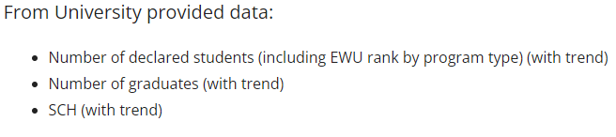
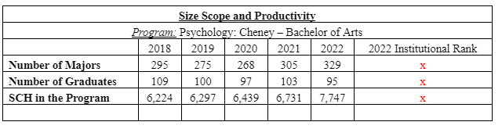
VI. Size, Scope, and Productivity
Number of Majors: The number of distinct students who had a declared major at any point during the academic year in the listed major.
Number of Graduates: The number of students who graduated in that academic year with that program listed on their transcript
SCH in the Program: This includes all SCH taken by students in this program within this subject code for the academic year
SRA Town Hall - 04/25/2023

Slide 23
Financial Data for Academic Programs
Banner Finance
  FY2022 (July 1, 2021- June 30, 2022)
  Chart of accounts (ORG) is generally at department level
Revenue
  Index 1 revenue is attributed to each program based on net operating fees per SCH
  Index 2
    directly attributed to programs where appropriate (e.g. graduate on line accelerated programs)
    Allocated to programs based on SCH for other index 2 revenue (course fees, etc)
  Index 5
    Department grants are one program

Slide 24
Cost Allocation
Department costs are allocated to SRA program list
Where appropriate, costs are directed attributed to a program (e.g. graduate accelerated online programs)
Allocation methodology is based on proportion of student credit hours
Once percentage proportionality is established, expenses are allocated to each program

Slide 25
Cost Allocation Methodology
Department (subject) SCH total
Primary allocation of SCH
  General education and services courses (course level) SCH
  Remaining SCH are distributed to programs based on student attribute
Further allocation to achieve adjusted SCH
  Gen Ed is weighted due to size of courses
  Graduate SCH are weighted due to greater level of effort/attention

Slide 26
VIII. Cost Allocation
(Example- non weighted)
 |  | Total SCH taught: 100
Department A
Program | SCH by Program | Percent of SCH
Program X (Masters) | 15 | 15%
Program Y (Bachelors) | 25 | 25%
General Education | 35 | 35%
Service | 25 | 25%
 |  | Department Cost: $100,000
Department A
Program | Percent SCH | Cost Allocation
Program X (Masters) | 15% | $15,000
Program Y (Bachelors) | 25% | $25,000
General Education | 35% | $35,000
Service | 25% | $25,000
SRA Town Hall - 04/25/2023

Slide 27
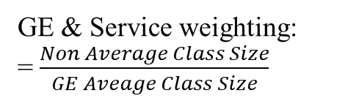
VIII. Cost Allocation
(Weighted Example)
 |  |  |  | Total SCH Taught: 100
Department A
Program | SCH by Program | Weighting | Weighted SCH | Weighted %
Program X (Bachelors) | 15 | 1 | 15 | 19%
Program Y (Masters) | 25 | 1.33 | 33.25 | 42%
General Education | 35 | 0.5 | 17.5 | 22%
Service | 25 | 0.5 | 12.5 | 16%
Masters programs receive a standard 1.33x weighting due to increased smaller classes and increased effort.
GE & Service weighting:
= $\frac{Non Average Class Size}{GE Aveage Class Size}$
 |  |  | Department Cost: $100,000
Department A
Program | SCH by Program | Weighted SCH % | Weighted % | Cost Allocation- Weighted
Program X (Bachelors) | 15 | 19% | $ 19,000.00 | $19,000
Program Y (Masters) | 25 | 42% | $ 42,000.00 | $42,000
General Education | 35 | 22% | $ 22,000.00 | $22,000
Service | 25 | 16% | $ 16,000.00 | $16,000
* Each subject with GE will have this weighting applied
SRA Town Hall - 04/25/2023

Slide 28
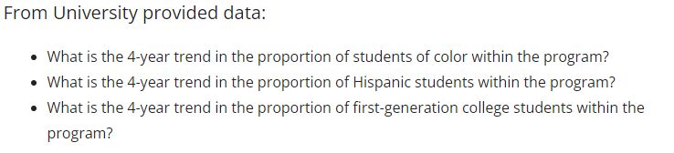
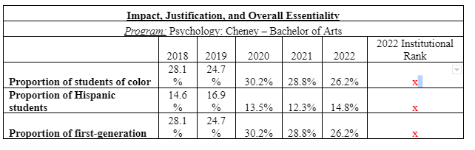
IX. Impact, Justification, and Overall Essentiality
SRA Town Hall - 04/25/2023

Slide 29
IX. Impact, Justification, and Overall Essentiality
Proportion of students “_____”: The proportion of students who self-identify as “_____” within the program
SRA Town Hall - 04/25/2023

Slide 30
University services Programs

Slide 31
Data Source
Banner Finance for revenues and expenses
FY2022 (July 1, 2021- June 30, 2022)
Chart of accounts (ORG) is generally at department level
Indexes provide additional detail
Banner HR/Payroll for number of employees paid

Slide 32
Financial Data for University Services Programs
Revenue
  Index 2 revenue is attributed to program based on org code level
  Index 3 revenue is specific to program
    Auxiliaries such as Housing, Dining, Bookstore, PUB, URC, Parking, Athletics, ASEWU
  Some programs will have index 2 and index 3 revenue

Slide 33
Expenses
Index 1 expenses at ORG or index level
Index 2 expenses allocated same as revenues
  200xxx generates revenue and has expenses
Index 3 expenses allocated same as revenues
Allocated items
  Staff effort which applies to more than one service area is allocated by percentage
    Source is the effort survey

