Slide 1
Nurturing Tomorrow’s Leaders: Effectively Managing Student and Temporary Employees
Presented by: EWU Human Resources
March 4, 2025

Slide 2
Student & Temporary Employment
Contact Us
Location: The Student Employment office is located in Showalter Hall Room 300 and the Human Resources Office is located in Showalter Hall Room 314.
Phone: 509.359.2525
Fax: 509.359.6262
Email: stuemploy@ewu.edu or HR@ewu.edu
Office Hours:
Mon - Fri: 8:00am - 5:00pm
Website: https://inside.ewu.edu/student-employment/

Slide 3
Agenda
Hiring Process
Position Approval
Posting in Handshake
Interviewing
Salary/Salary Raises
Hiring Paperwork
Background Checks
Work Study
Temporary Employment Policy
Leave
Mandatory Reporting/Training
Summer Reminders
Performance Appraisals
Effective Supervision/ Performance Management
Accommodations
Safety Issues
Additional Reminders
Resources

Slide 4
Common Issues Re: Performance
Lack of training.
Department Handbooks can be inconsistent with EWU Policy 407-01 Temporary Employment.
Lack of Appraisals.
Lack of Communication.

Slide 5
Performance Appraisals
Performance appraisals, reviews and evaluations are all terms used to describe the process for documenting and communicating employees’ performance.
Here at EWU, our Student and Temporary Employees are a key to the success of Excellence in Learning.
Supervisors play a key role.
Used to create documentation on positive or negative job performance or conduct.
Provide a time to provide constructive feedback.

Slide 6
Performance Appraisal/Evaluation
Recommended timing of appraisals/evaluations:
After 1st 6 weeks of work.
Once a term
After 1 year, go to every 6 months.

Slide 7
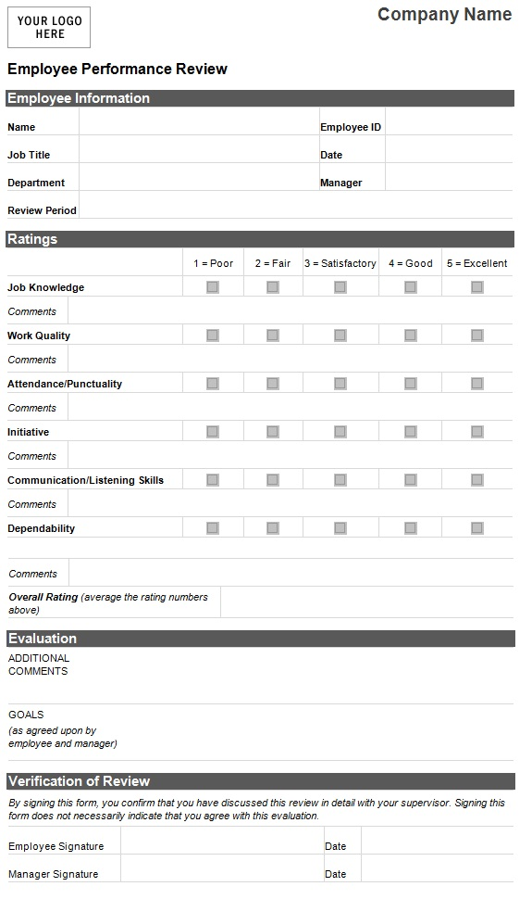
Performance Appraisal

Slide 8
Principles for Effective Supervision
Ensuring that employees understand their responsibilities and duties so they can be successful is an essential part of effective supervision. Supervisors must communicate clear expectations and be fair and consistent when managing performance and misconduct matters.

Slide 9
Performance Management
If performance issues arise, supervisors are encouraged to have informal discussions with the employee, clarify expectations, and to document in writing. If misconduct issues arise that violate University policy, supervisors should consult with the University’s Investigator or the Labor Relations Manager.

Slide 10
Examples of Proper Coaching
Employee is absent without notice or tardy or has problems adhering to or following management instructions.
Meet with employee as close to the issue as possible, verbally clarify the department expectations, and then send a follow-up email confirming the discussion.
Director of Labor Relations, and Student Employment Team available for consultation.

Slide 11
What if performance does not improve?
If you have made efforts to set expectations for attendance, performance, etc. and followed up with those expectations and the employee’s performance does not improve, then contact Student Employment Team or Labor Relations Manager for guidance.

Slide 12
What if Employee Engages in Misconduct?
Pursuant to EWUG 401-01 Investigations, if you believe an employee has engaged in misconduct, a violation of a University policy, rule or regulation, it should be reported to the University’s Investigators or Labor Relations Manager.
You can contact one of our Investigators:
Stacey Reece, 509-359-6612 or email sreece@ewu.edu; Danielle Dallas, 359-7495 or email ddallas1@ewu.edu
Director of Labor Relations (currently vacant) so reach out to Deborah Danner 359-2383 or email ddanner2@ewu.edu)
Submit a complaint electronically at https://inside.ewu.edu/hr/complaint-reporting/

Slide 13
Do……..
Confer with Human Resources/Labor Relations for their recommendations on how to proceed.
Select an appropriate time & place to meet privately with the employee.
Allow the employee to explain their side of the incident.
LISTEN.
Remain calm and professional.
Document!

Slide 14
Do Not...
Proceed with any disciplinary action without consulting with Student Employment/HR and obtaining appropriate approval from VP or designee.
Yell, scream or curse.
Base actions on rumors.
Discuss an employee’s performance or conduct issues with the employee’s co-workers or in a public setting.

Slide 15
Summary of Performance Mgmt.
Goal is to make employees successful.
Training is essential.
Timely follow-up to address performance issues and communicate clear expectations.
Contact Investigator or Labor Relations Manager if there is a misconduct issue that you believe may violate policy.
Termination is at the discretion of your Vice President or their designee.

Slide 16
The Goal of Documentation
To inform the employee and provide them with the opportunity for successful performance.
To establish an official record of the performance and conduct expectations.
Documentation should include the date, the employee, the facts of what happened, when it happened (on or off-duty), where it happened (on or off-campus).

Slide 17
Termination/Discipline
When terminating or disciplining a Student Employee - Must be pre-approved by President, Vice President or designee, in some cases there may be overlap between Student Conduct.
  Contact Student Employment/HR/Labor Relations to facilitate the process.
  HR will facilitate the preparation of termination letter.
  Hand employee letter. “Today we are terminating your position as an at will employee.”
  Termination letter needs to be sent to Student
  Employment

Slide 18
Student Employees
19 hours or less per week academic year
Our work week runs from Monday through Sunday.
To qualify as a student employee:
  Must be enrolled in 6 or more credits
  Summer employment requirements: enrolled for fall or summer in at least 6 credits if not returning in fall
Notes:
Some updates being made

Slide 19
Non-Student Hourly Employees
May work up to 40 hours per week
May not work more than 40 hours per week
May not work more than 1,050 hours in any 12 consecutive month period

Slide 20
Required Breaks and Lunches
Employees are legally required to take breaks as follows:
  A paid 15-minute break every 4 to 5 hours worked.
  Unpaid 30- to 60-minute lunch break for any shift lasting over 5 hours.
  Meal breaks must be noted on timesheet for compliance with FLSA (Federal Labor Standards Act).

Slide 21
Frequent Temporary Employment Issues
Timesheets not approved so not timely paid.
Timesheets not accurate, e.g., reporting time on holidays or in wrong pay period.

Slide 22
Timesheets
Timesheets: https://inside.ewu.edu/student-employment/getting-paid/
Must be reviewed and approved without delay.
  Hours must be on the days that they were worked.
  Watch out for hours on days that you are closed. Holidays will not be paid with Work Study money.
  Make sure hours are on correct timesheet.
  Make sure work hours are not on sick leave line.
Notes:
Supervisors are responsible for ensuring that timesheets are accurate and timely submitted/approved for payment. Failure to timely compensate can result in wage claims. This has occurred. The potential exposure for the university is legal fees and 3 times the amount of wages owed.
Tips for success: Direct students to provide their completed timesheet by the end of the last day of the pay period which is the 15th and last day of the month. You could set routine email reminders and provide direction upon hire.

Slide 23
Sick Leave
1 hour earned for every 40 hours worked in an hourly position.
May take in increments as soon as earned.
Sick leave can be used for the physical injury/mental illness/treatment/preventative care for self/spouse/child or for issues related to domestic violence, and school/daycare closure.
Employees are to notify manager ASAP or at least 2 hours ahead of shift.

Slide 24
Sick Leave cont.
You can check available leave balance in EagleNet.
VERY important that you make sure they’re not entering time worked on sick leave line.
FAQ list on our website: https://inside.ewu.edu/student-employment/supervisor-faqs/
Sick leave is not cashed out when employment ends.
Can only carry over 40 hours from 1 calendar year to the next. If rehired within 12 months, the accrued sick leave balance previously earned is available to them.
Notes:
Sick leave pool

Slide 25
WA Paid Family & Medical Leave Act (PFML)
Available for serious health condition, to care for a qualifying family member with a serious health condition, or to bond with the employee’s child.
Family members include child, grandchild, grandparent, parent, sibling, or spouse of an employee.
Premiums deducted beginning January 2019.
Hours available for use once employee has worked 820 hours in all jobs in a rolling year.
Hours maintained by Employment Security Department.

Slide 26
Mandatory Reporting
Reporting Child Abuse and Neglect
  Call the local police (911 or a non-emergency line) or Child Protective Services (1-866-END-HARM)
  “For a mandated reporter to knowingly fail to make a report, or cause a report to be made, is a gross misdemeanor.”
Notes:
We are considering a new online Title IX training version for fall and will continue to provide live training options. 30 – 45 minutes.

Slide 27
Required Training
The following trainings must be taken by all employees -- as supervisors it is your responsibility to ensure students timely complete.
Harassment and Title IX for Employees
Hazing and Bullying
DEI
If employees are assigned to work Youth Camps, must complete Youth Camp training.

Slide 28
Summer Reminders
Discuss whether student is returning to your department in the fall.
Work study ends the last day of spring quarter.
Remind students to:
  Complete last timesheet
  Change summer address in EagleNet

Slide 29
Summer Reminders cont.
If student is working in summer:
  Must be enrolled summer and/or fall.
  If no summer credits or <5, they may work up to 40 hours per week.
  If enrolled in more credits, they are held to 19 hours per week.

Slide 30
How to Address Disabilities
Employee’s responsibility to request accommodation for employment through Human Resources.
Accommodations for student employees for classes and activities go through SASS (Student Accommodations and Support Services).

Slide 31
Reasonable Accommodations
It’s not up to you to decide whether something is a disability.
Never ask the employee about their medical condition. If they voluntarily share, that is their personal choice.
Contact for Employment accommodations is Caren Lincoln, Senior Director Human Resources phone: 359-2384
You will be notified of the authorized accommodations, but not the medical condition.

Slide 32
Safety Orientation
Supervisors are required to conduct a safety orientation and complete the form verifying it has been completed for student employees. Orientation includes:
How and when to report incidents, work-related injuries, illnesses and unsafe conditions
Proper action in an emergency
Location of nearest safety bulletin board, emergency contact, etc.
If you need additional information, contact EH & S at 359-6496.

Slide 33
Incident Reporting
Required to report work related injuries, illnesses, near misses and vehicle collisions immediately.
Risk Management maintains a centralized reporting website for all types of incidents
Website link: https://inside.ewu.edu/rcp/compliance/report-it/

Slide 34
Additional Reminders
Students may not work overtime, and hours may not exceed 19 during academic year.
Scheduling – not during classes!
Let us know when employees leave your department
FERPA/confidentiality
Non-Students – will also need VP approval
Student and temporary employees cannot be hired to replace other employees.

Slide 35
Role & Authority of Student Employees
Student employees are not able to hire, discipline or terminate employees, including other student employees. They are also not responsible for sending email communications on behalf of a supervisor regarding these types of decisions. These are supervisory responsibilities.

Slide 36
Interviewing
Think about the traits you are looking for in the ideal employee.
Pick questions that will draw out the answers you need to know—select from standard interview question list.
Must ask all applicants the same questions.
Take notes so you can compare candidates—limit notes to facts not opinions.
Make it a professional experience – it’s important!

Slide 37
Interview Questions
There are some questions that are legally considered unfair preemployment questions related to topics such as age, disability, family/marital status, citizenship, etc.
HR has sample appropriate interview questions available on the Student Employee Website under the Supervisor tab which comply with these standards.
To avoid improper questions, proposed interview questions not on this list must be submitted, reviewed, and approved by HR prior to any interview to ensure questions comply with required legal standards.

Slide 38
Salary/Salary Increases for Student Employees
Must pay from the Student Employee Pay Scale – which changes yearly.
Do not bring in new employees at higher rates—Equal Pay Act requires equal pay for equal work.
At 450 hours worked in the same position and same department, students are eligible for a one-step bump—this is permissive and requires approval by VP.
  You keep track of the hours worked.
VP approval also required for promotion.
Notes:
Note, Mary Voves recently approved a series of positions for 2019 and pay rates.

Slide 39
Pay Scale
2025 Student Employee Salary Range
RANGES | ENTRY | EXPERIENCE
A | $16.66 | $17.41
B | $17.62 | $18.37
C | $19.12 | $19.87
D | $20.06 | $20.81
E | $21.04 | $21.79

Slide 40
Salaries Non-Student Hourly
Check with HR to confirm the proper pay rate for temporary employees.
They may not be paid at a rate higher than an entry level of pay of a classified person in a comparable position

Slide 41
Budget Planning
As you engage in future budget planning, note that the pay scale will be updated on January 1 of each year to reflect minimum wage increases.

Slide 42

Hiring Process

Slide 43
Position Approval
You must have approval from your Dean or AVP or their designee before you can post any student employee position.
A copy of the written approval must be sent to stuemploy@ewu.edu.

Slide 44
Handshake
All student employee positions must be posted in Handshake.
You can sign up for Handshake online at https://inside.ewu.edu/student-employment/ewu-supervisors-post-a-job/.
To access Handshake, sign in with your email and password rather than single sign on (SSO). Use the “Forgot Password” option if you need to reset.
Additional information about Handshake can be found online at https://inside.ewu.edu/student-employment/ewu-supervisors-post-a-job/.

Slide 45
Job Descriptions
Standardized job descriptions have been established for student employment positions.
The job descriptions are located online at https://inside.ewu.edu/student-employment/job-descriptions/.
Fill in any information in the standardized description that is in red (e.g. hours and location of position). If position will work remote, indicate in posting – we don’t expect many of these.

Slide 46
How Can I Personalize the Position?
If you wish to add some department or college specific language to the posting, you can add a short statement above the standard description in Handshake. For example,
The Eagle Entertainment Event Planner assists in development, planning, and implementation of campus wide, student-oriented activities and programs at Eastern Washington University. Events should be multidimensional and multi-faceted to represent Eastern’s diverse student populations. This position works under general supervision of Student Engagement and the PUB.

Slide 47
Handshake Tips
If posting a work study position and a non-work study position, you can duplicate the position.
Use your department name not college.
Use the salary range identified in the position description.
Check the temporary employment box.

Slide 48
Handshake Tips cont.
On the preference page, you can make the position as narrow or broad as you like by:
  limiting majors or
  specifying a GPA or grade level
  choosing to receive all or limited apps
  – now or later.
  You can also tag another person to receive applications.

Slide 49
Selection of Job Candidates
After you make your hiring decision(s), update applicant’s status in Handshake to “Reviewed”, or “Hired”, or “Declined” as needed.
Demonstrate professionalism and contact applicants who you did not choose to hire.
If you interviewed them, please call them. If you didn’t interview them, you can email them or use messaging feature in Handshake. See Supervisor Guide for instructions.
Close posting in Handshake when done hiring.

Slide 50
Pre-Employment Requirements
All the following must be completed before an employee can begin work. Do not allow employee to start until you receive confirmation from HR that all these requirements are completed:
Employment authorization form
Hiring paperwork—I-9, W-4, etc.
Background check clear, if applicable
Youth Program Training, if applicable

Slide 51
Hiring Paperwork
Complete Authorization form for Student Employes (not required for temporary employees)
If non-work study:
  Use the start date for the begin date not the date you selected employee on the form.
  Keep a copy for your records.
  If work study:
  -Student obtains form from Student Employment in Showalter 300
  -You will complete supervisor portion and have student return form to Student Employment.
Additional hiring paperwork is to be completed in Student Employment if student employees have a break in employment.
Students should come in ASAP to complete paperwork and allow at least 15 to 30 minutes to complete paperwork.

Slide 52
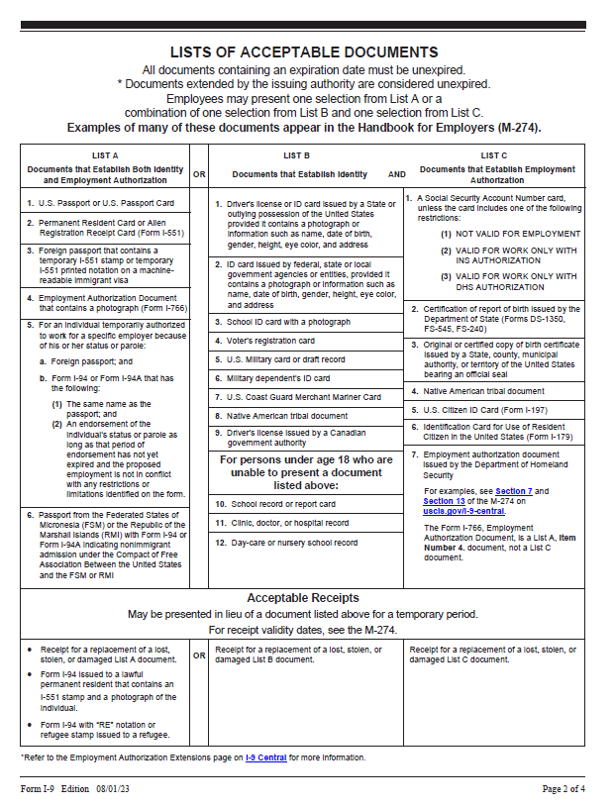
I-9 Documents

Slide 53
Hiring Paperwork
Special Instructions I-9
  The front of the I-9 must be signed on or prior to the first day of work.
  Advise new hires that they must present original ID documentation to complete the I-9 or they will be unable to work.
  If audited, fines can be levied against EWU for incomplete or incorrectly complete forms. Those fines are paid by the responsible department.
  IDs we see most often are picture ID, Social Security card, Birth Certificate, Passport or Visa.
  You can’t tell them which piece of ID to bring.
  If hiring an International student, paperwork takes longer when an original SSN needs to be ordered. They cannot work until received.

Slide 54
Background Checks
  Pre-employment background checks are required when employee “has unsupervised access to developmentally disabled, vulnerable adults, or children under the age of 16 years, OR when they may be in receipt of, or have accountability for, university funds or other items of value.”
  Fee is currently $11 to your index for student employees.
  Temporary employees complete checks through HireRight, fee is typically $45 which is charged to your index.

Slide 55
Work Study
Work Study awarding criteria
  Need-based on FAFSA
Your Responsibilities
  Make it a learning experience.
  Manager & student to keep track of award spending.
  Spend those Work Study dollars!
Work Study students are not free
  Background checks and hours worked on holidays will be charged to your budget.

Slide 56
More On Work Study
How to figure hours allowed/used
  The higher the pay rate, the fewer hours
  i.e. $2500/11 weeks/$16.28 = 13+ hrs/wk.
  Work Study Tracking spreadsheet on Student Employment Website
  Awards are by term
  Can’t work prior to first day of quarter
  Any overages will be charged to your budget after the quarter ends.
  Work Study carry forward amounts
Keep a copy of the Authorization form for your records.

Slide 57
Information and Tools Available on Website
Tools for Student Supervisors are available on the student employment website: https://sites.ewu.edu/student-employment/.
Hiring Manual
Hiring Checklist
Forms and Resources
Student Job Descriptions
Salary Ranges for Student Employment positions
Link to post jobs
Policies

Slide 58

Questions?

