Slide 1


Trauma Informed Practices
Behavior Intervention and Threat Assessment Track
Rebecca Peine

Slide 2

Body Scan Meditation
UCLA Mindfulness Awareness Research Center
  Free Guided Meditations

Slide 3

What is Trauma

Slide 4
Trauma Informed Care
Defined
  An approach that assumes that an individual is more likely than not to have a history of trauma.
  Recognizes the presence of trauma symptoms and acknowledges the role trauma may play in an individual’s life- including service staff.
Shift the paradigm
  “What’s wrong with you?” to “What happened to you?”
  Prioritizing understanding life experiences and impact on behaviors
“Trauma-Informed Care is about ensuring ALL individuals feel physically and emotionally safe, are noticed and listened to, and are given a voice.” (The Institute on Trauma and Trauma-Informed Care)

Slide 5
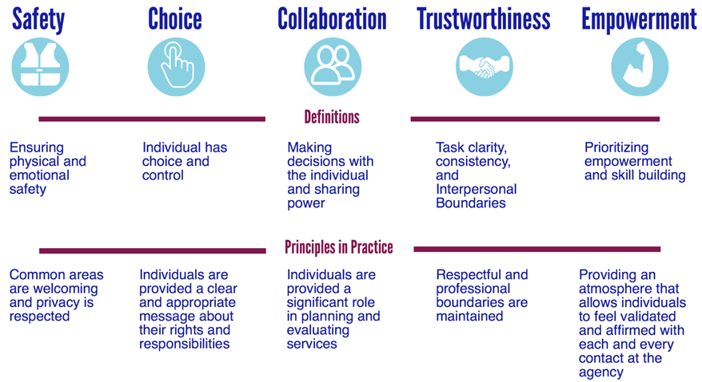
The Five Principles of Trauma Informed Care
Buffalo Center for Social Research

Slide 6
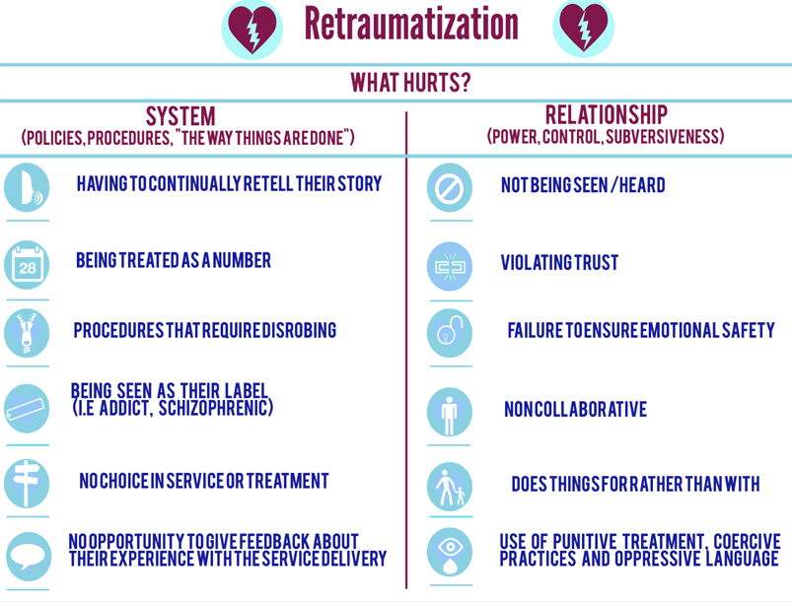

Retraumatization

Slide 7
Missouri Model: Developmental Framework
Trauma Awareness
Trauma Sensitive
Trauma Responsive
Trauma Informed

Slide 8
Trauma Responsive Practices and BIT
Clarity of Communication
Office Environment and Setup
Involvement in decision-making as appropriate
Basic Needs Assessment
Interventions that support resiliency, skill-building & self-efficacy

Slide 9
Trauma Responsive Practices and BIT
Reflection
  What value does a trauma awareness bring to your ability to assess for a threat and develop relevant interventions?
  What trauma responsive practices could be helpful to developing and implementing effective interventions?
  How would you work to generate buy-in and a collective understanding of the need to be trauma aware/sensitive amongst your team?

