Slide 1


Understanding Trauma
Behavior Intervention and Threat Assessment Track

Slide 2
Trauma Defined
"Individual trauma results from an event, series of events or set of circumstances that is experienced by an individual as physically or emotionally harmful or life-threatening and that has lasting adverse
effects on the individual’s functioning and mental, physical, social, emotional, or spiritual well-being.”
  Substance Abuse and Mental Health Services Administration (SAMHSA)

Slide 3
Trauma Defined
Events
  Events and circumstances that may include the actual or extreme threat of physical of psychological harm
    Single occurrence or repeated overtime
Experience
  The individual’s experience with the event and how they make meaning of the experience
    Linked to a range of factors including cultural beliefs, developmental stage, access to support and social services, etc.
Effects
  Adverse effects of the event
    May occur immediately or onset is delayed and can be short or long-term
    Inability to cope with normal stressors, limited trust and belief in relationships, cognitive functioning, hypervigilance, changes in neurobiology, and effects on health and well-being

Slide 4
Examples of Trauma
Abuse and Violence
  Physical and threats of abuse
  Intimate partner violence Sexual abuse, assault, victimization or harassment
  Victim or witness of a violent crime or abuse
  Wars and Military Conflict
  Genocide
  Living in a refugee camp or detention center
Parental and Family
  Abuse, neglect, or abandonment
  Separation from a parent or caregiver through incarceration or divorce
  Living with a parent or caregiver who abuses substances or experiences a mental illness
Society and Cultural
  Bullying, harassment and bias
  Experiencing chronic racism, homophobia, xenophobia, bias
  Systemic Racism and racial trauma
Adverse Childhood Experiences
  Abuse, neglect, and trauma that occurs to individuals under age 18
Poverty
  Chronic basic needs insecurity
  Homelessness
Forces of Nature
  Natural or man-made disasters
  Sudden or unexpected disasters
  Accidents (motor vehicle, airplane, train, etc.)
  Fire

Slide 5
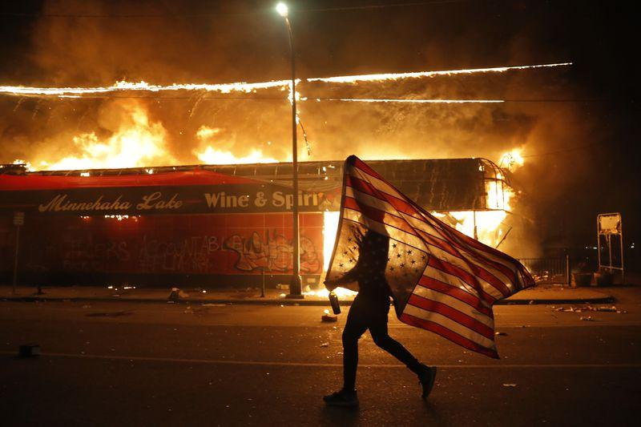

2020, A Collective Trauma
Global Pandemic
Civil unrest and the pursuit of racial and social justice
Experiences of bias, discrimination, and harassment
Economic uncertainty

Slide 6
Collective Trauma
Stay Connected
  Physical distancing vs social distancing
Limit Media exposure
  Research of the long-term effects of 9/11 shoed that people who watched four to seven hours a day of news coverage were four times more likely to report PTDSD symptoms. (Schlenger et al. Psychological Reactions to Terrorist Attacks)
Utilize Trustworthy Information
  People can make informed assessments of potential danger/threat when presented with reliable and trustworthy information (Fischhoff et. al. Public understanding of Ebola risks)
Utilize mental health resources
  Increased access to services through telehealth
Give grace to yourself and others.
  It’s okay to lower expectations
Collective Trauma has the power to transform
  “Although the memory of trauma may foster a paranoid and paralyzing post-traumatic outlook, it may also spur growth through the meaning derived from the trauma. A meaning that emphasizes the resilience of the group and its ability to rehabilitate and change in the aftermath of calamity.” (Hirschberger Collective Trauma and the Social Construction of Meaning)

Slide 7
Post-traumatic Stress Disorder (PTSD)
PTSD is a mental health condition that develops for some individuals who experience a traumatic event.
Symptoms Include:
  Re-experiencing the event
  Avoidance
  Arousal and reactivity
  Cognition and mood
Onset and Intensity of Symptoms
  Symptoms can vary in intensity overtime and can be triggered by stress and environment
  Onset occurs within three months of the incident, but can begin years later
  Symptoms must last longer than a month and be severe enough to interfere with daily lives, work, and relationships
  Early intervention and support is ideal and can help symptoms from increasing in severity
          (Mayo Clinic and the National Institute of Mental Health)

Slide 8
Vicarious Trauma
Vicarious Trauma
  Exposure to the trauma of others which can change an individual’s world-view
Vicarious Traumatization
  Negative reaction to trauma exposure with a range of psychosocial symptoms include disruptions in thinking and changes of belief about sense of safety and world-view.
Secondary Traumatic Stress
  Natural consequent behaviors and emotions that often result from knowing about a traumatizing event experienced by another and the stress resulting from helping, or wanting to help, a traumatized or suffering person. Its symptoms can mimic those of posttraumatic stress disorder.
Compassion fatigue
  A combination of physical, emotional, and spiritual depletion associated with caring for others who are in significant emotional pain and physical distress.
  (The Vicarious Trauma Toolkit: Glossary of Terms)

Slide 9
Resilience
“The process of adapting well in the face of adversity, trauma, tragedy, threats or even significant sources of stress.”
(American Psychological Association)

Slide 10
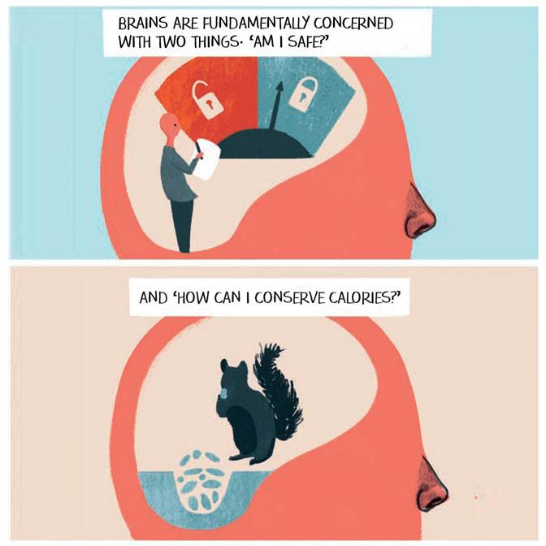
Trauma and the Brain
  © Sophie Standing

Slide 11

Trauma and the Brain

Slide 12
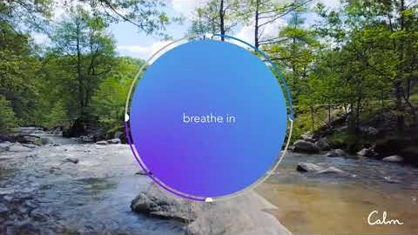
Breath Bubble

Slide 13
Citations
American Psychological Association. The road to resilience. Washington, DC: American Psychological Association; 2014. Retrieved from http://www.apa.org/helpcenter/road-resilience.aspx.
Cherry, Kendra. “Collective Trauma From COVID-19.” Verywell Mind, 22 May 2020, www.verywellmind.com/collective-trauma-from-covid-19-4844357.
Fischhoff B, Wong-Parodi G, Garfin DR, Holman EA, Silver RC. Public understanding of Ebola risks: mastering an unfamiliar threat. Risk Anal. 2018;38(1):71‐83. doi:10.1111/risa.12794
Hirschberger, Gilad. “Collective Trauma and the Social Construction of Meaning.” Frontiers in Psychology, Frontiers Media S.A., 10 Aug. 2018, www.ncbi.nlm.nih.gov/pmc/articles/PMC6095989/.
Schlenger WE, Caddell JM, Ebert L, et al. Psychological reactions to terrorist attacks: findings from the National Study of Americans' Reactions to September 11. JAMA. 2002;288(5):581‐588. doi:10.1001/jama.288.5.581
“Trauma and Violence.” SAMHSA, www.samhsa.gov/trauma-violence.
The Vicarious Trauma Toolkit: Glossary of Terms. ovc.ojp.gov/program/vtt/glossary-terms.

