Slide 1



Vicarious Trauma
Behavior Intervention and Threat Assessment Track
Rebecca Peine
@peinecone

Slide 2
List of Things I am currently handling well….
1.

Slide 3
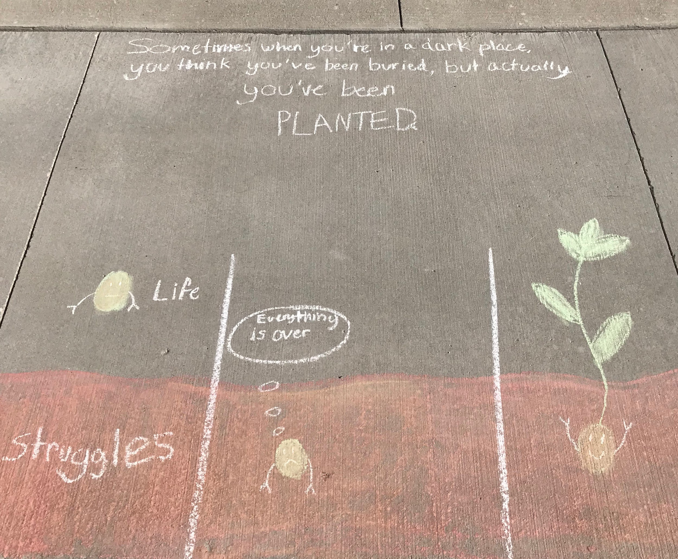
Vicarious Trauma: Coping and Transforming
Avery Zeone, Age 13

Slide 4

Drowning in Empathy

Slide 5
Vicarious Trauma
Vicarious Trauma
  Exposure to the trauma of others which can change an individual’s world-view
Vicarious Traumatization
  Negative reaction to trauma exposure with a range of psychosocial symptoms include disruptions in thinking and changes of belief about sense of safety and world-view.
Secondary Traumatic Stress
  Natural consequent behaviors and emotions that often result from knowing about a traumatizing event experienced by another and the stress resulting from helping, or wanting to help, a traumatized or suffering person. Its symptoms can mimic those of posttraumatic stress disorder.
Compassion fatigue
  A combination of physical, emotional, and spiritual depletion associated with caring for others who are in significant emotional pain and physical distress.
  (The Vicarious Trauma Toolkit: Glossary of Terms)

Slide 6
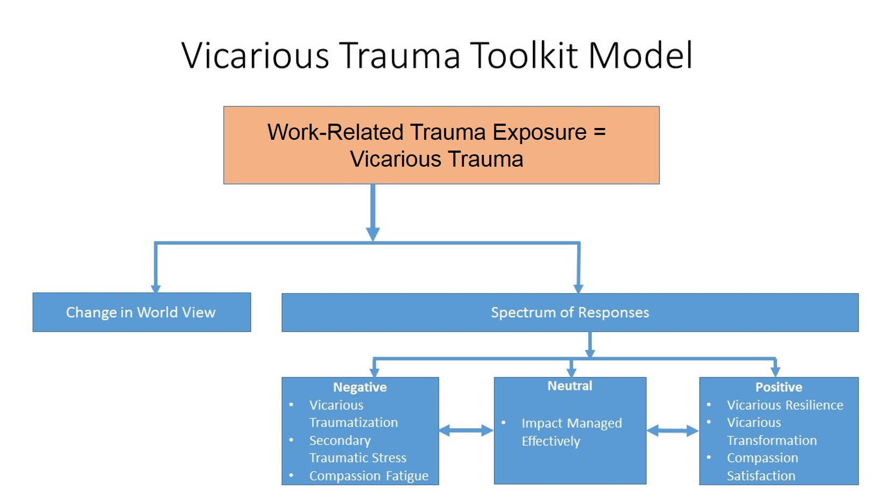
The Vicarious Trauma Toolkit Model
(Department of Justice: Office for the Victims of Crime The Vicarious Trauma Toolkit )

Slide 7
Negative Reactions to Vicarious Trauma
difficulty managing emotions;
feeling emotionally numb or shut down;
fatigue, sleepiness, or difficulty falling asleep;
physical problems or complaints, such as aches, pains, and decreased resistance to illness;
being easily distracted, which can increase one’s risk of accidents;
loss of a sense of meaning in life and/or feeling hopeless about the future;
relationship problems (e.g., withdrawing from friends and family, increased interpersonal conflicts, avoiding intimacy);
feeling vulnerable or worrying excessively about potential dangers in the world and loved ones’ safety;
increased irritability; aggressive, explosive, or violent outbursts and behavior;
destructive coping or addictive behaviors (e.g., over/under eating, substance abuse, gambling, taking undue risks in sports or driving);
lack of or decreased participation in activities that used to be enjoyable;
avoiding work and interactions with clients or constituents; and
a combination of symptoms that comprise a diagnosis of Posttraumatic Stress Disorder (PTSD).
  (Department of Justice: Office for the Victims of Crime The Vicarious Trauma Toolkit

Slide 8
Responding to Vicarious Trauma
Coping with Vicarious Trauma
  Identifying strategies that can help vicarious trauma from becoming severe and manageable during difficult times
    Self-care
Transforming Vicarious Trauma
  Identifying ways to develop a sense of meaning and hope
    Remind yourself of the importance of the work
    Social connections
    The little things
    Reflection
Reflection
  Identify three activities that you enjoy doing regularly that can help you cope.
  Can these activities help you cope and be transformative at the same time?

Slide 9

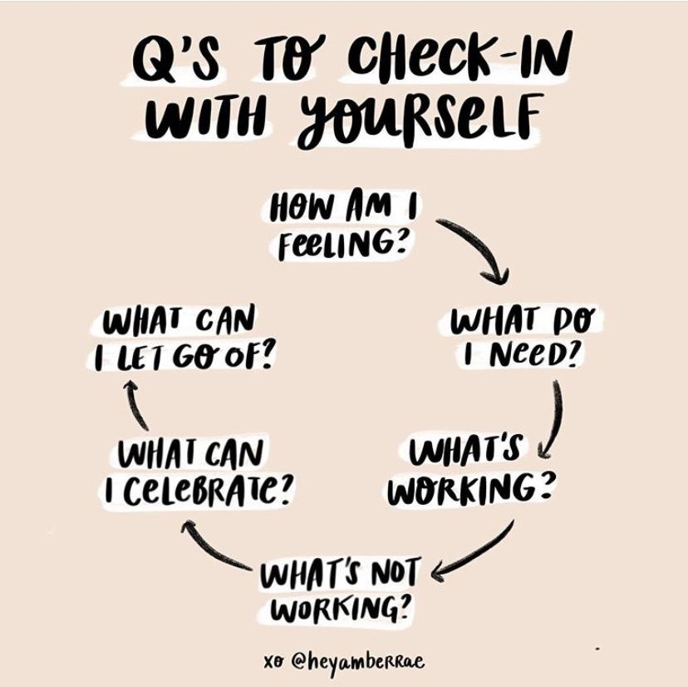
Reflection

Slide 10
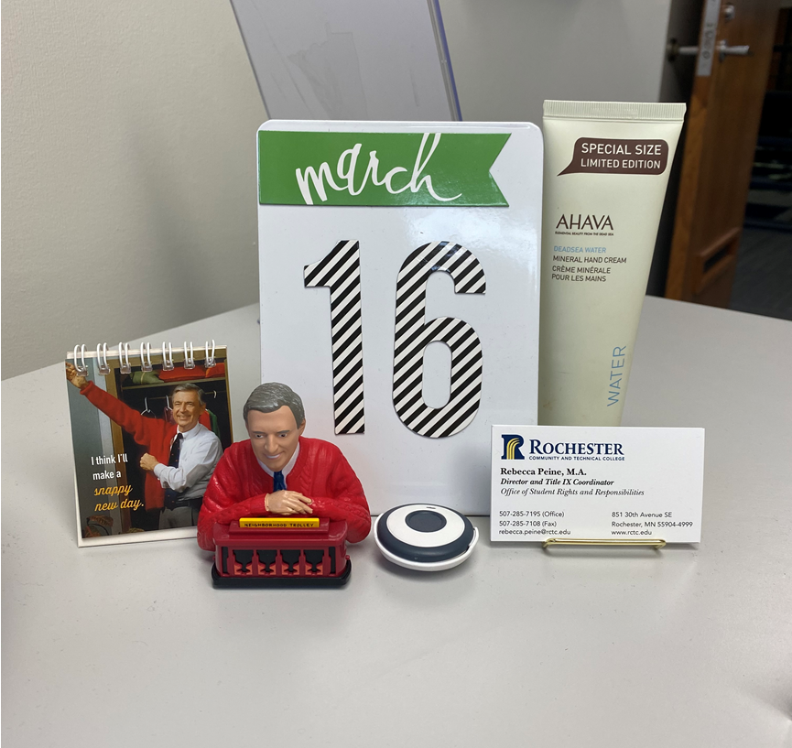
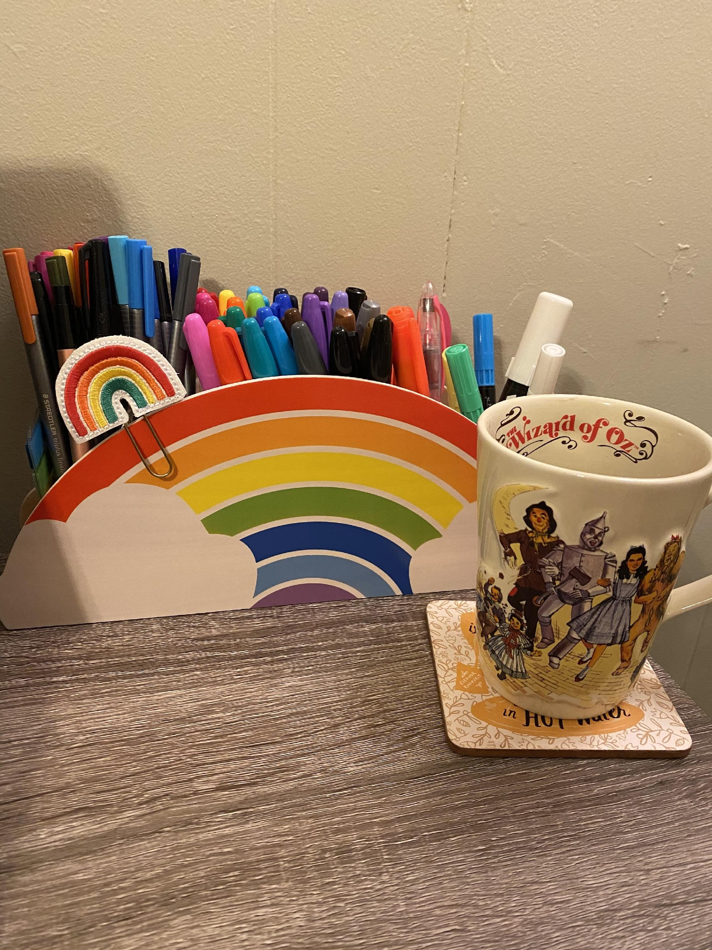
Environment Matters

Slide 11

Movement
Restorative Yoga and Trauma Recovery
Photo Credit: Getty Images

Slide 12
Mindfulness & Meditation
UCLA Free Guided Meditations
Mindful
UCSD Center for Mindfulness
Loving-Kindness Meditation
  Coping and transformative

Slide 13
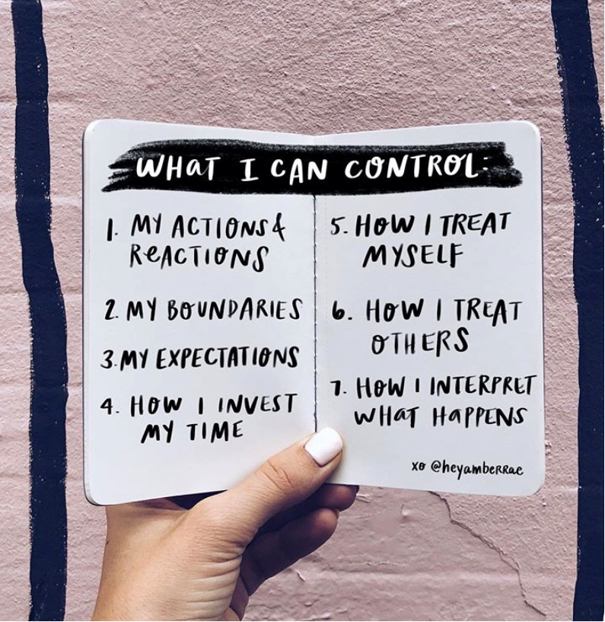
Boundaries and Responsibility

Slide 14
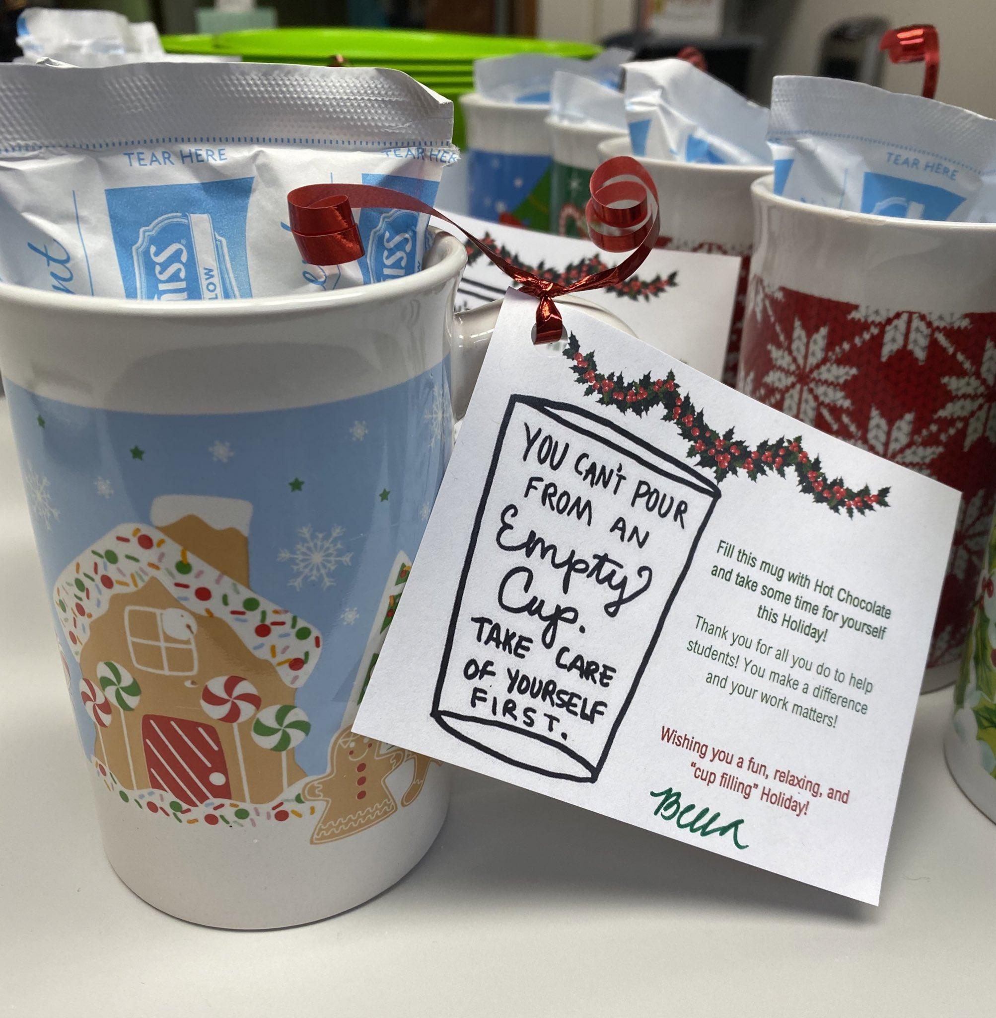
Self-Care and an Empty Cup

Slide 15
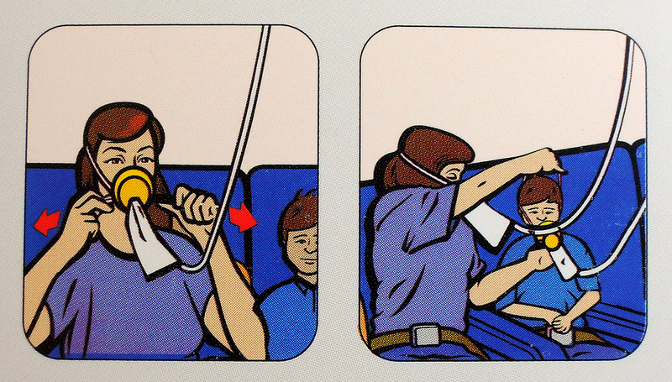
Take Ten

